Slide 1
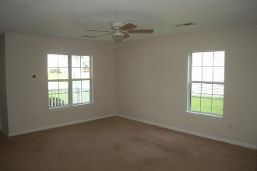
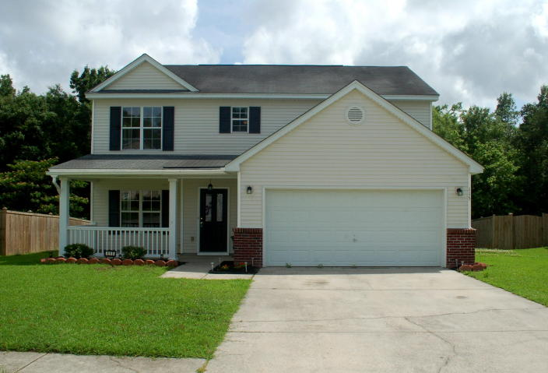
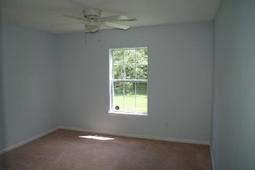
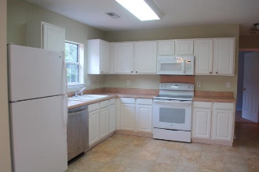
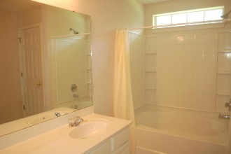
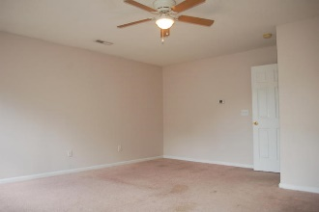
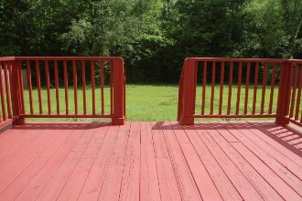
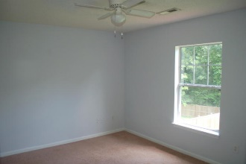
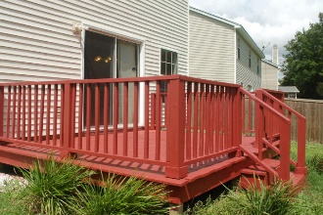
Open House Saturday June 9th from 12-3
115 Broken Branch Drive
Liberty Hall Plantation ~ Goose Creek
MLS# 18015220 ~ $224,500
Great layout for this 4 bedroom 3 full bath home! Freshly painted and ready for move in. There is a bedroom and a full bathroom downstairs, the huge master bedroom is upstairs with a large walk in closet. Enjoy the family room and large kitchen, you also have a deck to hang out on for pleasant evenings. There are 2 other bedrooms and a full bath upstairs. The 2 car garage offers plenty of storage. Schedule your showing today!
Mike Goldston, Realtor
mikesellscharleston@gmail.com | 843-343-7026 | www.cometocharlestonsc.com
Brand Name Real Estate | 4 Carriage Lane, Suite 106 | Charleston, SC 29407

