Slide 1
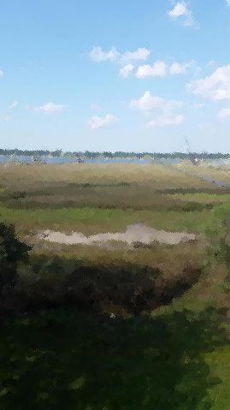
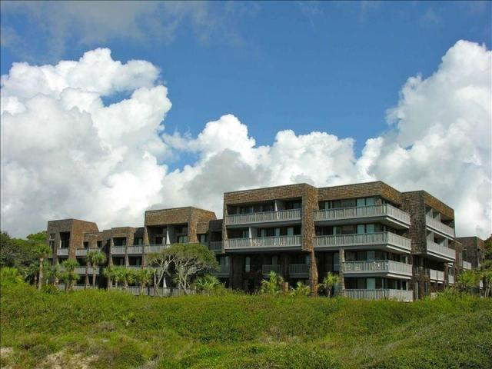
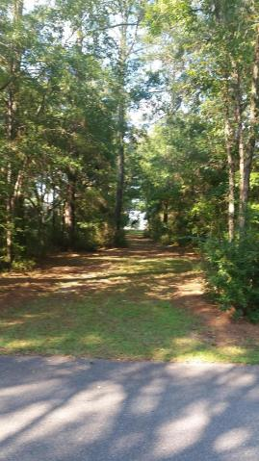
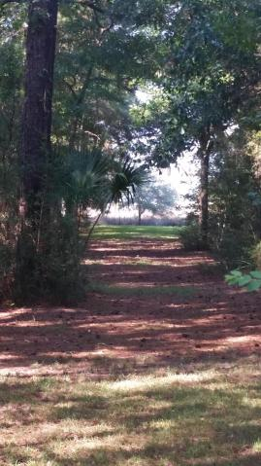
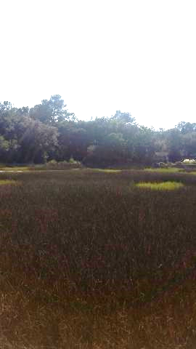
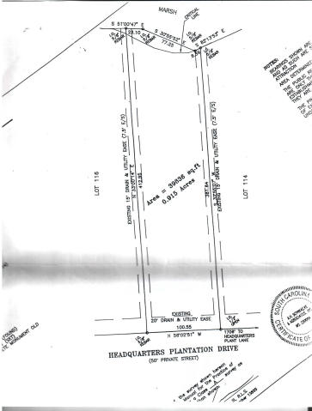
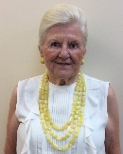

NEW Construction Community Dock on Wando Master DOWN!
115 Headquarters Plantation Drive
Headquarters Plantation · Johns Island, SC 29455 MLS# 16023763 · $1,100,000
Last Deep water lot on the intracoastal waterway in Headquarters. Dock permit in hand until 2021. Almost one acre wooded lot.
Ursula Erichsen
(843) 696-2346
uerichsen@carolinaone.com
RealEstateofCharleston.com

