Slide 1
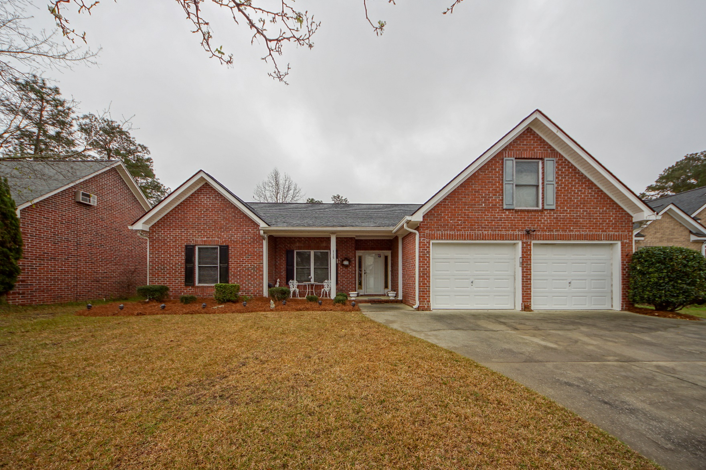
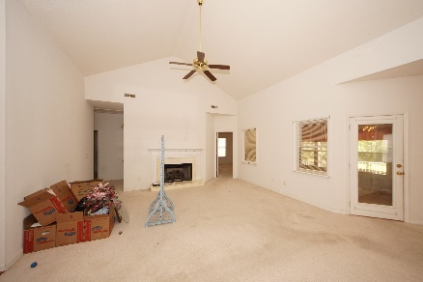
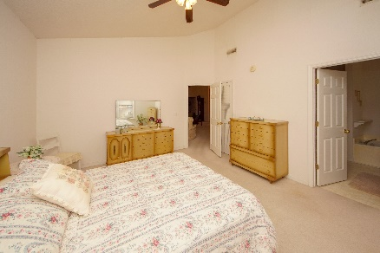
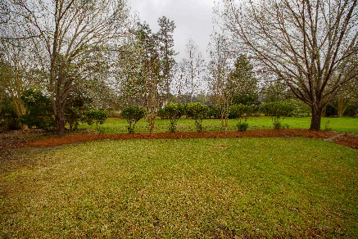


115 Innisbrook Bend Summerville, SC 29483 MLS# 19006599 :: $249,500 3 Bed / 2 Bath
2.67 Acres!
Elegant one story home in Pine Forest Country Club!
Owner was the builder and his detail is shown with custom shelving in the foyer and living room, open floor plan with gas fire place, spacious kitchen with 42'' cabinets, two beautiful columns leading to the dining room and a bonus room over garage.
Sun room leads to an over sized covered patio with a relaxing, private back yard. New Roof was installed 2017.
Stainless appliances are approximately 4 years old and HVAC approximately 6 years old.
Connie White, Broker
843-532-3356
connie@chrepros.com · conniewhiterealestate.com
Charleston Homes · 597 Old Mt. Holly Road · Suite 301 · Goose Creek, SC 29445

