Slide 1
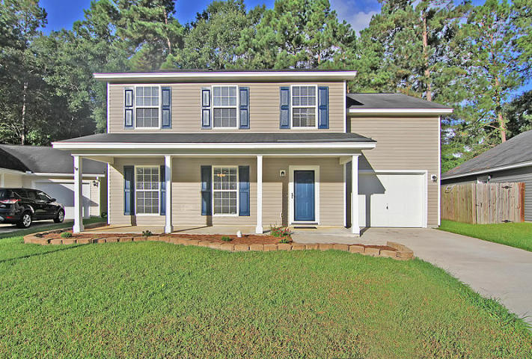
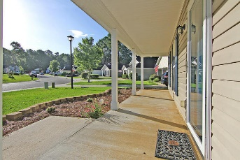
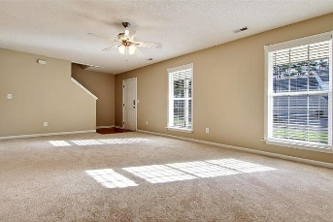
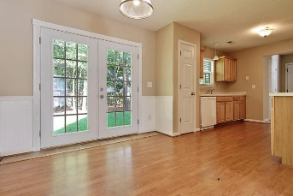
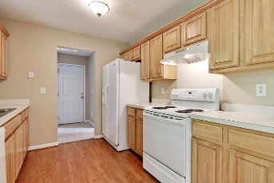
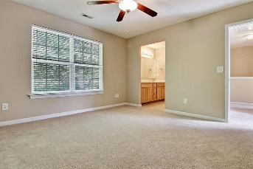
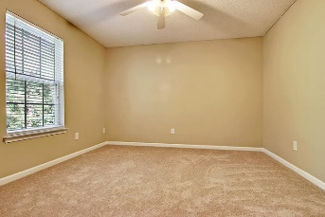
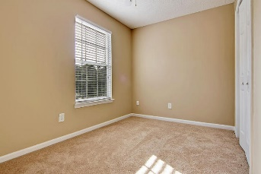
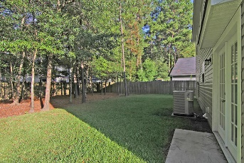
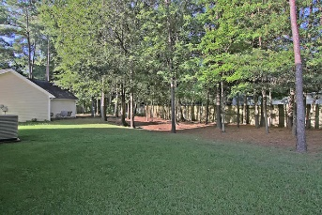
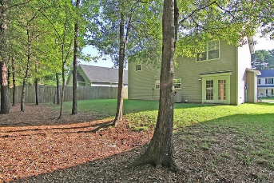
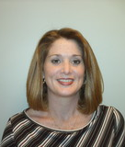

115 Trickle Drive Bradford Chase Summerville MLS# 16018778 $178,500
Move-in Ready in Dorchester District 2
This charming 3 bed 2 bath home is move in ready with new carpet and paint throughout. You're greeted by a front porch that is ideal for rocking chairs. The spacious living room leads into a Laminate & tile floored eat in area next to the kitchen. Kitchen has pantry for extra storage.
Upstairs is the Master bedroom with walk in closet and a master bath. The laundry area, 2 additional bedrooms, a hall bathroom and an extra storage closet are also upstairs. A fireplace could be added to the living room.
Private backyard with no neighbors behind you and a nice wooded area to relax in the shade. This neighborhood has waking trails and two lakes.
Michelle Riser
843-860-1229
mriser@ccim.net
Matthew Ryan Company, 104 Berkeley Square, PMB 59, Goose Creek, 29445

