Slide 1
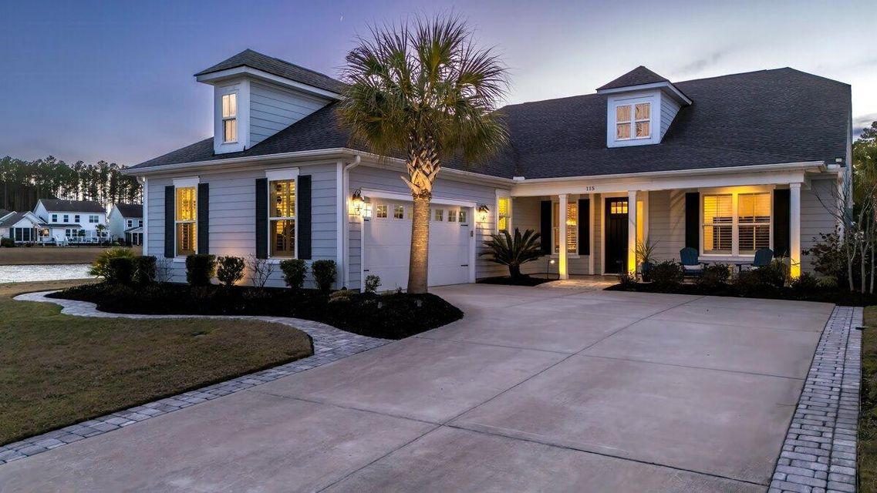
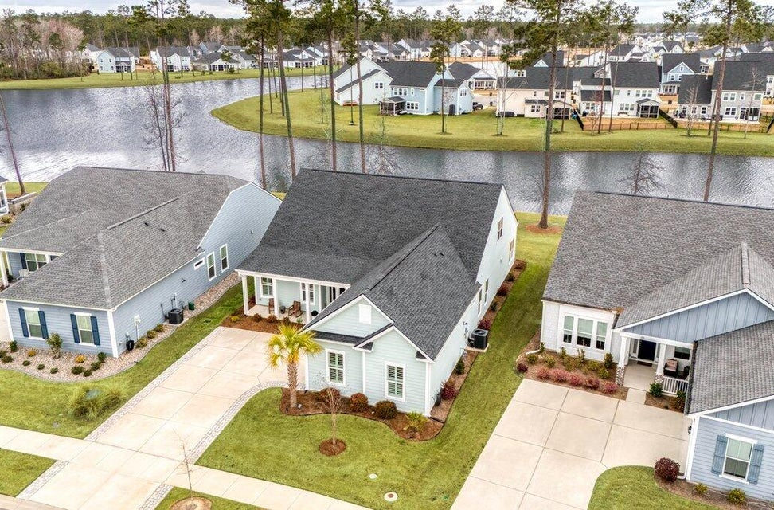


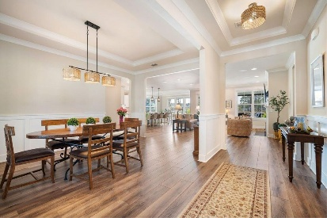
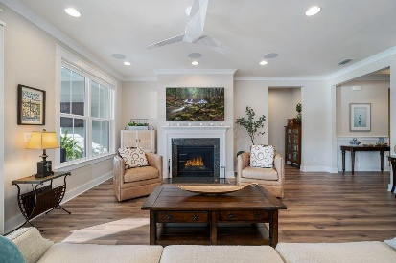
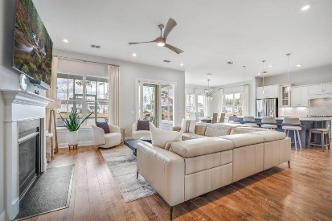
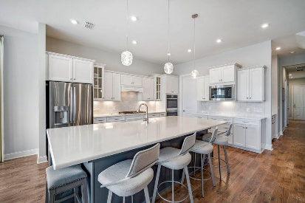
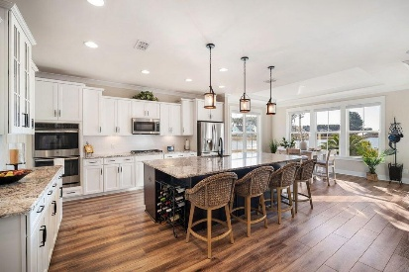
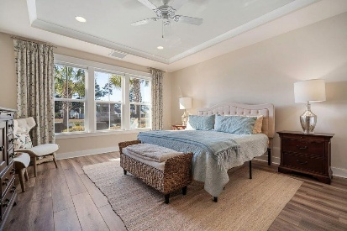
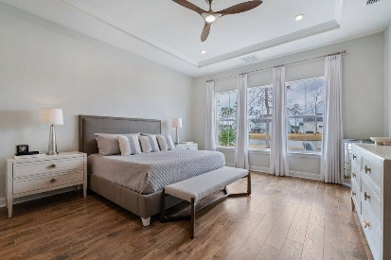
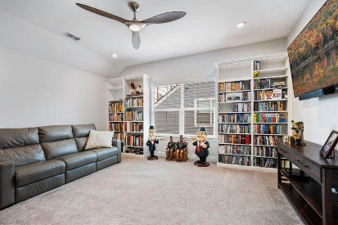
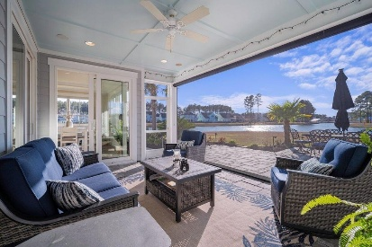
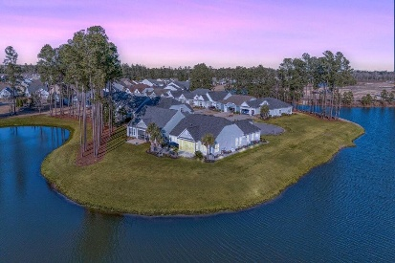
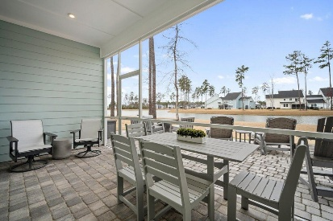
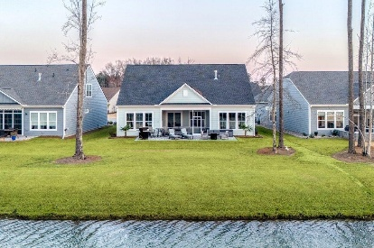
115 Bluff Isle Court Four Seasons at Cane Bay MLS# 25004292 | $775,000 Video Walkthrough
LUCKY DAY!!! 2 Luxury Lakeside Homes in Four Seasons!
Open Houses at Both, Saturday 3/8 12-2PM. Prizes for all, $50 Halls Giftcard for one "Lucky Winner!"
JUST LISTED!
357 Tupelo Lake Drive
Four Seasons at Cane Bay
MLS# 25005862 | $799,900
Video Walkthrough
Elissa Campbell
843-853-1433 | elissa.campbell@agentownedrealty.com
AgentOwned Realty Preferred Group | 824 Johnnie Dodds Blvd | Mt Pleasant, SC 29464

