Slide 1
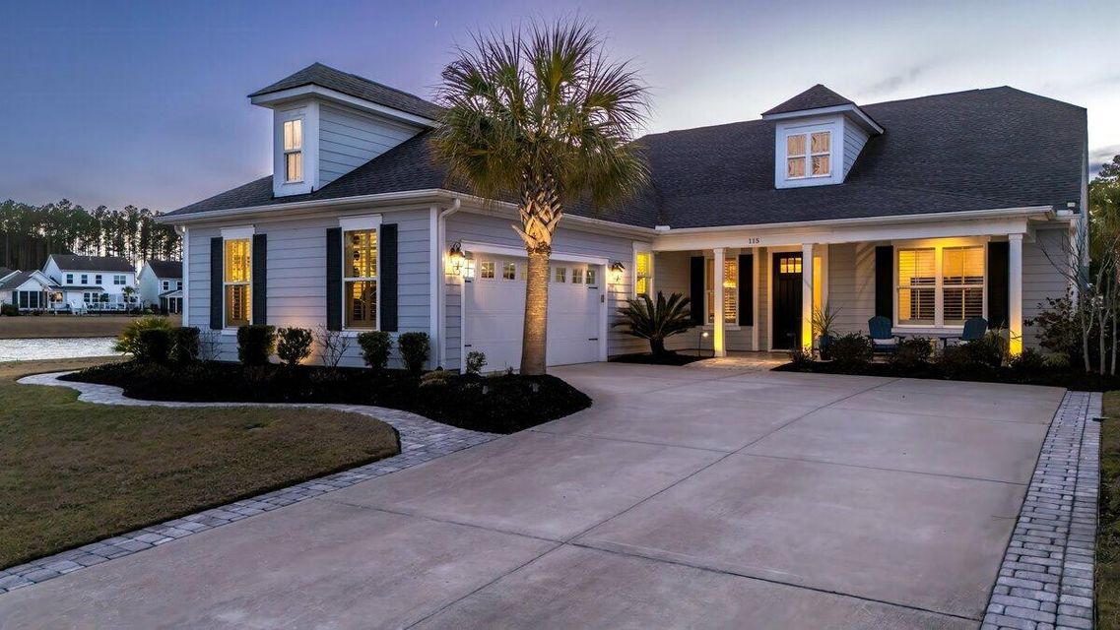
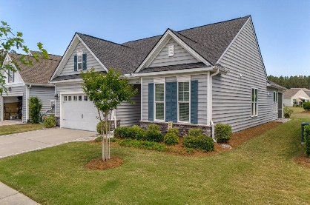
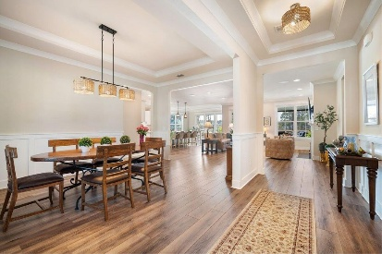
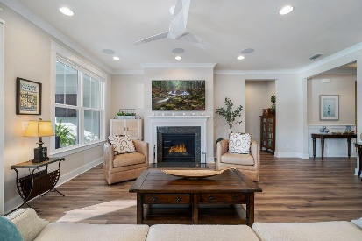
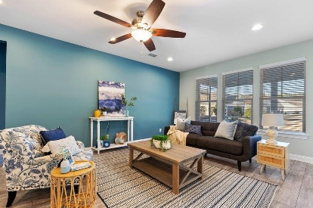
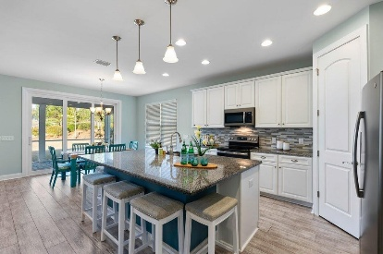
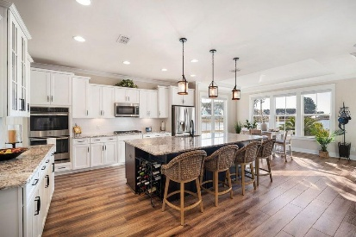
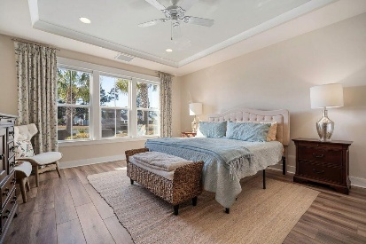
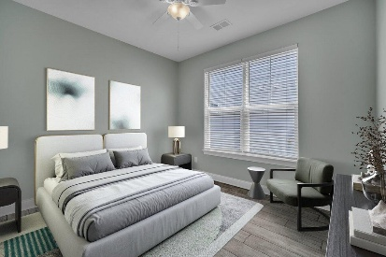
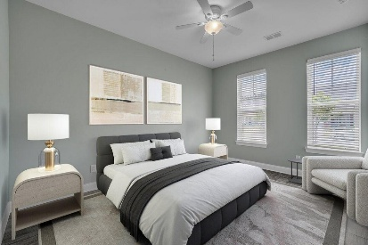
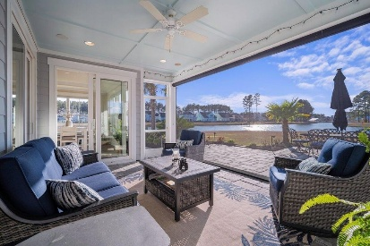
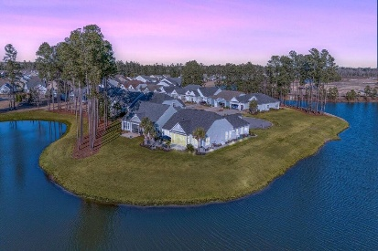
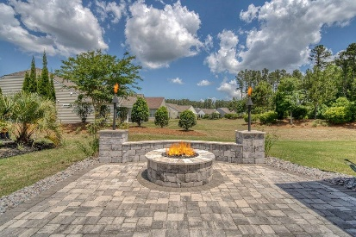
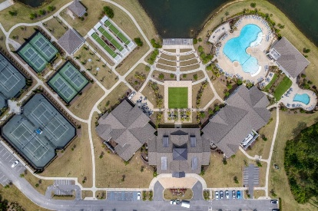
115 Bluff Isle Court Four Seasons at Cane Bay MLS# 25004292 | $775,000 Video Walkthrough
New Listing on the Lake in Four Seasons
Dual open house from 1-3 Saturday
Taco Boy Gift card Drawing for those who attend both
JUST LISTED!
546 Four Seasons Boulevard
Four Seasons at Cane Bay
MLS# 24011600 | $479,900
Video Walkthrough
Elissa Campbell
843-853-1433 | elissa.campbell@agentownedrealty.com
AgentOwned Realty Preferred Group | 824 Johnnie Dodds Blvd | Mt Pleasant, SC 29464

