Slide 1
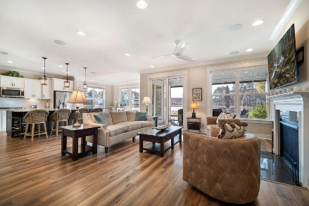



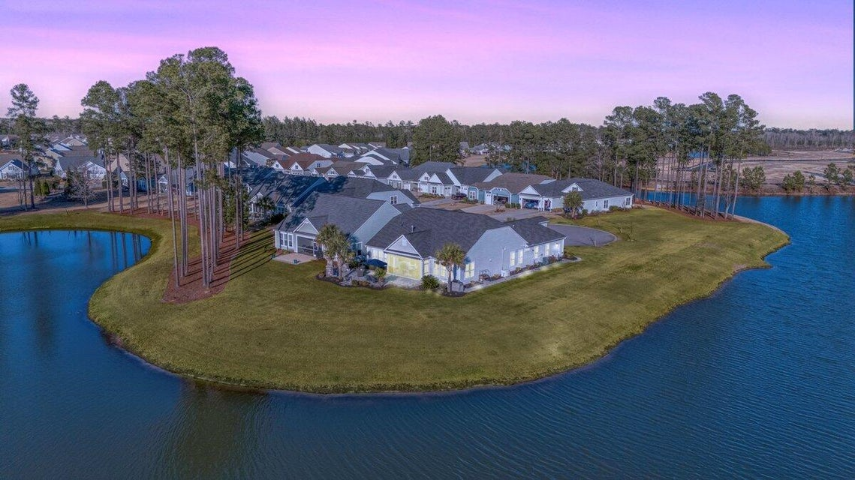

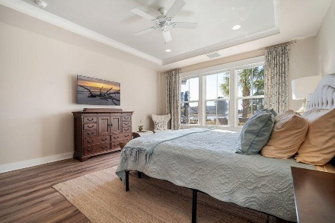
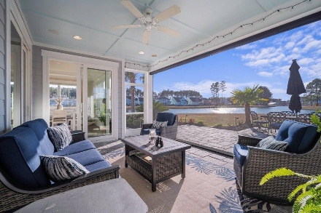




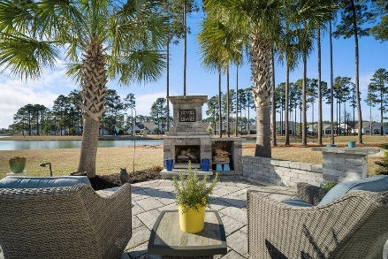


115 Bluff Isle Court
Cane Bay Plantation | Summerville, SC 29486 | MLS# 25004292 | $760,000
Darrell Creek Elevated Home With Elevator & Salt Pool
New EGGSellent Price on the Lake in Four Seasons
115 Bluff Isle Court Reduced $15,000!
The HUNT for your home is over…115 Bluff Isle Ct is Back on the Market at
No Fault of Sellers...HOP on over to the Open House Saturday 4/19 12-2PM
Co-hosting with
Lisa Wood from
Crown Home Mortgage
Offering $2500
Lender Credit
Welcome to 115 Bluff Isle Ct., the most extraordinary homesite in Summerville's premier 55+ community, Four Seasons. This exceptional property is a rare find, nestled at the end of a peaceful cul-de-sac and surrounded by water on two sides. With only one next-door neighbor, this home offers unmatched privacy and breathtaking views of the glistening 300-acre lake and abundant wildlife. If you've ever dreamed of fishing from your backyard or launching a kayak just steps from your door, this is the home for you. Enjoy the serenity of lakeside living while still being part of a vibrant and active community. This is the highly sought-after Ravenna floorplan, offering 2 bedrooms, 2.5 bathrooms, and a spacious office, with over 2,500 square feet of thoughtfully designed space on one level.
The primary suite is a true retreat, featuring tray ceilings, space for a cozy reading nook, and remote-controlled roller shades that allow you to tap a button and bring in the morning sun. The en-suite bathroom is a spa-like getaway, complete with an ultra-spa oversized walk-in shower, an AeroPure exhaust fan with infrared heat lamps overhead shower entry. The showstopping walk-in closet is designed by Closets by Design, providing ultimate wardrobe storage.
The pièce de résistance is the outdoor space. Birdwatch from your screened-in porch, which features a ceiling fan, speakers, custom pavers, and WiFi-enabled remote Phantom motorized retractable screen wall and Sunsetter motorized awning. Other standout outdoor features include a 20 KW whole-house generator, WiFi-enabled irrigation system, a French drain, and an invisible fence. A lighted path from the driveway leads along the side of the home to an outdoor kitchen space featuring a Weber Summit grill. The path continues onto the expansive patio, where you can dine and unwind by the stunning wood-burning fireplace. Sip a glass of wine and watch the sunset over the lake-this is luxury retirement at its finest!
In Four Seasons you will never be bored, as this is the only Active Adult Community in the area that is built around a 300-acre lake with its own private boat dock. Other amazing amenities include an indoor and outdoor pool, fitness center, ballroom, dog park, bocce,
pickleball, tennis courts, a kayak launch and so much more! There is also a packed monthly events calendar and Full-time Lifestyle Director. Once you move to the Four Seasons, you will never want to leave. Don't miss the opportunity to call this luxurious home with the best lot in the community, your home today! UP TO $4,000 LENDER CREDIT for those who qualify with Preferred Lender.
House Tour
Elissa Campbell
843-853-1433 | elissa.campbell@agentownedrealty.com
AgentOwned Realty Preferred Group | 824 Johnnie Dodds Blvd | Mt Pleasant, SC 29464

