Slide 1
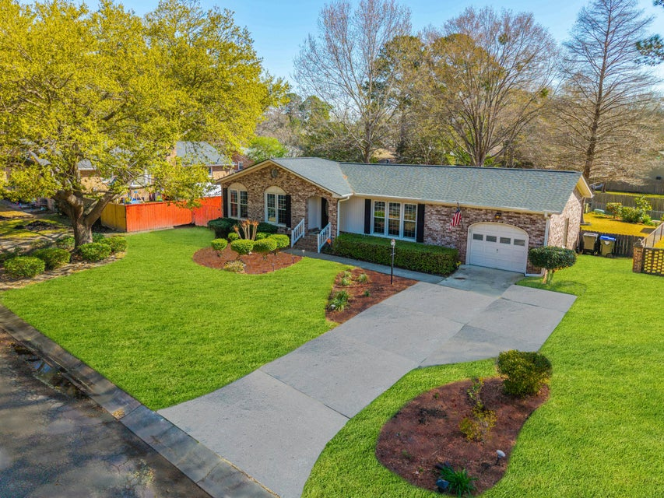




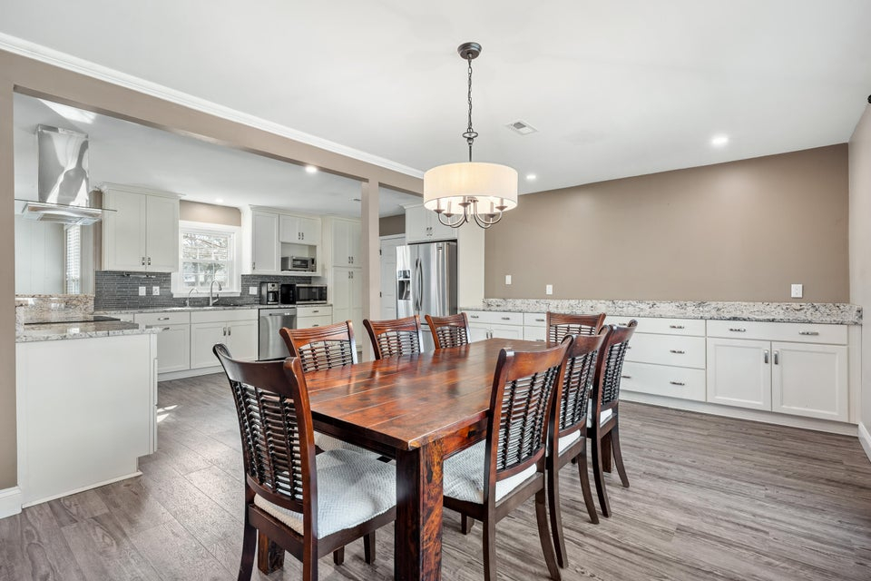
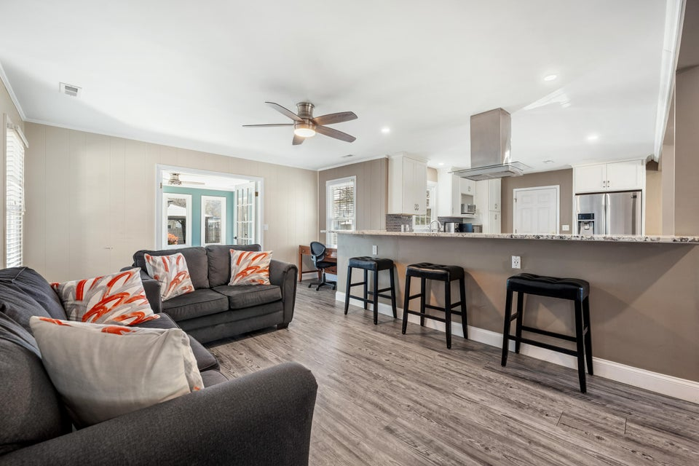
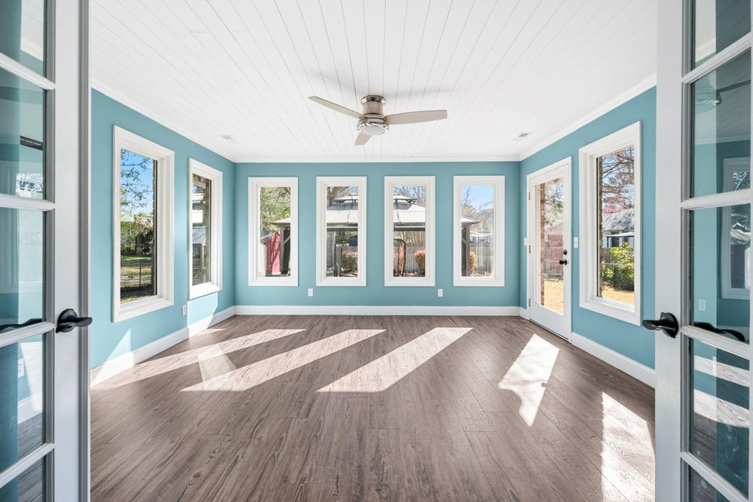
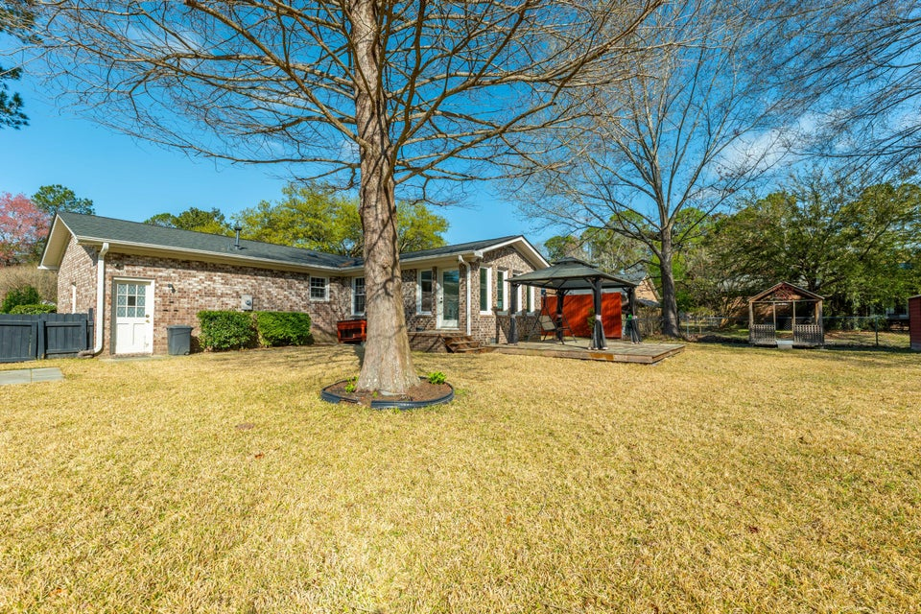

NO HOA ~ DREAM KITCHEN
115 Clubhouse Road
Corey Woods | Summerville, SC 29483 | MLS# 25007740 | $379,000
3 bedrooms, 2 full baths with stylish, modern updates
New roof (2023) for added peace of mind
Spacious, open-concept living and dining areas
Quiet, private street with cul-de-sac
Stately brick façade with stunning curb appeal
No HOA - enjoy the freedom to make this home truly yours!
This rare gem combines classic charm, modern upgrades, and incredible outdoor living spaces. Don't miss this one-of-a-kind opportunity - schedule your showing today!
VIDEO TOUR
Telecia Bilton 843-412-3586
tmbilton@rogcoastal.com
Realty ONE Group Coastal
1510 Trolley Rd
Summerville, SC 29485

