Slide 1
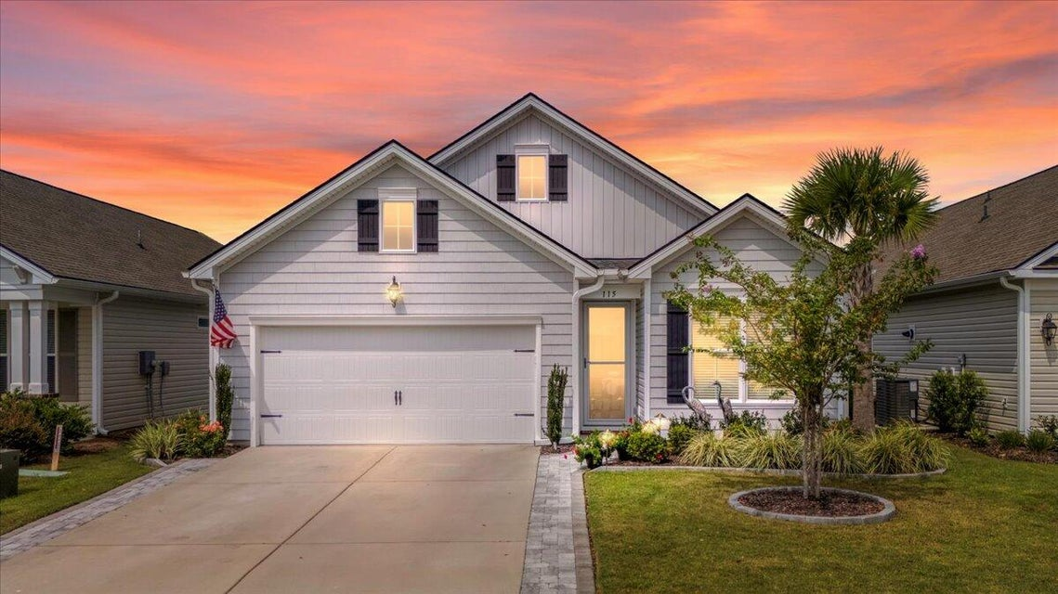



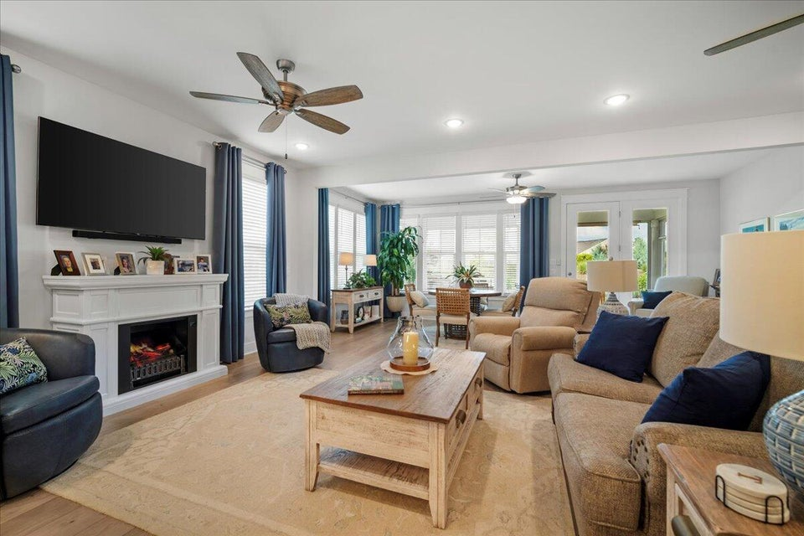
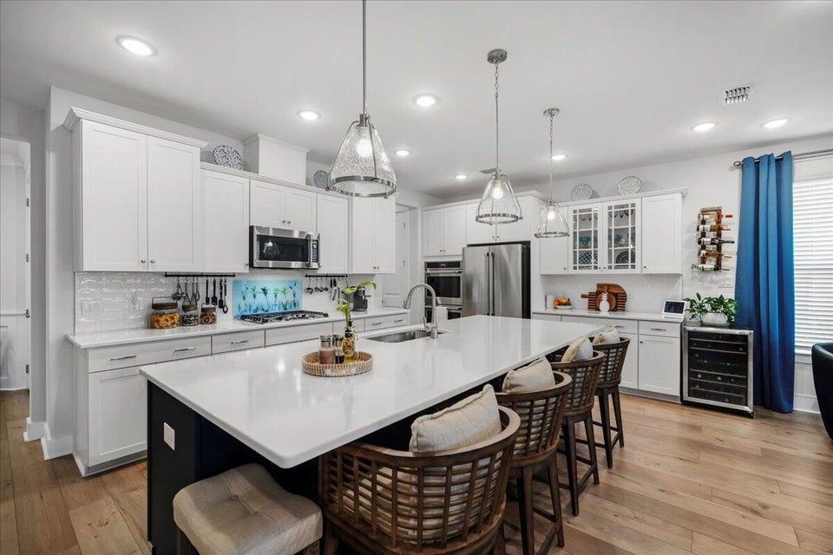
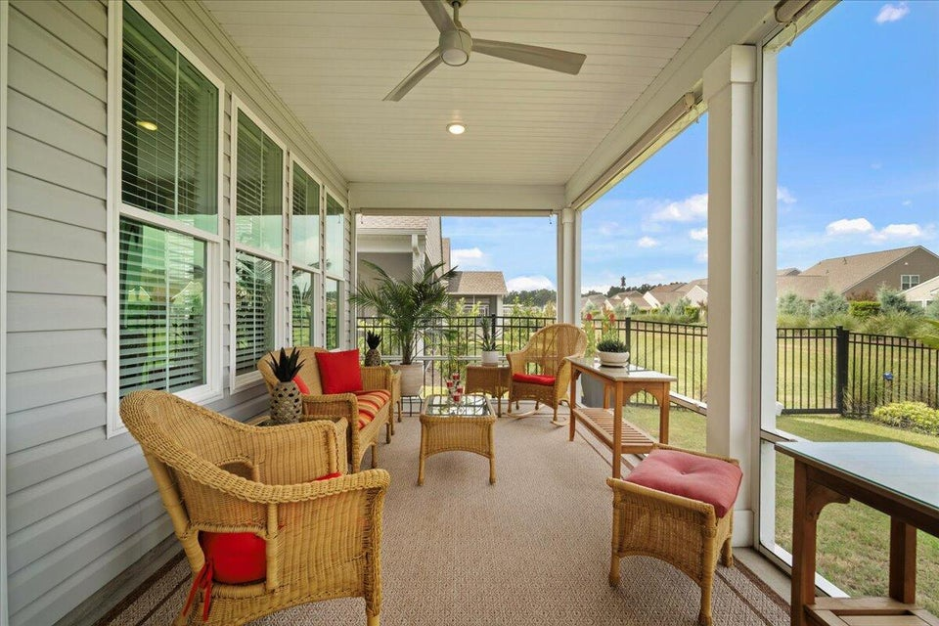
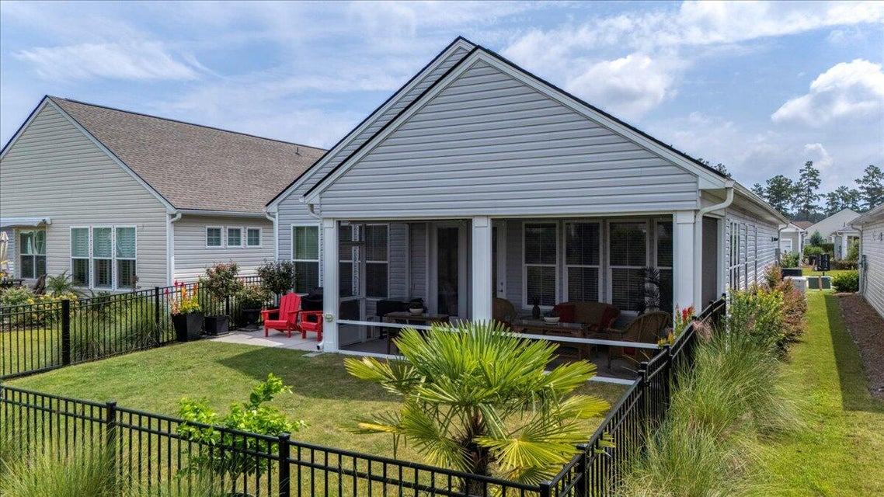


LIVE EVERYDAY LIKE A VACATION
FOUR SEASONS 55+
115 Leeward Landing
Cane Bay Plantation | Summerville, SC 29486 | MLS# 25023153 | $520,000
Meticulously cared for and move-in ready, this sought-after Donegal plan offers effortless, resort-style living behind the gates of Four Seasons at Cane Bay. A full-home Generac® generator provides peace of mind, while the screened-in porch opens to a beautiful berm view—perfect for morning coffee or unwinding at the end of the day. The smart layout features 2 bedrooms, 2 full baths, plus a versatile flex room ideal as an office, den or craft room. Inside, a gourmet kitchen built for entertaining takes center stage with generous prep space, expansive island seating, 5 burner gas cooktop, double ovens and seamless flow to the dining and great rooms. Enjoy unmatched amenities: lake access for kayaking or paddleboard, a stunning clubhouse, resort-style pools, pickleball courts, fitness, social clubs, dog park, miles of trails, and golf-cart accessibility throughout the community. This is the active lifestyle you've been waiting for where every day feels like vacation. Living here means enjoying a true "lock-and-leave" lifestyle- perfect for travelers, part-time residents, or anyone who values low-maintenance living Schedule your private showing today and experience Four Seasons living at its finest.
VIDEO TOUR | VIRTUAL TOUR | AMENITY TOUR
Telecia Bilton
843-412-3586
tmbilton@rogcoastal.com
Realty ONE Group Coastal
1510 Trolley Rd
Summerville, SC 29485

