Slide 1
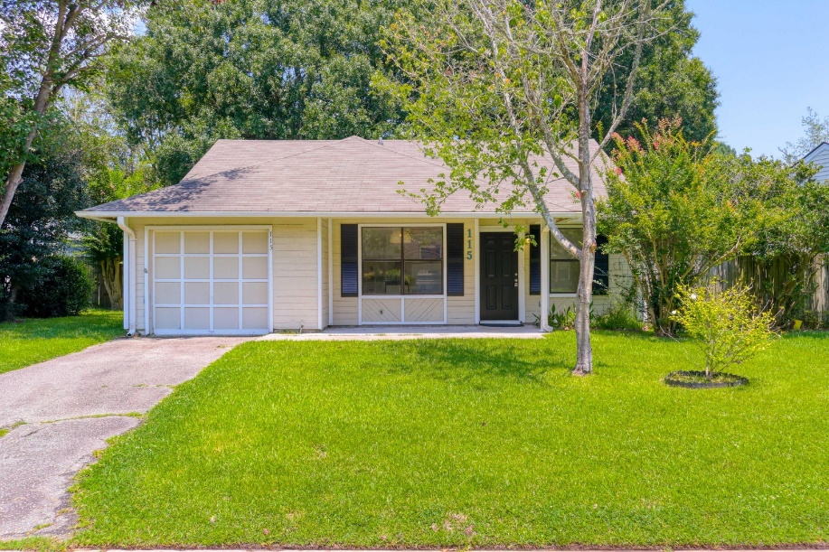
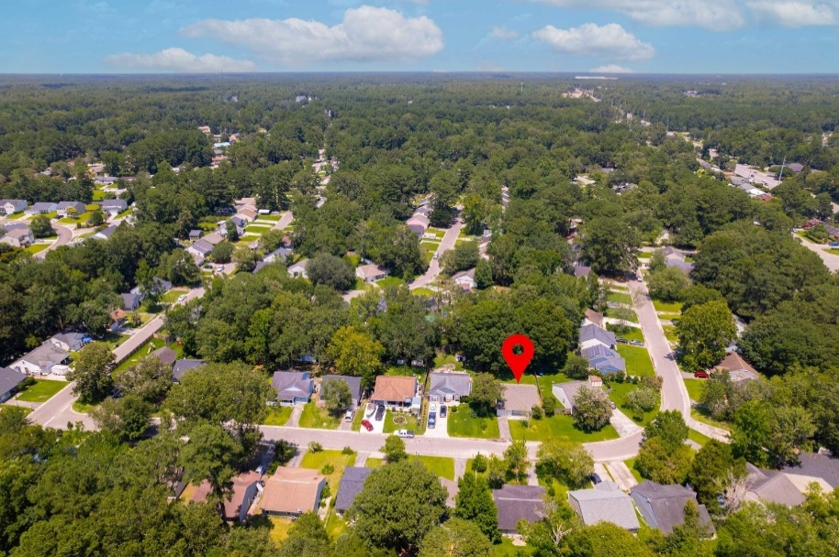
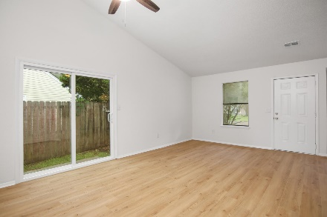
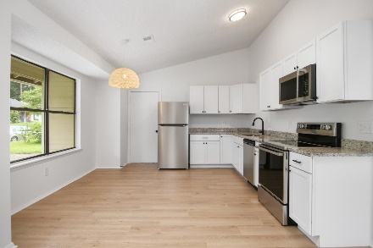
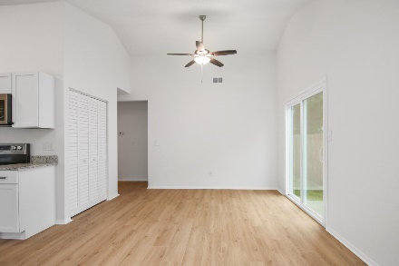
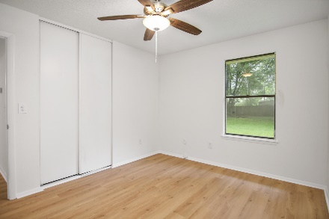
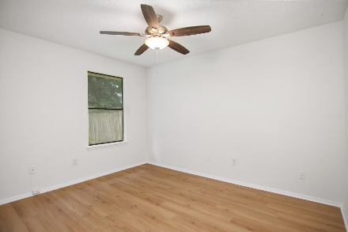
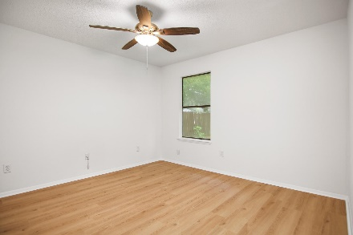
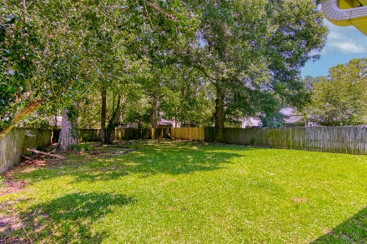
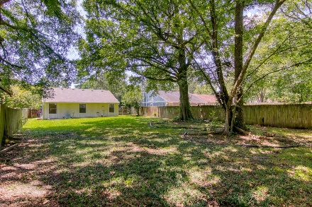



115 Mickler Drive Moss Point | Ladson, SC 29456 MLS# 23015710 | $284,900
Good News... Priced to Sell!
Welcome to your NEWLY renovated dream home situated in the pleasant neighborhood of Moss Pointe. You are greeted by an open airy layout which displays a high vaulted cathedral ceiling enhanced by the natural lighting within the home. There you will view an all new functional kitchen with brand new appliances, new granite countertops and plenty of cabinet space. Envision entertaining friends and family in the spacious living dining area. This home also includes attractive light wood laminate flooring throughout, full bathroom with brand new vanity and mirror. View the Master bedroom with large closet space and two additional bedrooms. Wood fencing provides privacy in the massive backyard bordered by lush, mature trees. Come on by and see for yourself! Thank you for showing.
Click here for interactive floorplan and virtual tour
Susan Stanley
832-323-5573
susancstanley@gmail.com
Brand Name Real Estate
4 Carriage Lane Suite 106
Charleston, SC 29407

