Slide 1
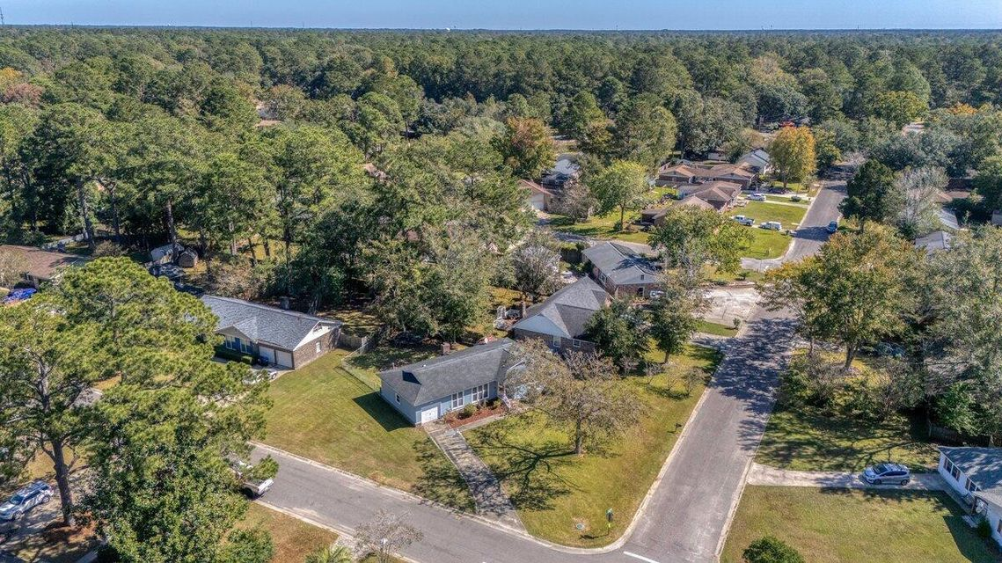
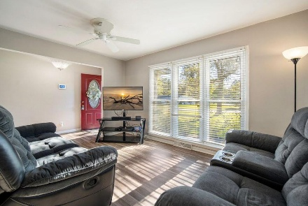
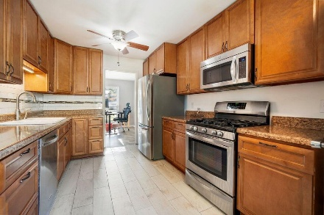
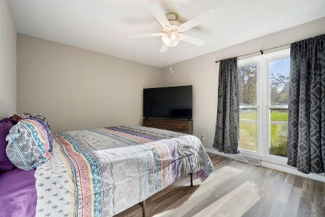
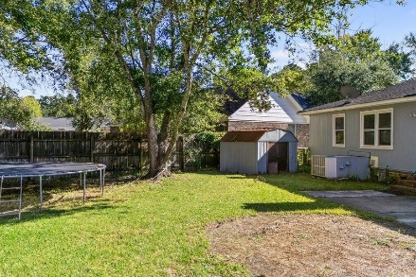

115 Three Wood Lane Corey Woods | Summerville, SC 29483 | MLS# 25001906
Darrell Creek Elevated Home With Elevator & Salt Pool
PRICE REDUCED TO $315,000
Open House Sunday 4/6 from 1-3PM
Co-hosting with Lisa Wood from Crown Home Mortgage
Offering $2500
Lender Credit
Welcome to 115 Three Wood Ln in the heart of Summerville, SC! This updated 3-bedroom, 2-bathroom ranch-style home sits on a spacious quarter-acre corner lot in the well-established, non-HOA neighborhood of Corey Woods. Step inside to find a newly painted interior with an open layout perfect for modern living. The sunny living room flows seamlessly into a versatile dining area or office area. Cozy up by the wood-burning fireplace in family room, which could also serve as a formal dining room, providing plenty of room for relaxation and entertaining. The kitchen is the heart of the home, featuring newer stainless steel appliances, plenty of counter space, and appointed with 42 in crafted wood cabinets. Sip your morning coffee in the breakfast nook by the large picture window.
Just off the kitchen is a convenient laundry room, access to a 2-car garage, and an expansive walk-up storage room over the garage. Down the hall, you'll discover two generously sized guest bedrooms, each with easy access to an updated full bath. The master suite is a true retreat, offering a large en-suite bathroom with a new vanity, a tiled walk-in shower, and a spacious walk-in closet. Other updates include new flooring, new refrigerator, and new water heater 2 years ago.
Located in the sought-after Dorchester District II School District, Corey Woods is only a short drive to Summerville's downtown shopping and dining scene. Plus, you're just 30 minutes from historic downtown Charleston and its beautiful area beaches. Whether you're buying your first home or looking to downsize, this charming updated ranch offers the perfect blend of comfort, convenience, and location. Don't miss your chance to make this beautiful home your own!
House Tour
Elissa Campbell
843-853-1433 | elissa.campbell@agentownedrealty.com
AgentOwned Realty Preferred Group | 824 Johnnie Dodds Blvd | Mt Pleasant, SC 29464

