Slide 1
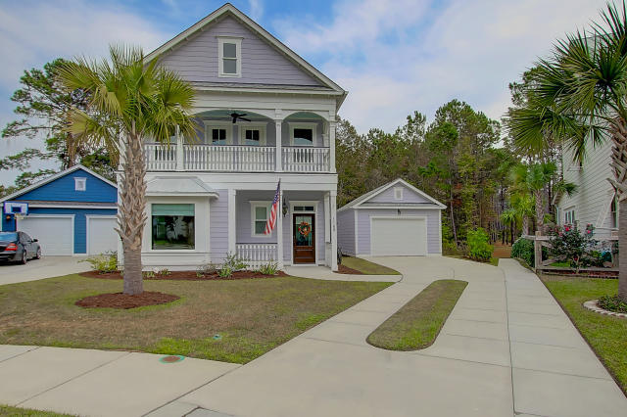
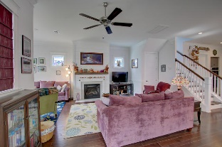
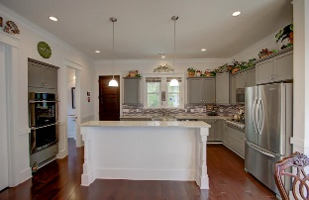
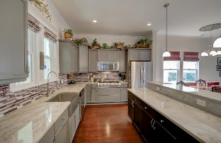
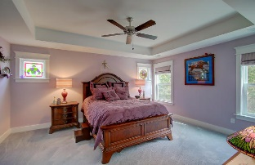
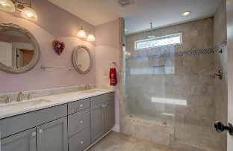
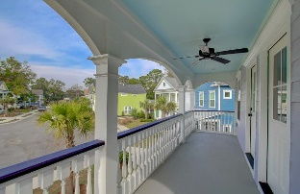
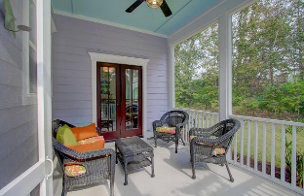
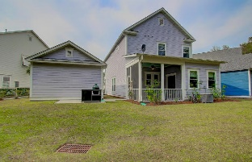


1160 Wexford Park Wexford Park · Mt Pleasant · MLS# 16029297 · $475,000
Move-In Ready Model Quality Home With Appliances Included!!
Open concept floor plan with natural light that's exceptional for entertaining family and friends in your custom kitchen. This home offers many upgrades - granite & marble counters in the kitchen and bathrooms, Electrolux ICON Designer Pro-Style Gas Rangetop with 6 Sealed Burners Including 2 Min-2-Max Burners, Continuous Grates, Ceramic Glass Surface, and Electrolux Wave-Touch Series Double Wall with Wave-Touch Electronic Controls and perfect turkey settings for the ovens. The KitchenAid French door refrigerator has an interior water dispenser- conveniently located for easy access to ice-cold filtered water. Soft close cabinetry throughout the home - the kitchen island and bar includes a side shelf for your cookbooks, drawers below the rangetop will house all your cookware and the cabinetry above and below the double ovens will be home to all your baking and cooking essentials. The office has built in cabinetry with granite desktop with built in hanging files. There are lighting and nickel fixture upgrades throughout the home. The great room features a lovely fireplace with ship lap surround between two windows that further accentuate the homes natural lighting. There is plenty of storage in the oversized garage for your golf clubs, sporting equipment and for your outdoor toys. Enjoy the beautiful Lowcountry weather from the privacy of your screened in porch and watch the woodpeckers, egrets, blue heron and birds in the wooded wetlands right in your back yard. Set up outdoor seating on the patio to keep watch of the delicacies cooking on the grill. Just bring your personal items and move right in. Beautiful Mt Pleasant Home in the quaint neighborhood of Wexford Place.
$550,000
Nick Collins Office - (843) 266-5000
Mobile - (843) 224-8771
ncollins@carolinaone.com
www.nickacollins.com
Carolina One Real Estate | 2713 Highway 17 North | Mt. Pleasant, SC 29466

