Slide 1
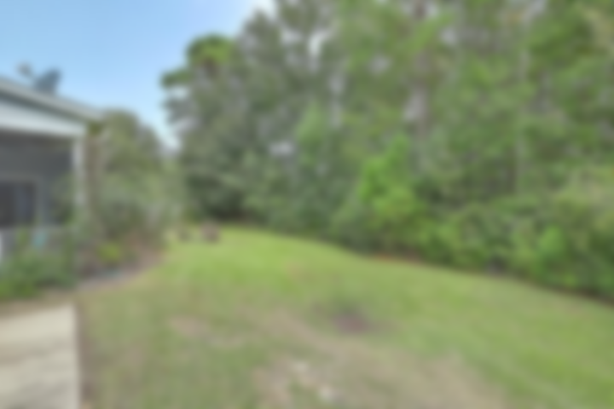
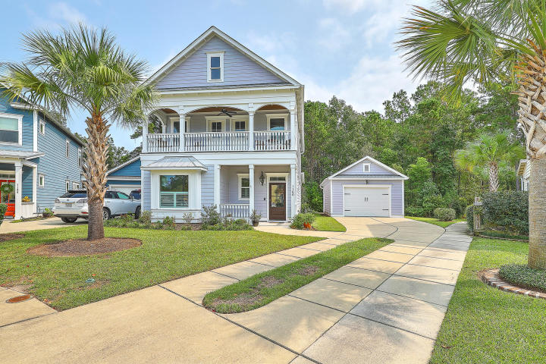
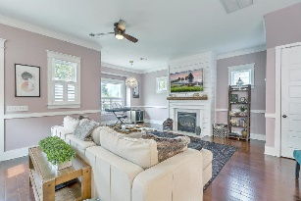
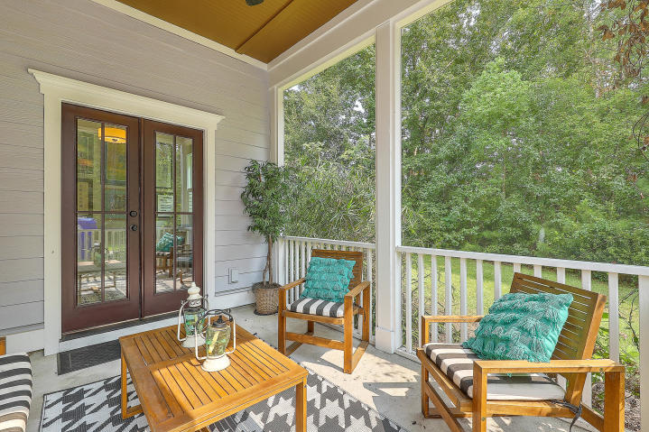
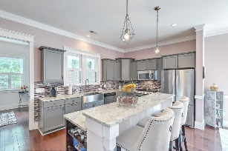
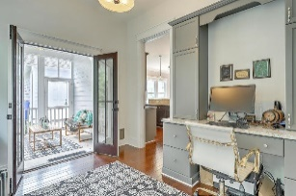
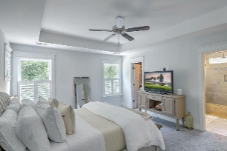
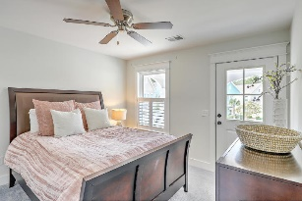
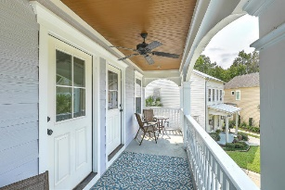
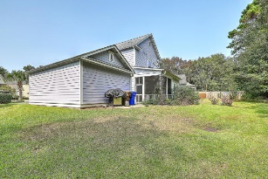
Beautiful Home For Your Buyer!!!! 1160 Wexford Park Wexford Park ~ Mount Pleasant, SC 29466 ~ MLS# 20027986 ~ $513,500
This beautiful home, in pristine condition awaits you! It is a spacious 3 bedroom, 2 1/2 bath with a bonus room that can be used as an office or flex space. You can enjoy the privacy this lot affords you as it backs up to a wooded area and a private screened in porch. The double porches and tasteful landscaping provides great curb appeal. In addition to the exterior features the home offers beautiful hardwood floors, crown molding and designer touches such as shiplap and gorgeous backsplash. The Chef Kitchen'' invites you to cook on a fabulous gas stove, pot filler, large stainless steel farmers sink, beautiful double ovens, and beautiful spacious granite counter tops. Lawn Care maintenance is covered by HOA fee!
Video Tour: http://vimeo.com/464538843
Mary Beth Minor
marybethminor@outlook.com
859-339-9444
Land South of Charleston, LLC | 180 E Bay St Ste 300 | Charleston, SC 29401

