Slide 1
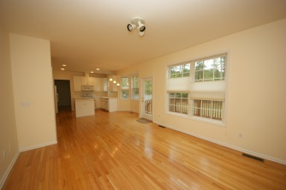
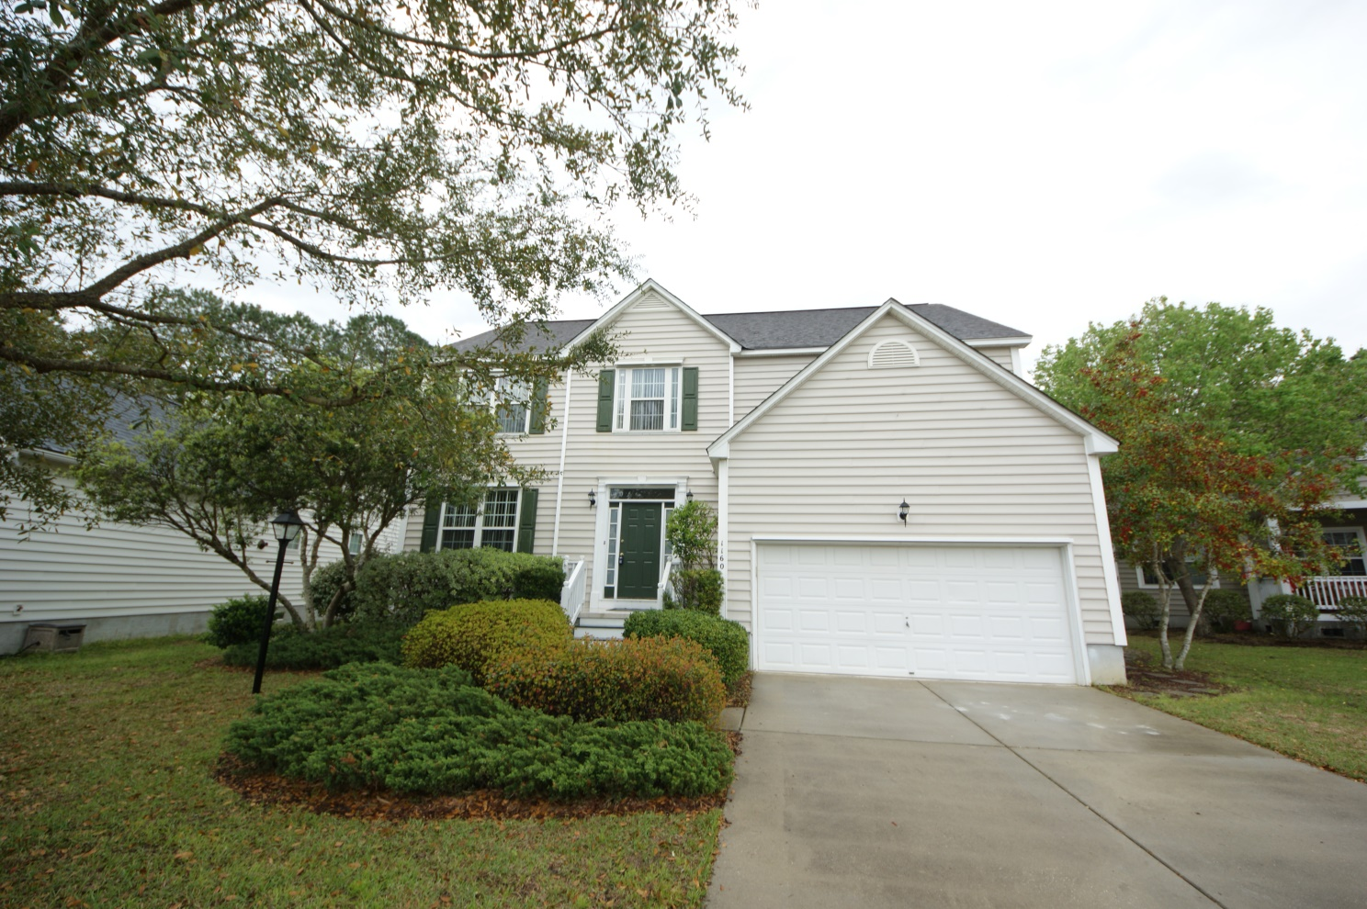
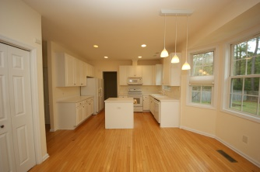
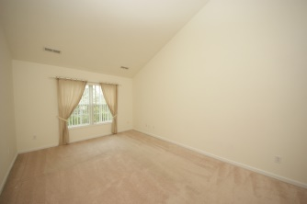
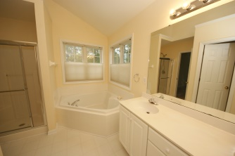
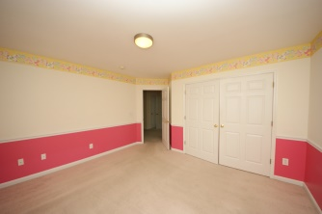
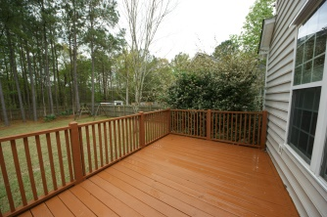
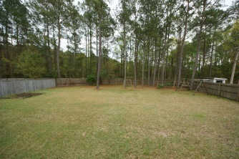

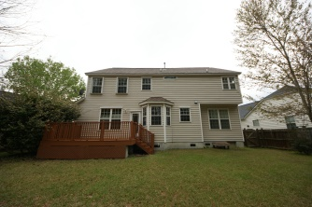
If you’re looking for a Lowcountry home with contemporary qualities, this may be it.
1160 Willoughby Lane
Park West :: Mount Pleasant
MLS# 15008597
$389,000
Easy to show, ready to go!
Located in one of the most popular neighborhoods in Park West. Largest lot in Churchill Park backing to a private wooded area! This home has an open, comfortable flow and is in great condition and been well maintained by one owner! 4 bedrooms upstairs with large landing and laundry on second floor. Master suite has ample sitting area, master bathroom has soaking tub, separate shower, double vanities. Large eat-in kitchen with Island overlooks family room, large deck and fenced in backyard with privacy fence. Formal dining room and living room connect to foyer and kitchen. You'll particularly enjoy the beauty and variety of mature flowering trees, shrubs and plantings. Additions include hurricane shutters and attic storage in 2 car garage.
Karla Leahy
Realtor CRP, ASP, QSR
karlaleahy@gmail.com | (M) 843-452-6670
www.yourlowcountryproperties.com
Harbor City Real Estate Advisors | 510 Live Oak Drive | Mt Pleasant SC 29464

