Slide 1

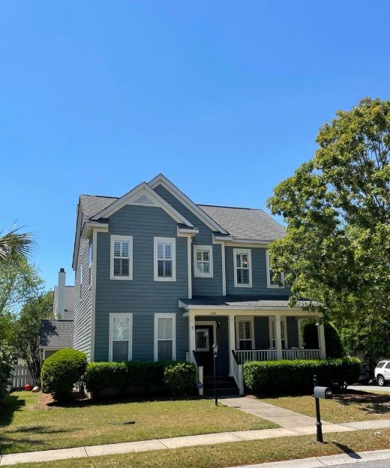
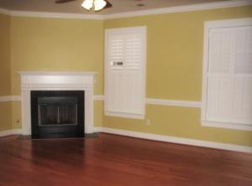

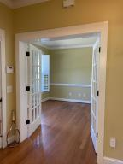
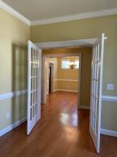
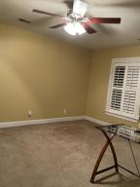
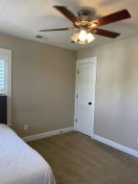
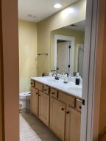

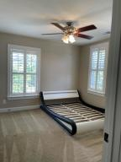
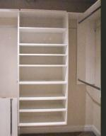
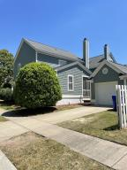
Primo Location ~ Corner Lot Home
Just Off Of Coleman Boulevard
Liz Lyman
(843) 732-0017
liz.lyman@exprealty.com www.exprealty.com
1160 Dawn View Terrace
New Parrish Village | Mt Pleasant | MLS# 21010474 | $675,000
LOCATION!
Only 2 mile drive to Sullivans Island or a 10 minute bike ride. Terrific 3 bedroom/2.5 bath home in the quaint subdivision of New Parrish. Easy access to beaches, grocery stores, restaurants, shops, Shem Creek and more. Only 7 miles to downtown Charleston.
First floor boasts a spacious living room, kitchen with corian countertops and natural wood cabinets and breakfast bar, separate formal dining area, laundry, half bath and a large office/den area. Second floor has large master bedroom with en suite bathroom and walk in closet. Two additional bedrooms and full bath also located on second floor.
This beautiful home has the perfect front porch and screened in rear porch! Wont last long!
eXp Realty Charleston · 711 Fairview St · Fountain Inn, SC 29644

