Slide 1

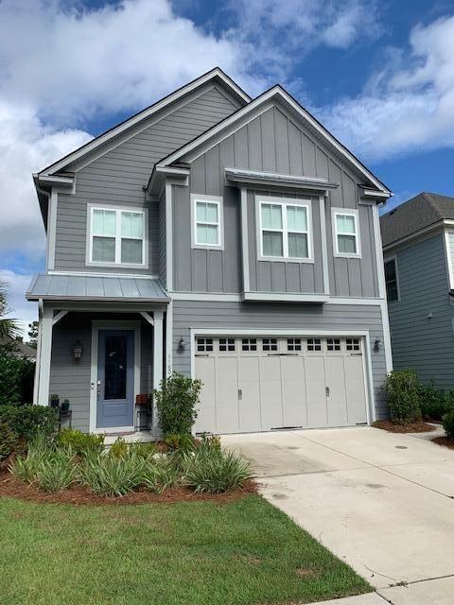
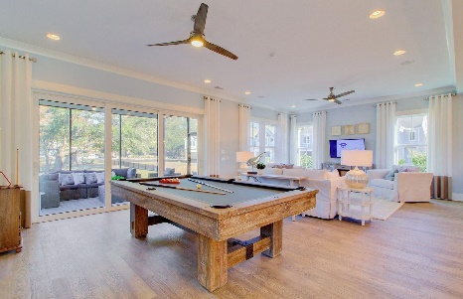
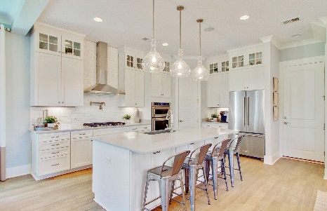

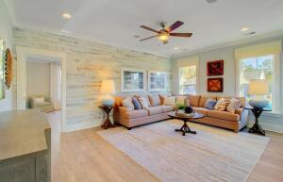

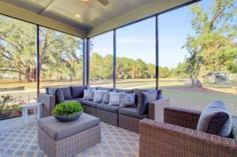
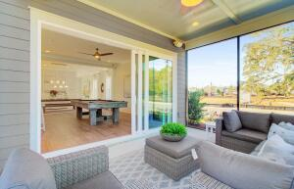
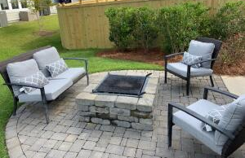


ALMOST BRAND NEW HOME CLOSE TO IOP
1160 Penderlee Court
Pointe at Primus
Mount Pleasant, SC 29466
MLS# 21027234 | $735,000
1160 Penderlee Ct is located in the heart of Mt. Pleasant and close to schools, shopping, restaurants, and the Isle of Palms! This is the prior community model so it has so many beautiful upgrades! The Thompson floor plan offers a spacious great room, which opens to the eat in kitchen, dining room, and flows to the screened in porch through the large sliding glass doors! There is ample natural light throughout the home and is perfect for entertaining family and friends! There's even an outdoor patio with a fire pit for smores! Upstairs boasts 3 bedrooms including the master, a large loft, laundry room, and 3 full baths. Here is the list of over $100k of upgrades in this home... Shiplap throughout the first floor, 2nd floor loft, master bedroom, and one of the guest rooms. $20k in remote electric blinds throughout the entire home, surround sound in the living room, porch, master bedroom, and loft. Upgraded chefs kitchen with top of the line cabinets, quartz countertops, and kitchen aid appliances. Upgraded wood flooring throughout the downstairs, loft, and master bedroom. Master bath has large family shower and upgraded cabinets with large walk in closet. Laundry room was upgraded with cabinets and countertops. Garage is fully cooled and heated and has an upgraded side door entry. All lighting fixtures and fans were upgraded! There are just too many upgrades to list, you just have to see it for yourself!! Pointe at Primus is a great community that is now fully completed with 72 homes. Great walking trails throughout the neighborhood with several ponds and beautiful large oak trees! You can't beat the location either! Come see this one quick as it won't last long!
Kristen Whitehead
Mobile - 843-670-1671
kwhitehead@kwchs.com
www.charlestonislandagents.com
Keller Williams Realty
Charleston Islands
1304 Palm Blvd
Isle Of Palms, SC 29451

