Slide 1
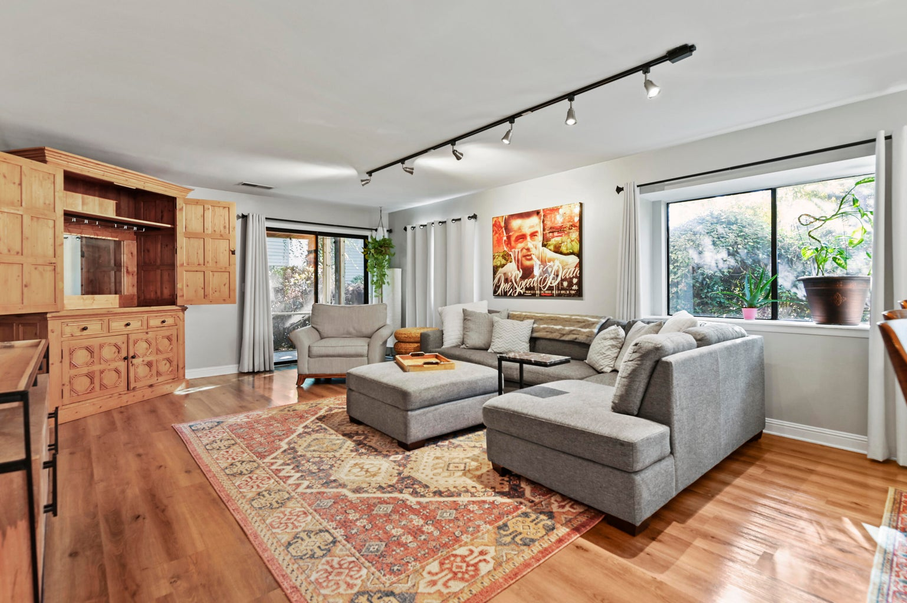

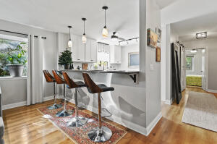
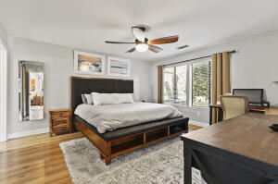
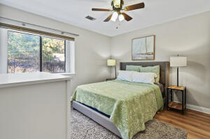
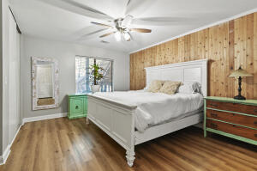
Furnished 3 Bedroom Condo
1161 Shadow Lake Circle J Snee Farm Lakes | Mount Pleasant, SC 29464 | MLS# 22030069 | $3,500
Available for 3 months or longer. Beautifully furnished 3 bedroom and 3 bathroom condo in desirable Snee Farm Lakes. Condo is located on the ground floor and easily accessible parking. All 3 bedrooms are spacious and feature beds with linens and ample storage. Kitchen has been fully updated with modern cabinetry and counters and fully stocked with the essentials. Main living area has open-concept floor plan and opens onto a screened porch to enjoy the Lowcountry weather. This condo has everything you need, just bring your suitcase. Snee Farm Lakes features swimming pool and is convenient to shopping and restaurants. Snee Farm Club Membership is available for tenants to purchase. Application fee is $60 per person. All occupants over 18 and guarantors must apply.
Property Manager will screen all applicants. Proof of income 3 times the rent and driver's license or state or federal issued id required. Security deposit equal to one months rent and Lease Initiation fee of $100 due at the time of accepted application. All applicants must complete a profile with PetScreening.com to certify that they have no animals, give information about their pets or verify service or emotional support animals. Pet rent will apply to pets. Pet rent is $30 for the first pet and $20 for the second pet.
Lindsey Blackburn 843-364-4451 | lindsey@rogcoastal.com
ROG Coastal Property Management | 1510 Old Trolley Road | Summerville, SC 29485

