Slide 1
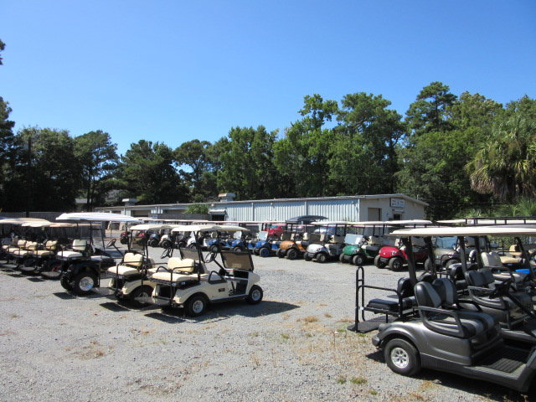
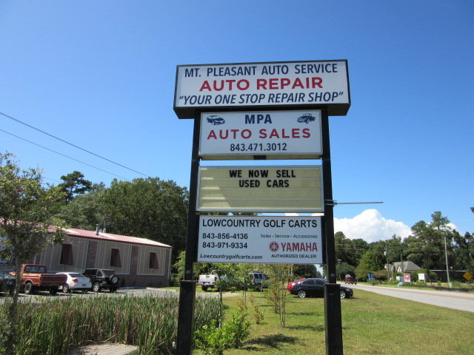
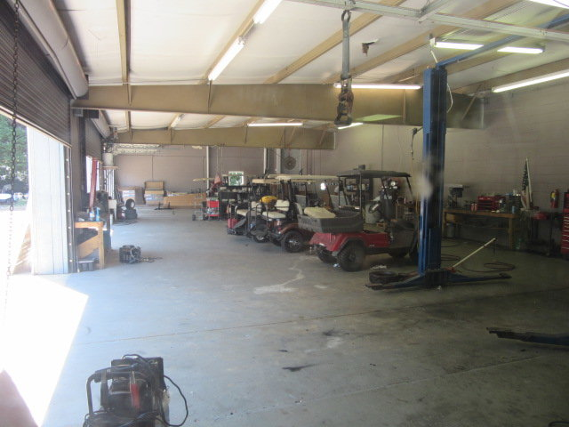
Golf Cart Business & Building
For Sale
$40,000
Price Reduction!
1161 SC-41, Mount Pleasant, SC 29466
Retail-Commercial for Sale
Catylist ID: #30326447
Many potential uses...Currently being used for golf cart sales and service. Both the building and business are for sale and the business can either stay or relocate. The building is $1,500,000 and the business price is $375,000. The 8,748 sq ft building has about 3,519 sq ft of office and retail space that is heated and air conditioned. The balance of the building is and has been used for golf cart and auto repairs and has some lifts and garage doors (roll up). The property has 15 designated parking spaces with additional land for dozens of additional spaces or to construct an additional building. The property is located about 300 feet from the intersection of Hwy 17 North and Hwy 41. There is signage on Hwy 41 as well as visibility of the building located behind mt. Pleasant auto. The property is zoned commercial ab-2 and is .87 acres in size. The property is accessed from “Old Hwy 41" (Frontage Rd) that also accesses the retail properties at the corner of Hwy 41 and Hwy 17.
Rick Willis
843-327-3017 Rick@RickWillis.com The Group, LLC

