Slide 1

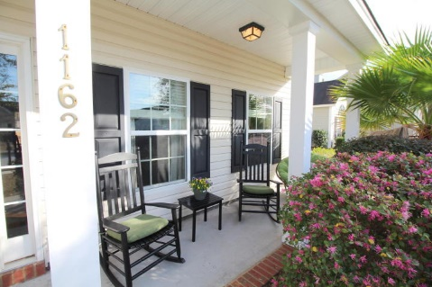
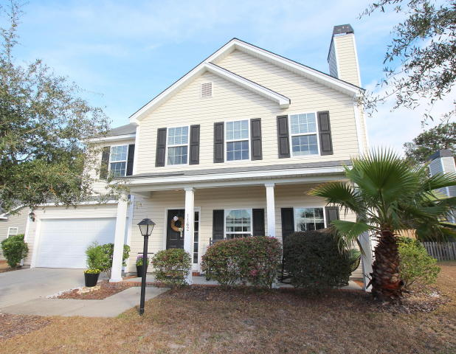
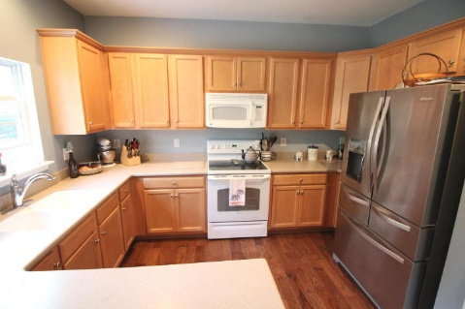
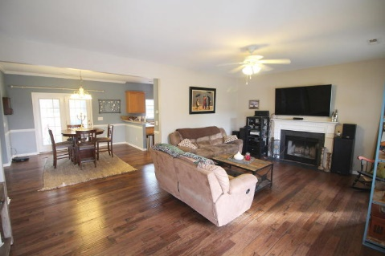
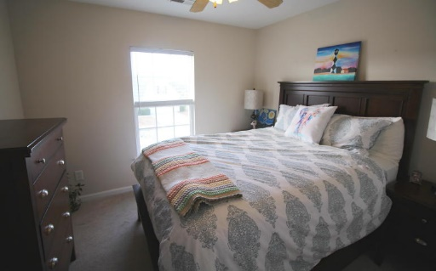


Well Priced 4 BR Home In Summertrees
1162 Startrail Lane
Johns Island, SC 29455 ~ MLS# 17002478 ~ $260,000
Updated 2 Story home in sought-after community of Summertrees. 1162 Startrail is a perfect family home near all that Charleston has to offer in a lowcountry setting. The home is one of the most private in the area and backs up to the woods. The beautiful flooring in the first floor’s open floorplan is carried through the kitchen, living room and dining room making it perfect for entertaining. The spacious kitchen is well-appointed and offers plenty of cabinet & counter space. Plenty of storage in the oversized garage and one of the best values for a Johns Island 4 BR. Schedule your visit today!
Peter Stanley
M 843-300-8251 | O 843-885-6199
petermstanleyjr@gmail.com
Colony & Craft LLC
716 Meeting St Charleston SC 29403

