Slide 1
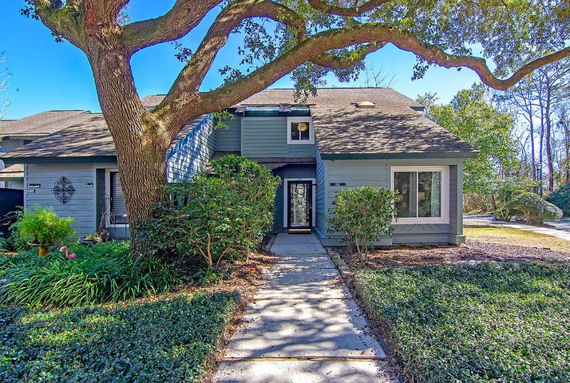
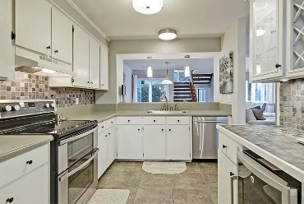
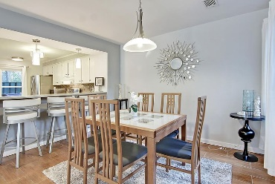
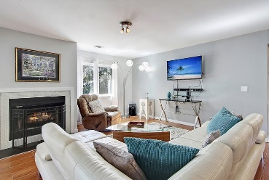
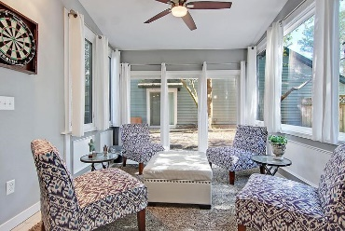
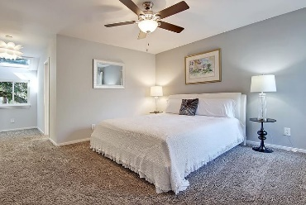
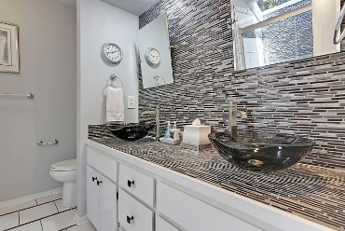
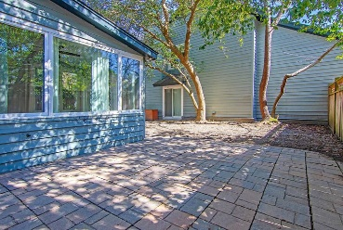
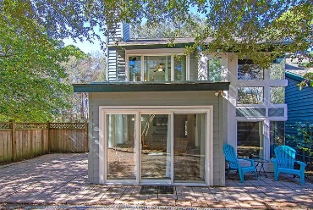

1162 Shadow Lake Circle #44 Snee Farm · Mount Pleasant, SC 29464 MLS# 21004869 · $361,500
Gorgeous Listing
New to Market End Unit
STUNNING-Contemporary Executive End Unit Townhouse located in the heart of Mt. Pleasant! Beautifully updated 3 bedroom, 3 bath townhouse in sought after Snee Farm Subdivision boasts an open floor plan, high end finishes including glass and ceramic tile, gorgeous floors, vessel sinks, chrome light fixtures, stainless steel appliances, double oven, oversized stainless sink, beverage center, spa shower, bedroom on main level, patio room, newer vinyl windows, an abundance of natural light and the list goes on and on!! Minutes to shopping, dining, beaches, airport, Boeing, Daniel Island and historic downtown Charleston! HOA fee includes water/sewer, pest control, landscaping, pool, exterior maintenance, termite bond & ext.
Take a video tour
https://vimeo.com/charlestonrem/review/516058285/8a7594231d
Stan Huff
843-670-2835 stan.huff@agentowned.com
Jill Marcacci
843-297-5590 jill@agentowned.com
www.agentownedrealty.com
AgentOwned Realty Co. Preferred Group, Inc. | 824 Johnnie Dodds Blvd | Mt Pleasant, SC 29464

