Slide 1
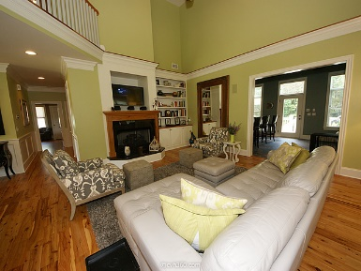
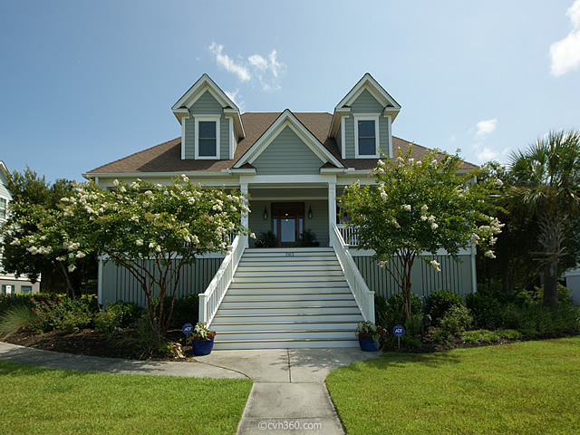
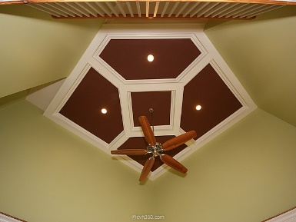
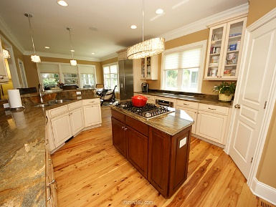
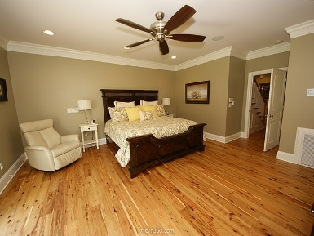
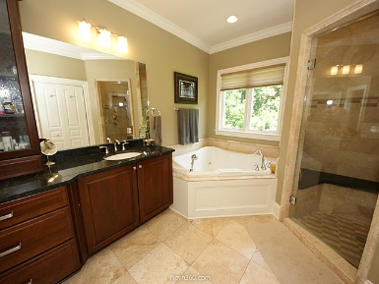
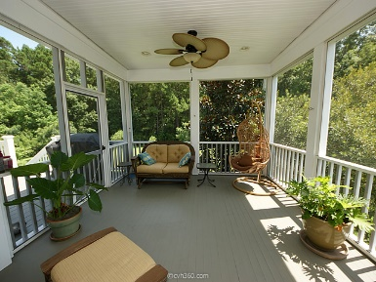
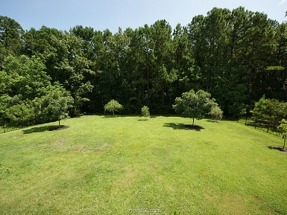


1163 Rivershore Road Beresford Creek Landing ~ Charleston ~ MLS# 15020280 ~ $739,000
Agent Open House Sept 24th, 11-1
You can tell by the designer touches and fine craftsmanship that no expense has been spared in the construction of this gorgeous home that is within a short walk to a community dock with great fishing and crabbing. The flooring throughout is recently refinished 5 1/4 Australian Cypress except for the marble bath rooms, slate bar floor and the three upstairs bedrooms that have carpet. The entrance is warm and inviting and when you enter the grand family room with its high coffered style ceilings with fan and gas fireplace with built-ins it almost takes your breath away. This home is an entertainer’s dream with the open floor plan and gourmet kitchen. There are granite and stainless steel Bosch appliances, including double ovens, microwave, dishwasher and gas cooktop. It has plenty of counter space and custom cabinets. The bar area around the corner has slate floor and beamed ceilings with a wet bar, wine cave and plenty of cabinets for glass wear. The bar opens to a large deck overlooking a very private backyard. The master, another bedroom and office are located on the first floor. The large master has an en-suite bathroom with Travertine marble floors and a steam shower. There is also a whirlpool bath to relax after a hard day's work. Attached to the master bath is a very large custom closet. The upstairs has three more bedrooms with ceiling fans in each one. The home also features central vacuum for easy cleaning. The home sits on a gorgeous lot and with a new fence that is beautifully landscaped. Owners have recently had the home painted, inside and out, and a new lower lever air handler and dual thermostats were installed in 2014. There is over 1,000 sqare feet of decks/porches that provide excellent opportunity to enjoy the lot that is just under Â½ acre! There is really too much to tell about this home it truly is a jewel and a must see to really appreciate all the details.
It is a celebration of a great home with prizes and refreshments!
Cheryll Woods-Flowers
ABR, e-Certified, SHS
(843) 442-2219
www.woodsflowers.com

