Slide 1
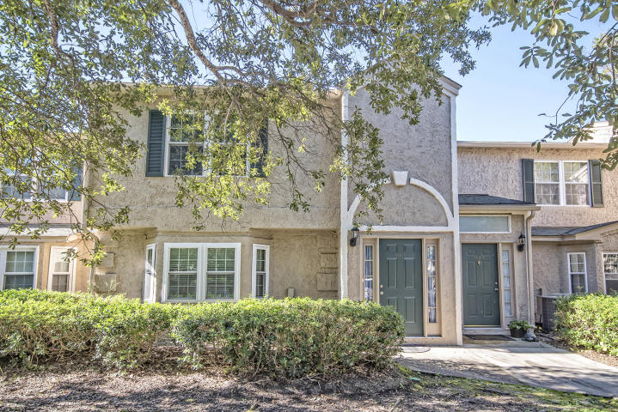
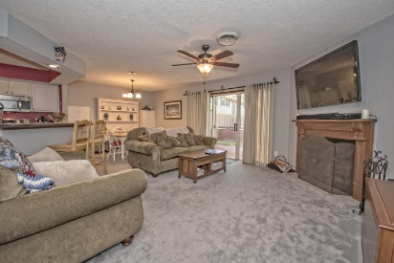
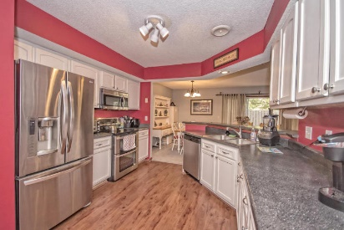
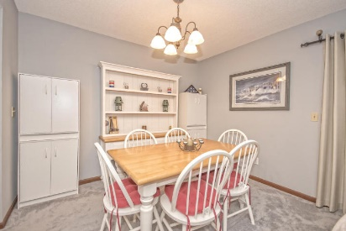
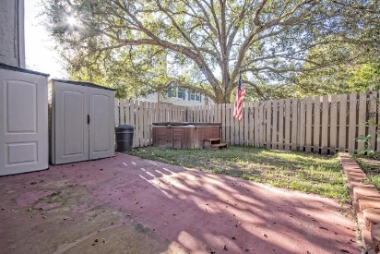
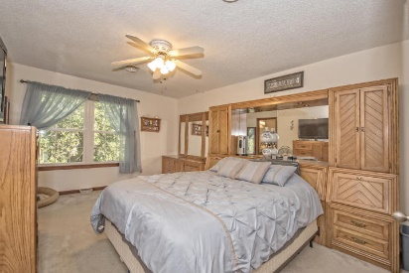
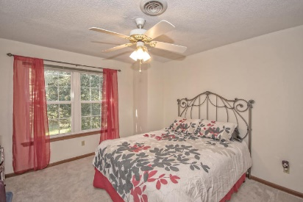
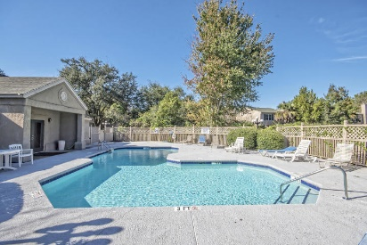
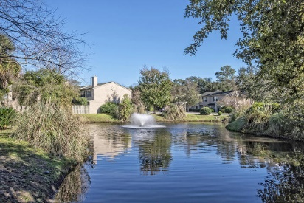


1165 Monaco Drive ~ Beaumont Financing fell through, so take advantage of this opportunity!
Back on the Market!
Come see this nicely updated & open floor plan in one of the best locations in Mt. Pleasant. Located right off Highway 17 North (just past the entrance to Snee Farm), 1/2 mile from the Mt. Pleasant Towne Center, and only a couple miles to beach! Updated appliances, expanded and privacy fenced-in back yard patio for privacy and perfect for pets, new carpet downstairs, huge master with on-suite, updated kitchen, NEW double hung and double paned impact resistant windows (installed in 2015), 2010 HVAC, and Does Not require Flood Insurance! Accompanied with such a large and homey feel, this is a fantastic place to call home!
MLS# 15028738
$204,900
Haynes Johnson
Mobile - (843) 864-8159
haynes.charlestonproperties@gmail.com
The Boulevard Company, LLC | 35 Broad Street | Charleston, SC 29401 | haynes.charlestonrealestate.properties

