Slide 1
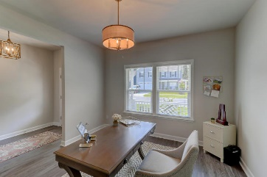
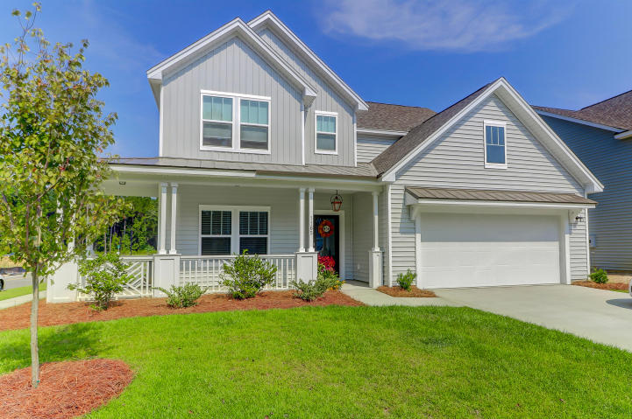
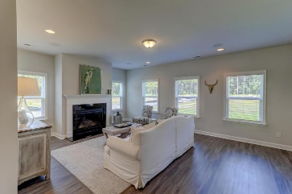
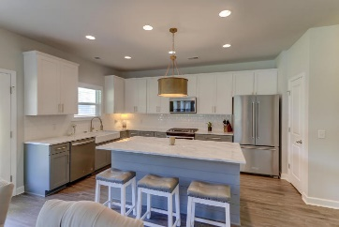
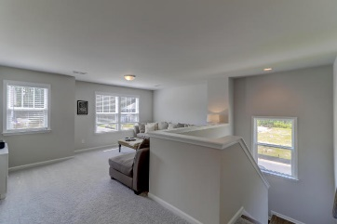
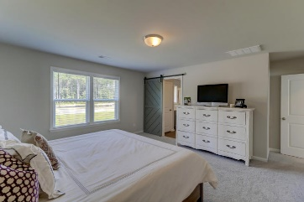
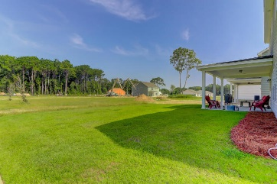
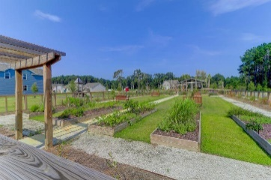


1165 Turkey Trot Drive
Riverview Farms ~ Johns Island, SC 29455
MLS# 18024009 ~ $369,000
Improved Price
Stunning Like New Tons of Upgrades
Seller Pays $3,000 Closing Costs
Almost new designer home in Riverview Farms on Johns Island. Beautiful in and out with upgrades galore. Enjoy the outside on your beautiful wrap front porch or covered rear patio. Metal roof over the front porch and above garage door. Large corner lot backs to Green Space for privacy. Surround sound speakers in the great room and back porch. This spacious interior with wide plank vinyl flooring, lovely muted wall colors, gas fireplace, and tons of streaming light is is just perfect. Upon entering they've chosen the room to be an office but would make a great dining or living space. The kitchen is open to the dining and great room featuring gorgeous cabinetry and hardware, Quartz counters, huge island, farm sink, stainless appliances, a walk in pantry, lots of storage throughout and off the kitchen, a butlers pantry with wine cooler. Upstairs, the loft area could be a family room or play area. The large master is an amazing size with a barn door to the master bath and the walk in closest is a dream. Expansive Quartz counter space in the master bath and the exquisite tile shower features a rain shower.
This neighborhood garden at the entrance is enjoyed but those with or without a green thumb. Whether you pick your produce or cut flowers this is a beautifully maintained feature for all.
Act quickly ... this home has it all! Move in and know you are getting a home of your dreams.
Darlene Smith
Office - (843) 886-8110
Mobile - (843) 696-7824
darlenesmith@carolinaone.com
DarleneSmithTeam.com
Carolina One Real Estate
1503 Palm Blvd Ste
Isle of Palms, SC 29451

