Slide 1
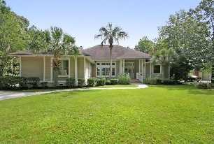
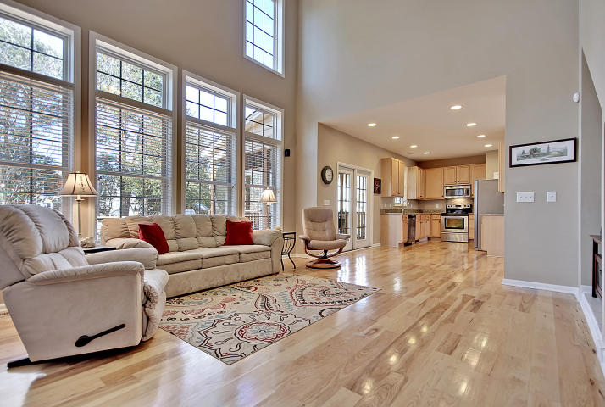
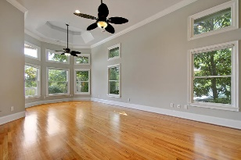
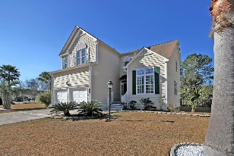
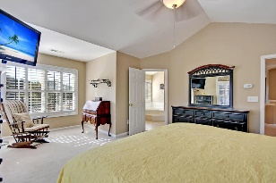
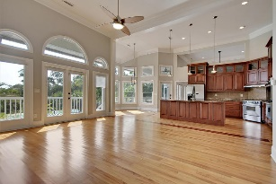
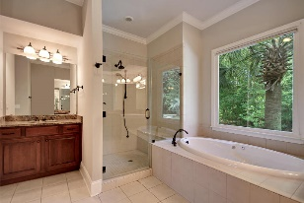
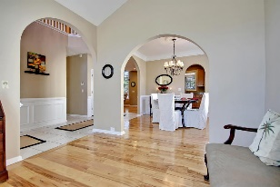
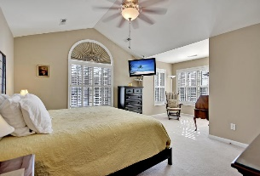
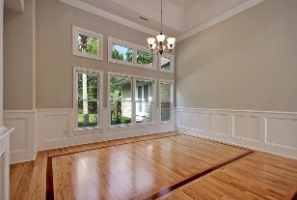
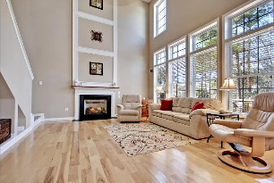
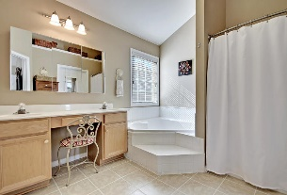
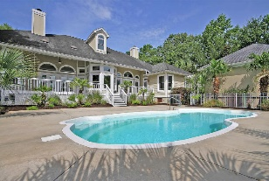
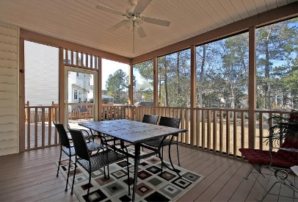
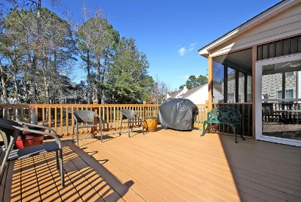
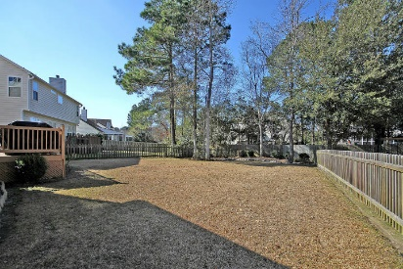
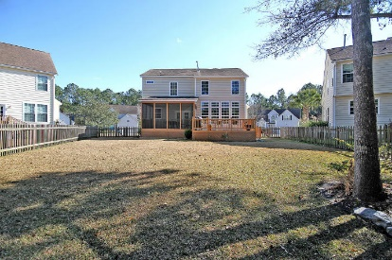

1165 Willoughby Lane
Park West | Mount Pleasant, SC 29466 | MLS# 16003797 | $363,771
Soaring Ceilings, Open Concept & Dock
Amazing Natural Light & Great Outdoor Living
The best location within Mt Pleasant’s walk-able community of Park West! This golf cart friendly neighborhood enjoys restaurants, bars, doctors, banks, Publix, O2 Fitness and more just minutes from your door. WALK to Cario Middle School & the Mt Pleasant Recreation center. The Rec Center boasts Miles of Walking/Biking trails, Tennis courts, Football & Soccer fields, Indoor Volleyball & an Indoor Swimming Pool, along with a dog park. Park West has its OWN amenities including 2 swimming pools, 6 tennis courts, a Volleyball Court, Summer Kitchen, Community Clubhouse & Crabbing Dock. Sidewalks connect the neighborhoods for lots of dog walking & jogging. Your new home in Churchill Park is the closest neighborhood to the Commercial Section & is just minutes to Hwy 17, Mt Pleasant Towne Center Shopping and the Beach! Two Golf Courses within 10 minutes drive! Pull up to this spectacular, Open Concept home and notice the custom driveway and immaculate landscaping. Custom Wide Plank Hardwood flooring leads to the Soaring Ceilings in the living room that create Wall of Windows flooding the home with natural light. A massive screened in porch with adjacent outdoor deck for grilling and large parties overlooks a large, .21 acre lot with more lovingly kept landscaping & Palm Trees. Fully fenced backyard has 2 gates, one on each side. A gas line is already installed on the deck! The upgraded screen door even has a sliding glass panel. Your stainless steel Whirlpool stove (only 3 years old), Stainless BOSCH dishwasher (2 years old), Stainless Whirlpool Microwave, and Granite Countertops make cooking a breeze! Upgraded Moen kitchen faucet & 42" cabinets. Your Master Bedroom boasts its own sitting area. The Master Bath has it all...Double Vanity, Ceramic Tile floors, Deep, Jetted Corner Tub, Huge Shower & Separate Toilet room with Wainscoting. Even a Walk-In Closet! All the bathrooms have raised Vanities & Cultured Marble tops. The Spacious Laundry ROOM even has a hanging area. Looking for storage? The garage has a HUGE storage shelf built above the garage door opener. Venetian blinds & Plantation Shutters keep the lines in this home clean. Upgraded ceiling fans and light fixtures everywhere! The living room is wired for surround sound, too. ADT wiring in place as well. Hot Water Heater is 2 years old & Upstairs A/C was replaced Spring of 2015. Want more? Gutters are on the front & back of the house. X500 Flood Zone, so no flood insurance required! Come see this beautiful home today!
Call or email for details: (843) 214-8451 or Robin@ThePhillipsRealtyGroup.com

