Slide 1
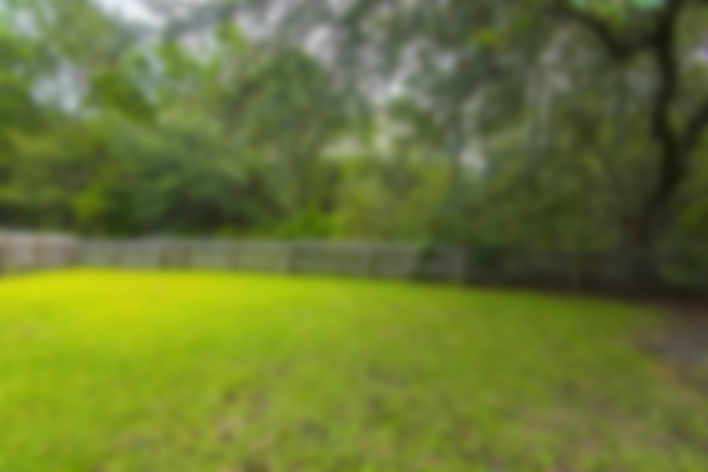
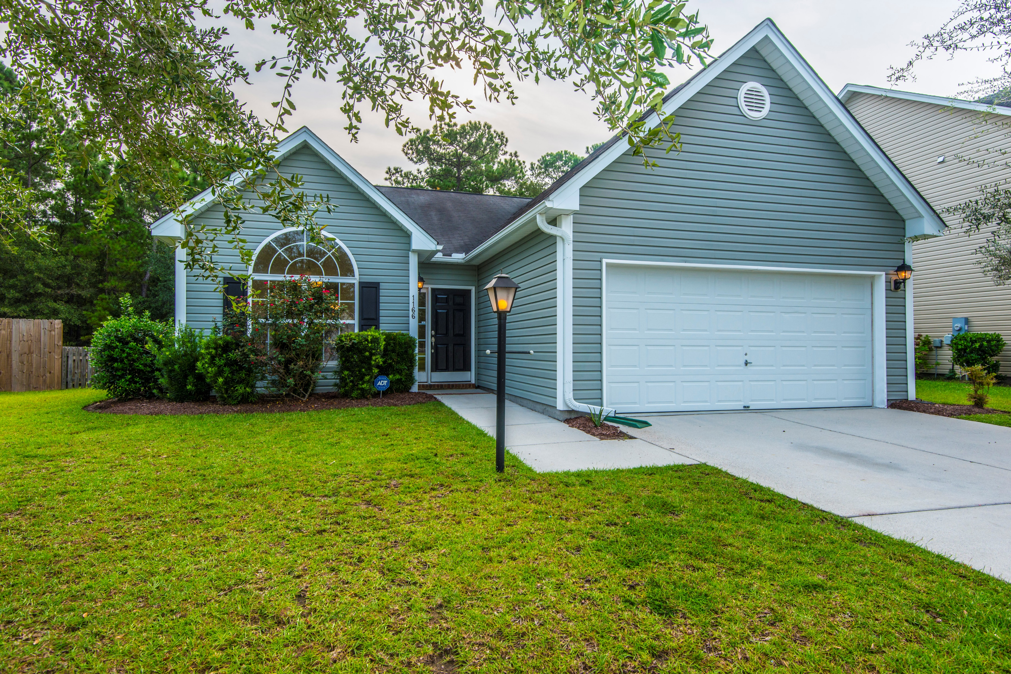
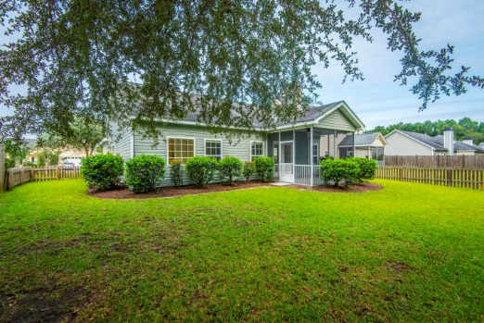
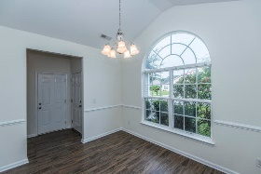
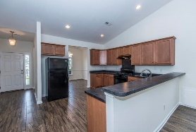
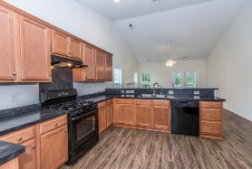
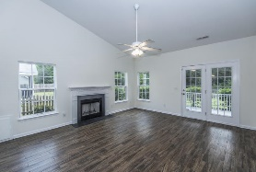
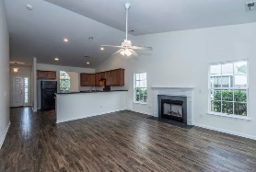
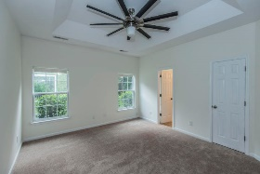
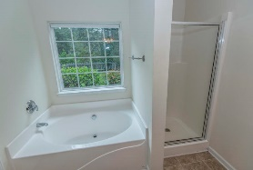
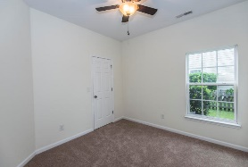
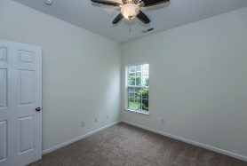
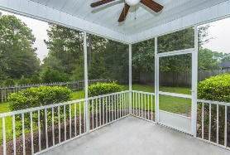


Just Listed in Summertrees
1166 Startrail Lane
Johns Island, SC 29455 | MLS# 17025051 | $254,000
Well maintained one level home in the highly desired neighborhood of Summertrees.Interior has been freshly painted and new flooring throughout the home. Spacious kitchen with many cabinets as well as a breakfast bar. Separate dining room has a large window that allows for plenty of light! Chair railing gives this room a touch of class! The living room with smooth vaulted ceiling and fireplace and large windows makes this a cozy space for gathering. There is a screened in porch off the family room which leads to your fenced backyard. The master bedroom is large with a linen closet and great sized master closet. The master bathroom has dual vanities, a walk in shower as well as a deep garden tub and large window that lets the light shine in. The 2 other bedrooms have great closet space and are convenient to the secondary bathroom. Please take notice to the oversized two car garage which gives you plenty of storage! The landscaping is well manicured and this home is in impeccable shape! Please come and take a look at this beauty!
Lauren Courcoux
Mobile - (843) 224-8613
lauren.courcoux@carolinaone.com
www.laurendelucacourcoux.com
Carolina One Real Estate | 2713 Highway 17 North | Mt Pleasant, SC 29466

