Slide 1
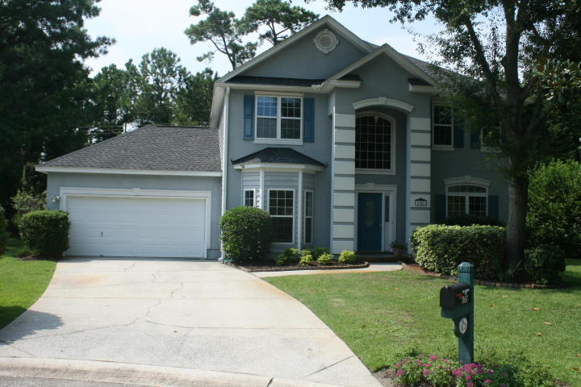
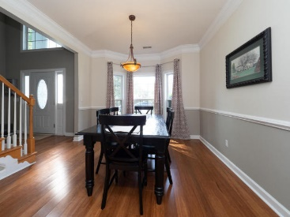
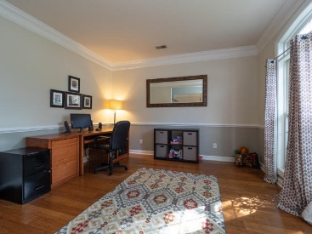
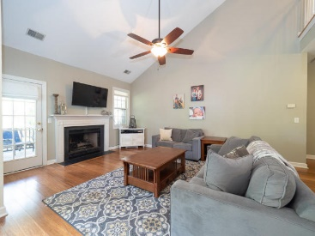
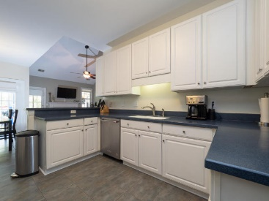
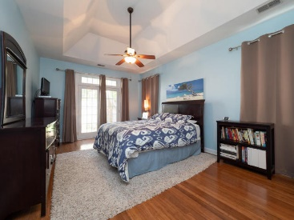
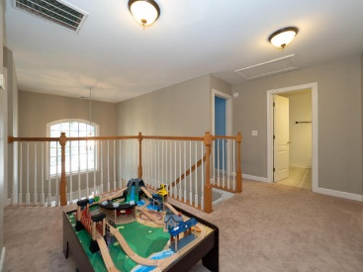
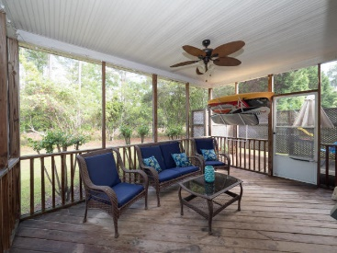
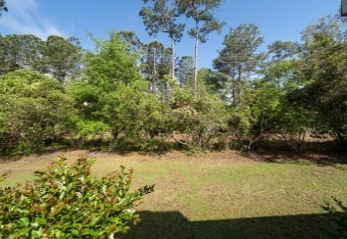


1167 Ballyliffen Drive Charleston National | Mount Pleasant, SC 29466 MLS# 18011677 | $399,900
New Price!!
Open House Sat and Sun 1pm-4pm
True 4 Bedroom on a Cul-De-Sac in the Beautiful Golf Community of Charleston National. Attend new and sought after Carolina Park Elementary. Spacious Master on the First Floor, with 3 additional Bedrooms and a Loft upstairs. Separate Dining Room and Private Office also on Main Floor, Family room with Fire Place. Newer roof, hardwood floors downstairs and stainless steel appliances. Roomy 2 Car Garage, Private lot with Wooded Area behind, Screened in Porch and Multiple Decks for Entertaining and Enjoying. Neighborhood is conveniently located near Roper Mt. Pleasant Hospital, Wando High School, Neighborhood amenities include, available golf membership, neighborhood pool, play park and tennis courts. Well fed irrigation system. Flood Ins. not required. 15 mins to beach.
Jane Manuel
(843) 324-2838
jane.manuel@cbcarolinas.com www.cbcarolinas.com
Coldwell Banker Residential Brokerage | 1127 Queensborough Blvd. 103 | Mt Pleasant, SC 29464

