Slide 1
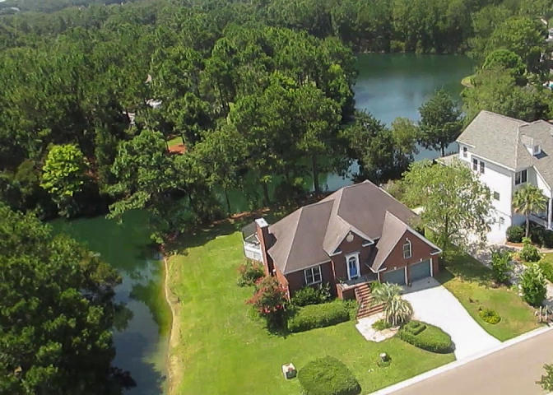
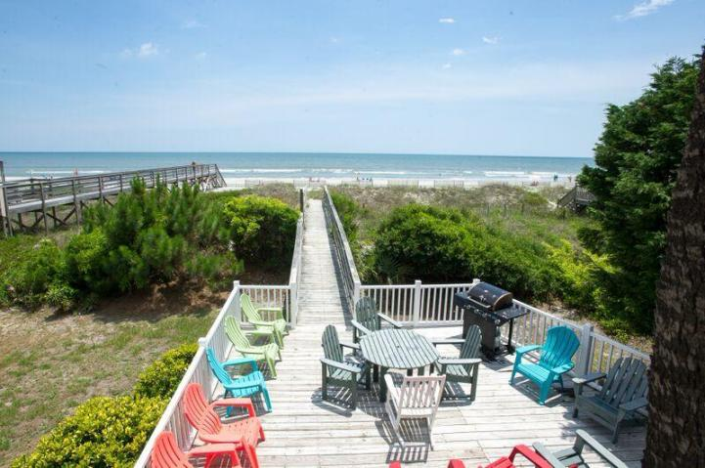
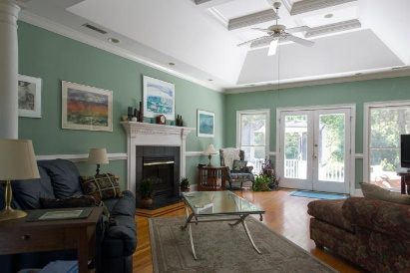
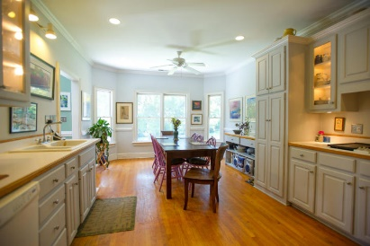
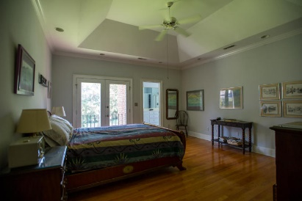
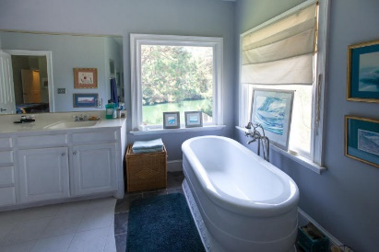
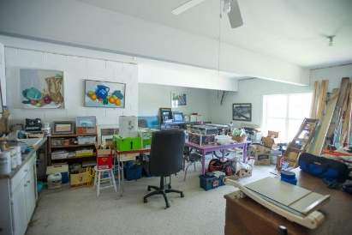
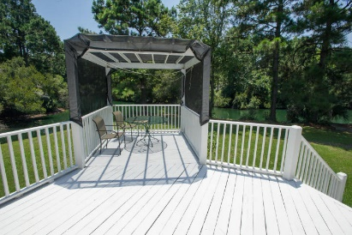
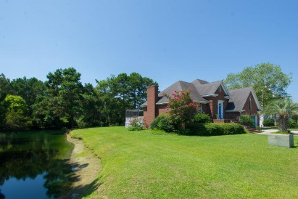
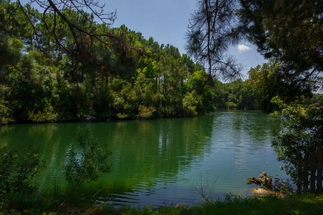


BEST DEAL ON THE WATER ON JAMES ISLAND
1169 Sea Eagle Watch
Seaside Plantation
Charleston, SC 29412
MLS# 15019566 ~ $455,000
3 Bed | 2 Bath
SEASIDE ESTATES*** BRICK home in well sought after and premiere Seaside Estates section of Seaside Plantation. Has a great open flow of space, a large garage and approximately 500 square feet of work space NOT included in the square footage. Only 5 steps to the landing to the large master bedroom with beautiful water views on this beautiful creek. Large garden tub overlooking some of the prettiest nature views on James Island. Home has beautiful charm, great working kitchen with views galore. Fresh paint. cherry inlaid floors updated kitchen. Best buy in Seaside Plantation/close to Folly Beach and the new expanded Harris Teeter. Neighborhood dock. Seller to pay up to All new plumbing in home, Tankless Water, Flood insurance is currently assumable at $560. seller to pay 5k in closing/upgrades
Bryan Thompson
Office - (843) 769-5100
Mobile - (843) 452-1686
bryan.thompson@agentownedrealty.com
www.bryanthompsonrealestate.com
AgentOwned Charleston Group | 902 Savannah Hwy | Charleston, SC 29407-7802

