Slide 1
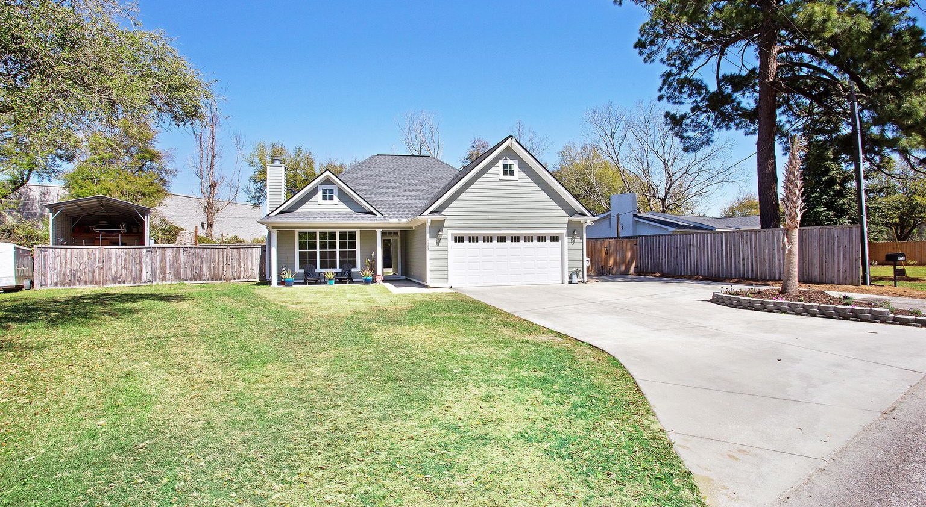
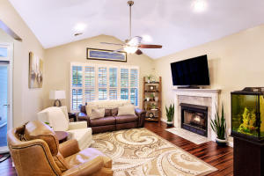
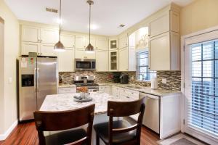
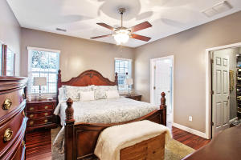
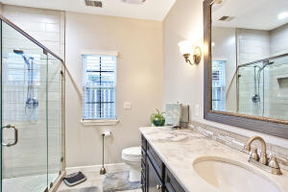
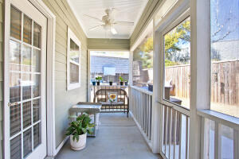
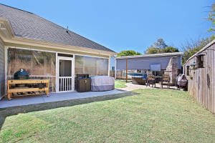
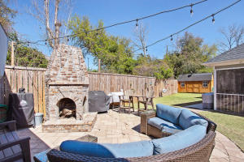
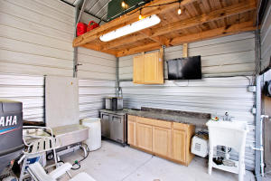


Price Reduced
New Price!
1169 Carter Avenue
Louise Terrace
Mount Pleasant, SC 29464
MLS# 21009046
$595,000
Be close to most of your daily shopping needs in this Mt Pleasant, well designed 3 br/2ba house with hardiplank siding and lots of extras like: granite counter tops, gas range , gas fire place, beautiful bamboo flooring, fenced back yard with two large gates for access, fire pit with large deck and running water-great for entertaining, two storage sheds that are powered and one large enough to house a motor home or boat, large concrete parking area adjacent to garage, heated/cooled garage, top grade Amana 18 seer hvac system, appliances/security that can be controlled remotely, lots of space in attic (could be finished room), and more. Bonus features-great schools, beach approx 10 minutes away, no HOA, and no flood insurance required (verify). Need to see!
Check out the video walkthrough: https://www.youtube.com/embed/XW0Ys3lJ5fo
Carey Budds
843-475-1505
cdft73@aol.com
Jerry Wise
843-442-7633
jerrywise03@gmail.com
ERA Wilder Realty, 125-F Wappoo Creek Dr, Charleston, SC 29412

