Slide 1
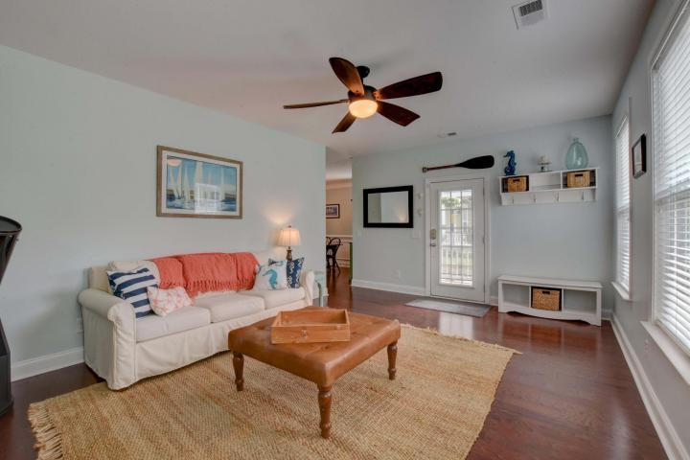
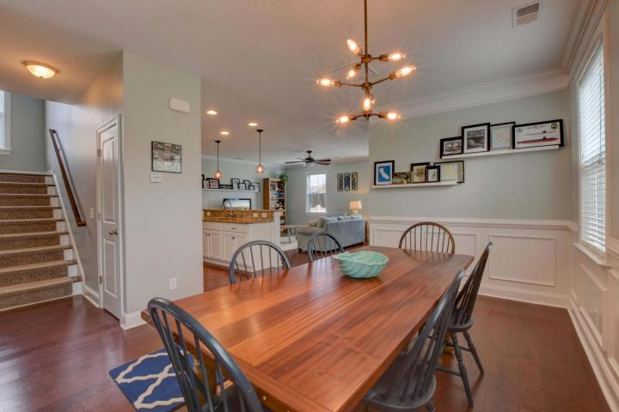
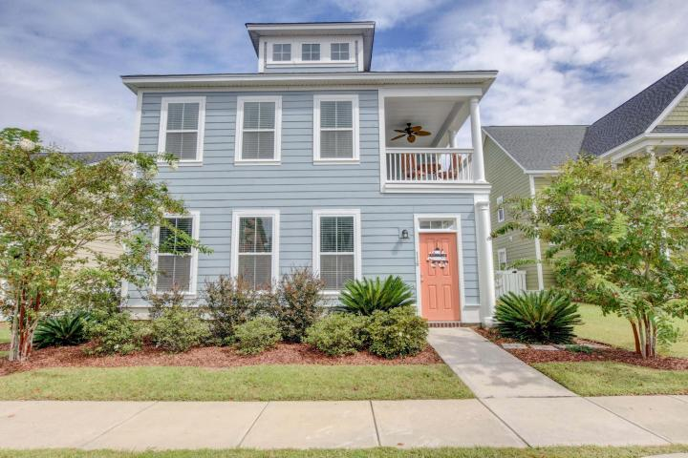
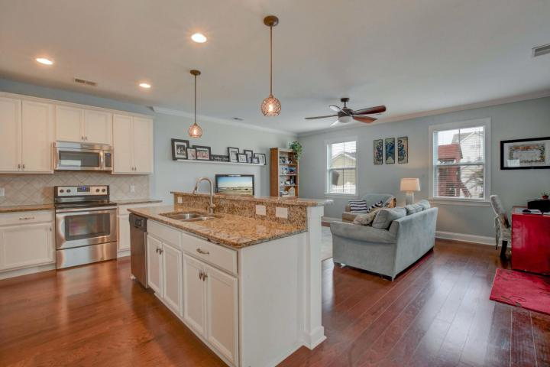
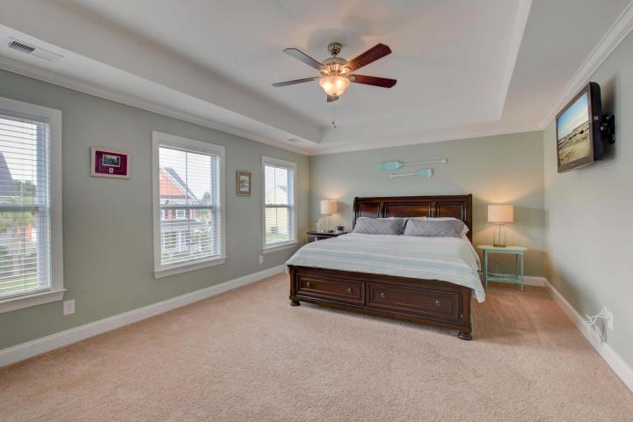
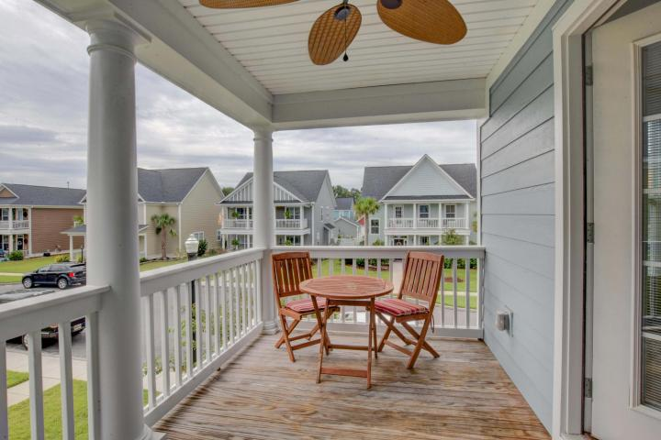
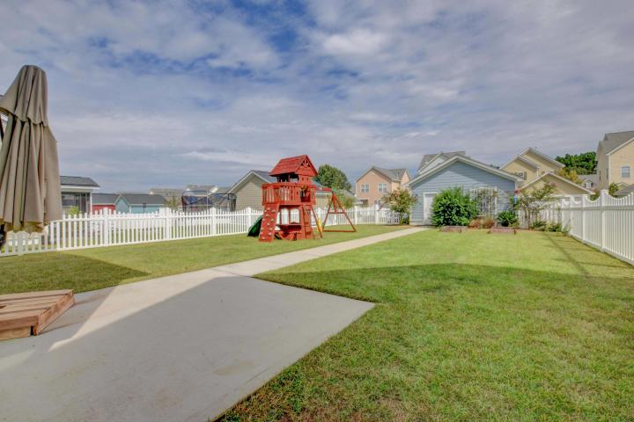
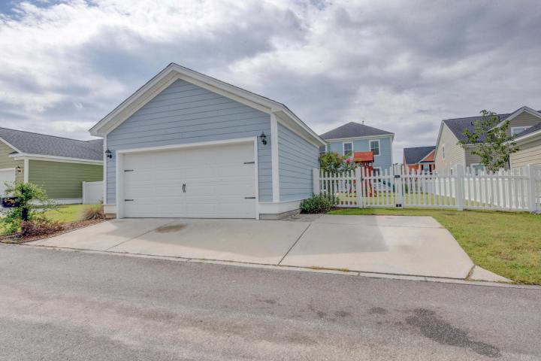

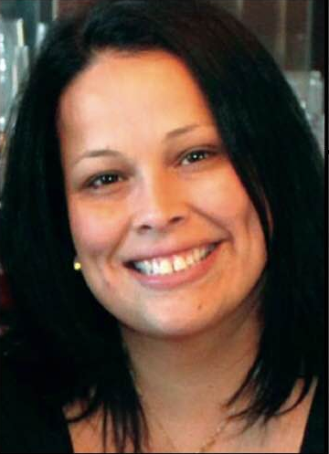
Come See This Home Today!
Gorgeous Better Than New Construction!
116 Amaryllis Avenue
White Gables ~ Summerville
MLS# 17025347 ~ $265,000
Motivated sellers!
3BR 2.5BA is perfect for any family. The Magnolia is a spacious & the perfect setting for entertaining & BBQs in the large backyard. Inside, find first the family & a formal living room. The kitchen is open to the family room & dining room with gorgeous granite center island. Upstairs, master suite has a huge walk-in closet, garden tub w/dual vanities, water closet & stand alone shower. Master bedroom has its own private balcony! Every home is built to Energy Star standards! Don't miss out on calling this your home! Amaryllis is famous for the largest yards in white gables, don't let this one slip away! Close to all every day conveniences and DD2 Schools!
Lisa Horan
Full Service Realtor
843-501-8856
lisaghoran@gmail.com
AgentOwned Premiere Group • 100 Crowfield Blvd • Goose Creek, SC 29445

