Slide 1
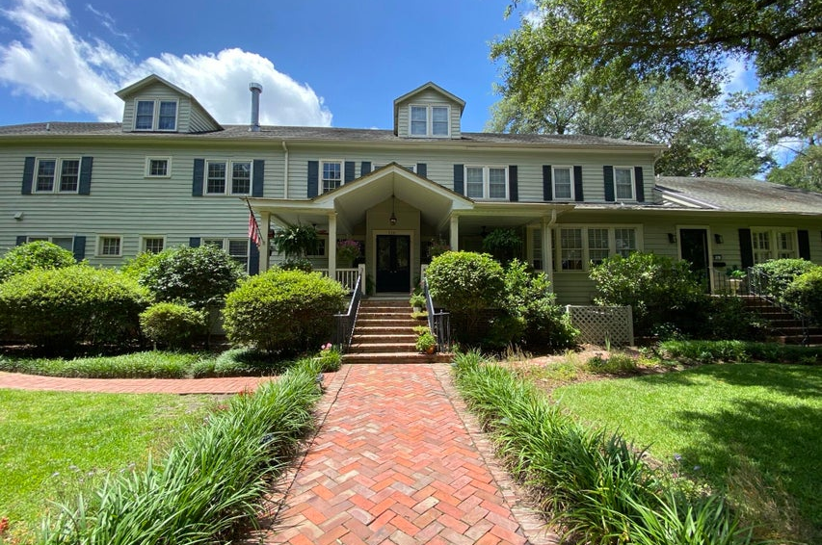
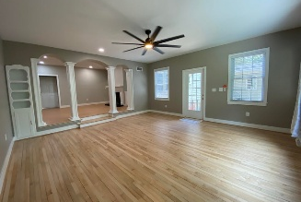
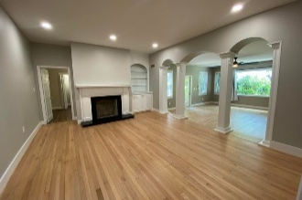
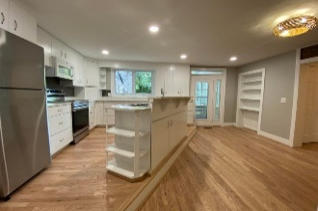
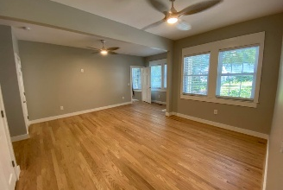
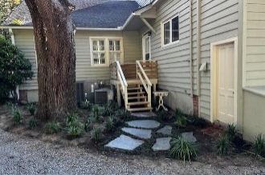


Squirrel Inn Rental – Furnished or Unfurnished
$15,000 Agent Bonus
with ratified contract by 4/15/18
116 W 5th South St B
Historic District
Summerville, SC 29483
MLS# 25017218
Now Offering at $3,000
$12,100 Under
Recent Appraised Value
This can be an unfurnished rental home or can be furnished & offered at a 30 day minimum Great opportunity to live across from Azalea park & easily walk to downtown to many restaurants, shopping,& Hutchinson Square activities. Walking distance to many Summerville churches. This 1990sq.ft unit has just been renovated & is ready for occupancy. It is a 2 Bedroom unit & could easily be used as 2 primary bedroom/bath suites. The 3rd room is a large utility room that could be used as an office or sewing or hobby room. Work from home opportunities The kitchen is terrific with new appliances & granite counter tops & cabinets galore. There are 2 pantry closets. Wood flooring throughout plus tiled bathrooms. Enjoy gorgeous picture window (measures5'x 8'8'') that looks out to lush local landscaping. You couldn't look for a more accommodating living space. Rooms measure: Kitchen/Breakfast Room is a (15' x 13') triangle and adjoins the triangle kitchen at similar size... Utility-Hobby-Sewing-,etc. room is (10' x 10'6'')...Long hall is perfect for your computer work (18' x 5..5') ...
Dining room/Reading room (14' X16') opens to the lobby of the SQUIRREL INN with doorbell for entry plus mail delivery in the Inn vestibule and then enjoy the fabulous Living Room (17.5' x18.5') Master bedroom (17'4'' x13'4'') master bathroom is tub ,walk-in shower, double, vanity (all new) very good closet space and private exterior entrance. secondary master bedroom/ bath is (13'9'' x 13''9'')includes walk-in closet and private bath. Great storage throughout and Enjoy your deck off the kitchen, or private entry from primary master Bedroom, or small porch off the living room. or come swing and rock on the front porch while overlooking W 5th Street and the Azalea Park. Tennis and pickle ball courts are a very short walk away. Owner has flexibility on rental term but no short term rental is available.
Candace Pratt
843-696-5508
candace@prattandco.com
www.prattandco.com
RE/MAX Southern Shores
9209 University Blvd, Charleston, SC 29406

