Slide 1
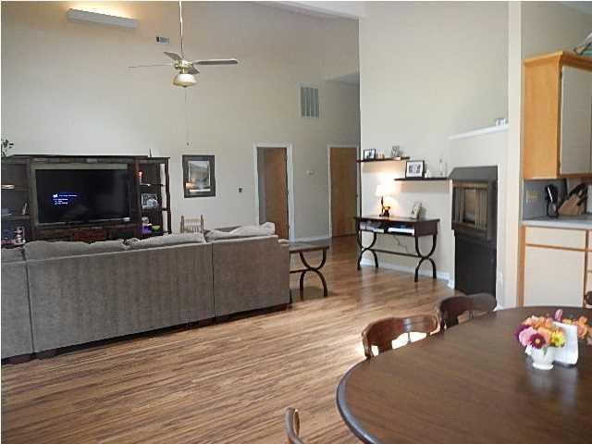
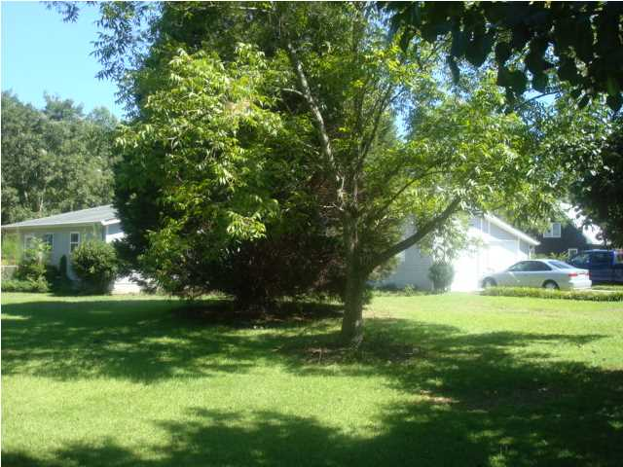
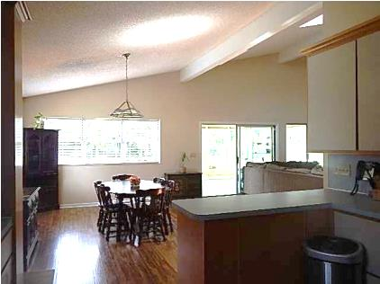
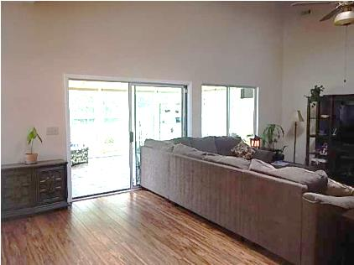
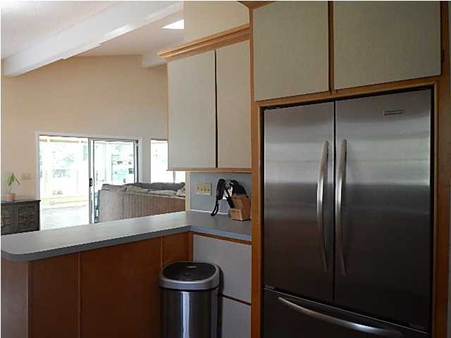
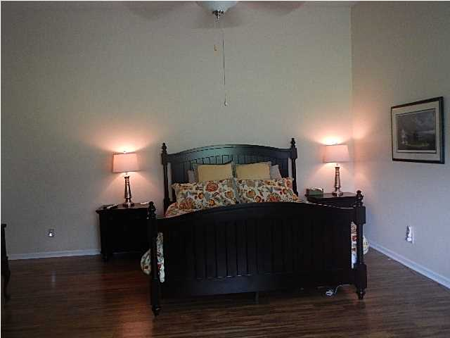
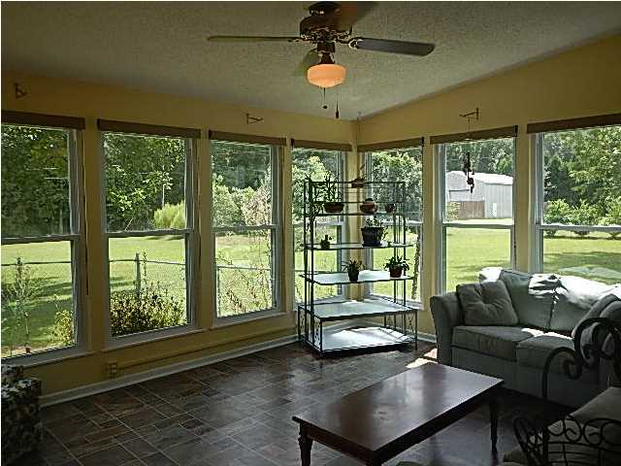
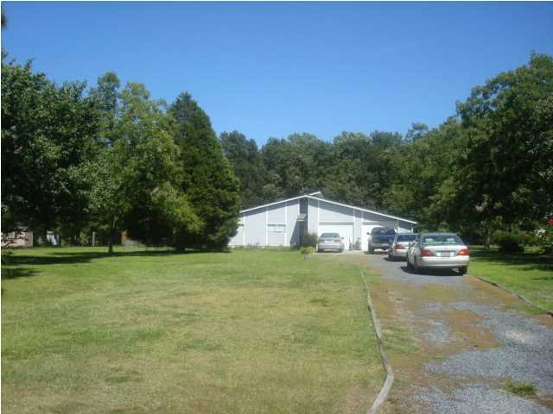
Open House Saturday Sept 27th 1-4
116 Chaussee Blvd - Summerville
Modern designed home on approximately two acres of beautifully landscaped country land which backs up to woods. Deer and other Wildlife is abundant according to owners who enjoy watching out their back yard . This home was built with energy conservation in mind by forward thinking owners. The home features an expansive open floor plan which adjoins a roomy back deck and sunroom for enjoyment of the views. Because of it's design, every room has a vaulted ceiling which is most prominent in the main living area. New wood floors updated in the last 2.5 years. Large Skylight in the living room/dining room area. A spacious office can easily be converted and used as a fourth bedroom. Additionally, the office has it's own outside access so it could be used as a home business as well. The kitchen is spacious and features LOADS of cabinet space and drawers with new stove, Dishwasher and Refrigerator. New hot water heater. Skylights are featured in the master bath and secondary bath which is shared by the other two bedrooms. Master bath features double sinks. Master bedroom is very roomy and has huge walk in closet. All rooms have ceiling fans. The home has both city water as well as deep well and multiple sprinkler points which can be used to keep the grounds beautiful. Large azaleas edge the woods in the back and make a beautiful sight in the spring. This is a perfect home for a family who wants the benefits of country living and still be minutes from downtown Summerville. Owner also has built in generator "AS IS" and attachable hurricane planks which can be installed in less than 1 hour. The oversized garage is a handyman's dream. Lots of pegboard, storage and room for work tables. Caire Yelleau is zoned for the award winning Dorchester 2 school district. This neighborhood features large lots and NO HOA. You may park your boat or camper in your backyard and horses ARE allowed! There is not much like this available so make your appointment today to come see this special property. You won't be disappointed! Sellers are offering a 1 year home warranty through American Home Shield (AHS) for an acceptable price by seller at seller's expense.
Rick Willis
843-327-3017
rwillisteam@gmail.com
The Group, LLC

