Slide 1
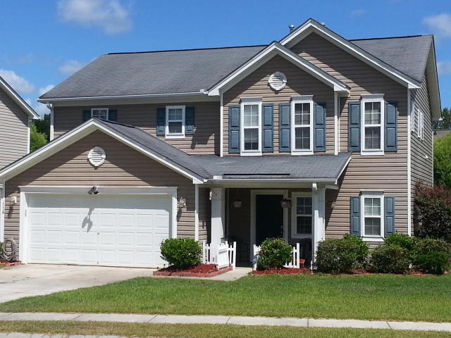
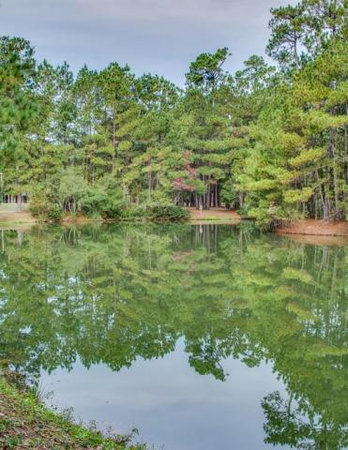
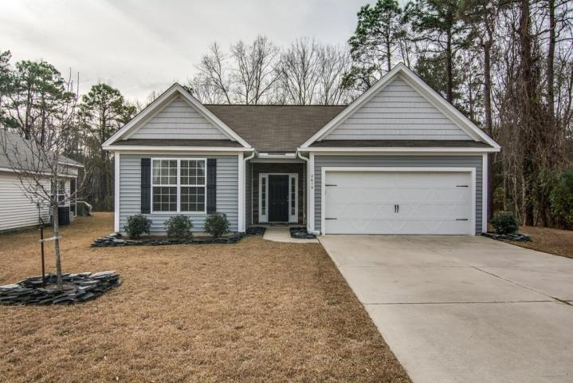
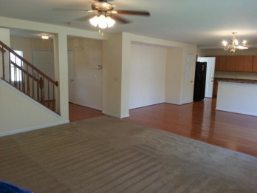
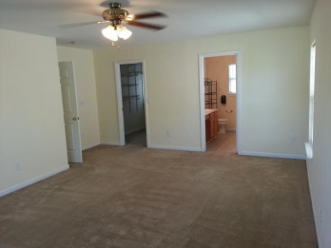
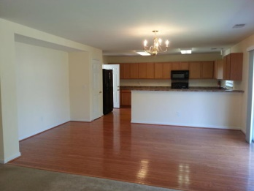
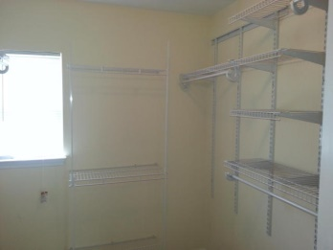
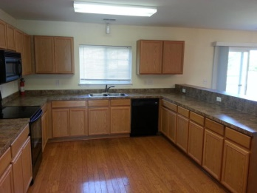
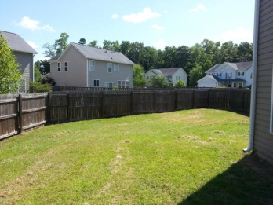
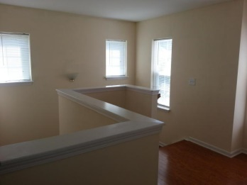
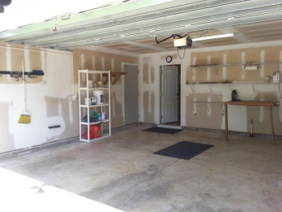

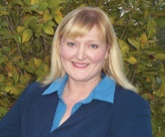
· Priced to Sell ·
116 Education Blvd
· Eagle Run ·
· Ladson ·
· MLS# 15014409 ·
· $199,999 ·
Location…
Location…
Location!
Charming & Comfortable Living
Move-in ready, 3 bedroom, 2.5 bath home features an open floorplan with kitchen, dining area and family room downstairs. The kitchen is well appointed with 42'' cabinets, dishwasher, microwave & Fridge.
The upstairs master has a huge walk-in closet and private bath. There are two well-sized secondary bedrooms with good closet space and laundry room upstairs.
Large 2 car garage and big fenced-in-yard. Eagle Run is a great neighborhood with a Ladson address, but located in the heart of Summerville, and right across the street from Award winning Dorchester II Schools, Oakbrook Elementary and Oakbrook Middle School.
1.4 mile to Walmart, shopping, dining, medical facilities and easy access to Ladson, Dorchester, Boeing, Airport and freeways. Priced to sell. Easy to Show. Quick close possible.
Julie Johnson
843-826-0088
juliemjohnson123@Gmail.com
AgentOwned Realty Premiere Group · 1800 Old Trolley Rd · Summerville, SC 29485

