Slide 1
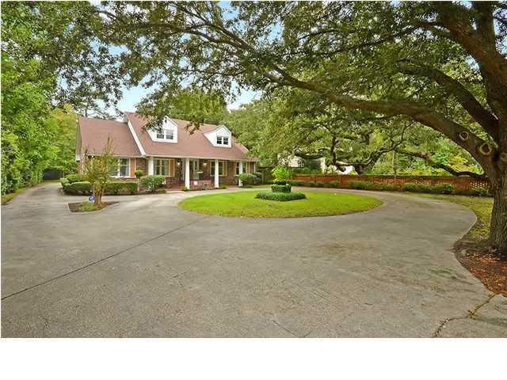
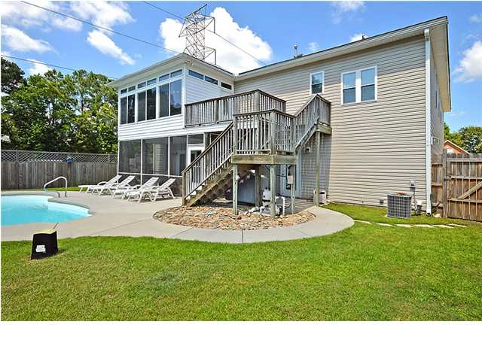
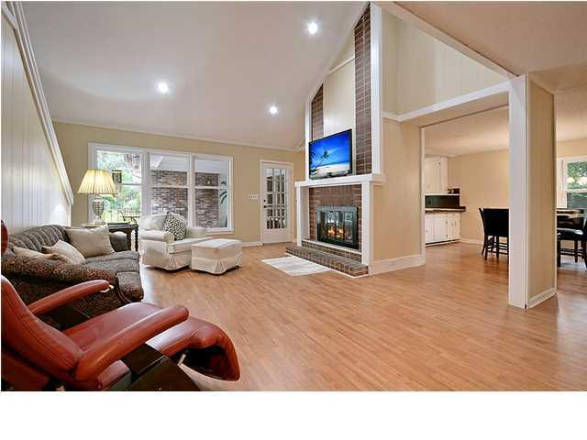
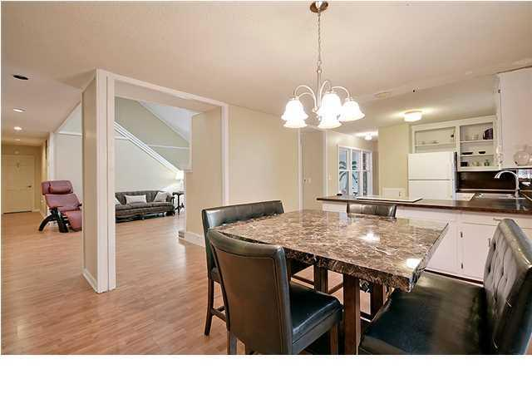
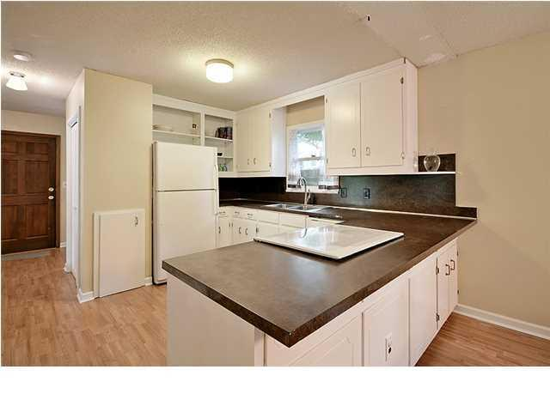
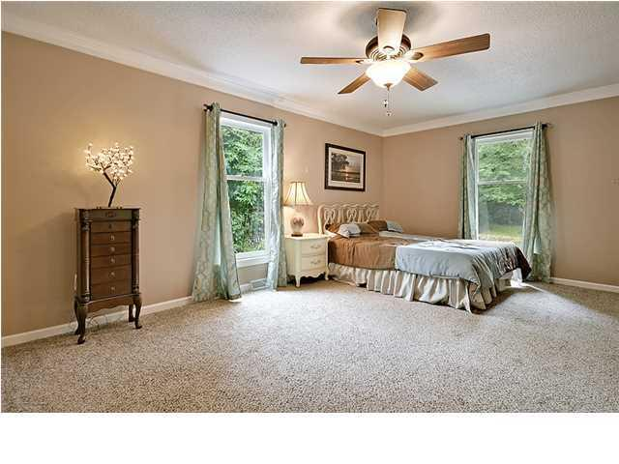
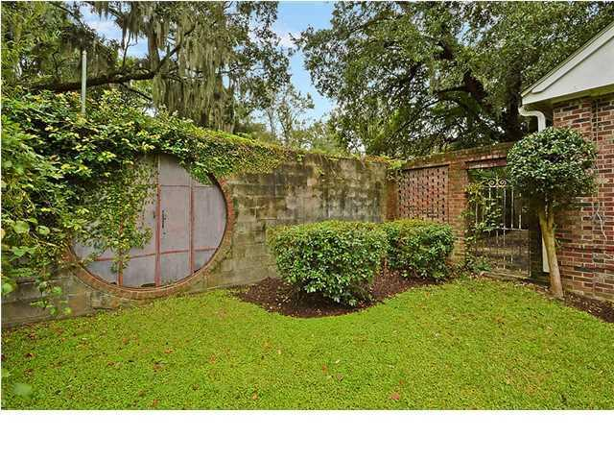
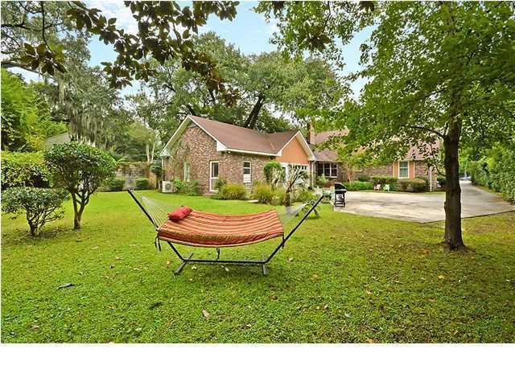
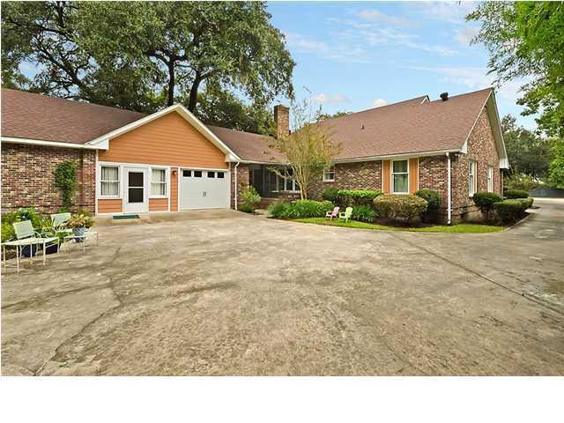
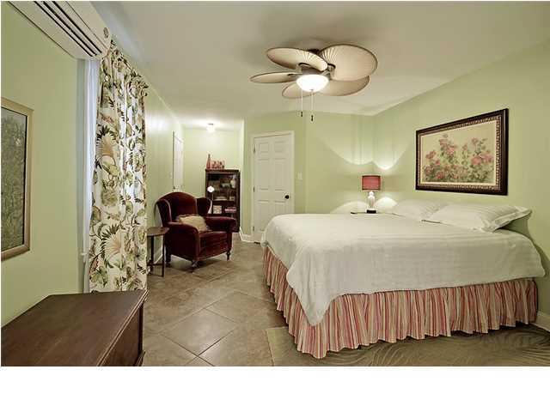

Price Reduced!
Wappoo Heights Open House
Saturday 11-3 & Sunday 12-3
116 Folly Road Blvd ~ Charleston ~ MLS# 1426112 ~ $599,000
Wait until you see this wonderful surprise that awaits you in Wappoo Heights with five bedrooms, four bathrooms and 3,677 square feet of living space. Driving up to the home you'll see a majestic Live Oak tree creating a shady canopy over the circular driveway that leads up to the front covered porch. With a mother-in-law suite on the other side of the attached garage, this home is an ideal solution to give guests or visiting family a private and fully functional living arrangement. In the main house, the family room features a soaring vaulted ceiling, recessed lighting and a beautiful brick fireplace. The open concept floor plan flows into the eat-in kitchen where there's a butler's pantry, plenty of counter space to cook and a large window in the breakfast nook to let lots of natural light in. The formal dining room and living room offer additional areas that are perfect for entertaining and everyday living. The owner's retreat is located on the first floor and is extremely spacious. Another bedroom is located on the first floor while there are two more and a bathroom on the second level. The renovated in-law suite with its own entrance is one that will have your friends and family looking to book reservations at your home. The kitchen boasts new cabinets, countertops, stainless steel appliances, ceramic tile flooring and a breakfast bar that runs into the living area. The bedroom also has tile flooring and a gorgeous en-suite bath with a beautiful vanity, walk-in shower and oversized soaking tub. The outdoors can be enjoyed from front or rear patios while the wrought iron doors, brick fence and side courtyard add to the home's character and charm. Updates to the home include three new HVAC systems, a new hot water heater and fresh paint. Just minutes from shopping, Starbucks, dining, the library, MUSC, downtown and the public boat landing, this location is one that you will just love. With such a lovely home in a convenient location, don't let this one pass you by!
Call/email for details:
Stephanie Toole (843) 277-4498 Stephanie@MattONeillTeam.com
Angel French (843) 367-5333 Angel@MattONeillTeam.com
Tara Hasenberg (843) 830-2880 Tara@MattONeillTeam.com

