Slide 1
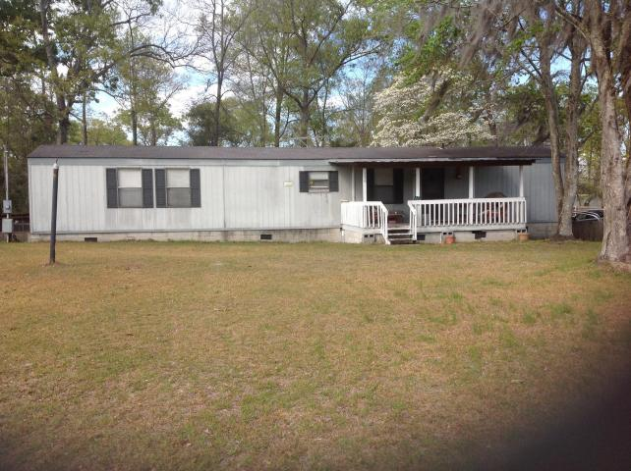
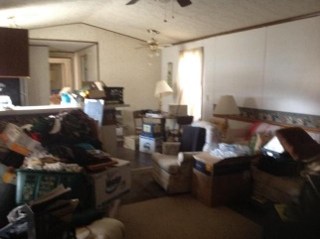
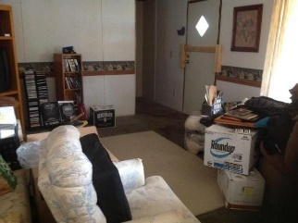
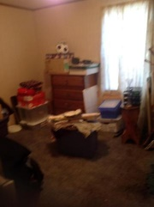
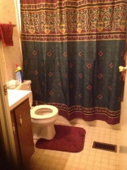
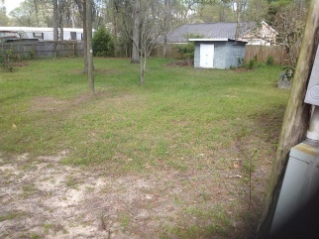
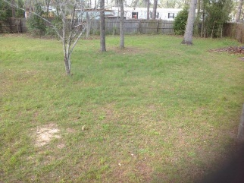

Great property just minutes from Little Cathead Boat Landing!
116 Moncks Corner Road
Eutawville, SC 29048 | MLS# 17008727 | $49,900
2 Beds | 2 Baths | 924 Square Feet
This 2 bedroom, 2 bathroom home is the perfect size to be either your new home or your new weekend place at the lake!
Book an appointment to see it today!
Carla C Davis
Mobile - (843) 437-4873
gaweber@tds.net
AgentOwned Premiere Group
141 A N. Main Street
Summerville, SC 29483

