Slide 1
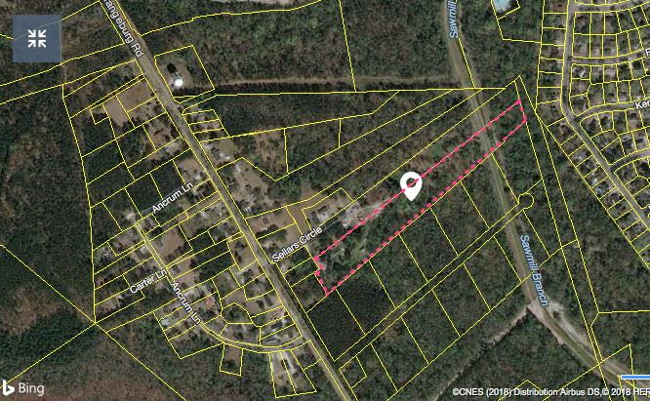
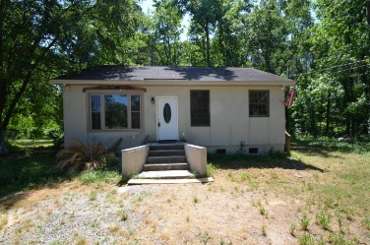
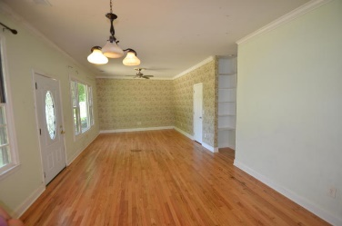
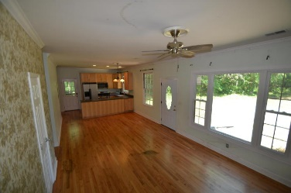
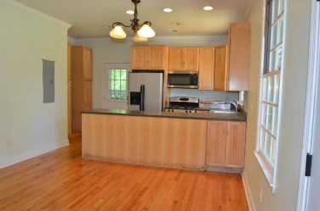
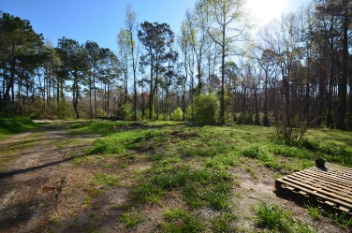
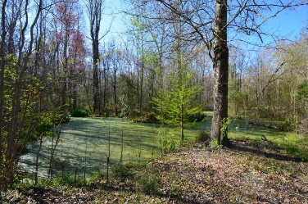
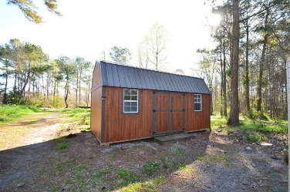
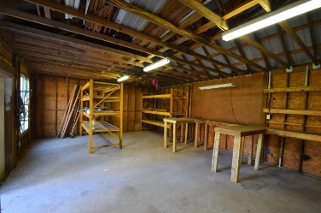

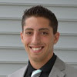

116 Sellars Circle Summerville, SC 29483 MLS# 18007560 $244,000
Just Listed
+
Open House
Saturday, March 24th 11-1
Just Reduced!
Enjoy almost 8 acres of peace and serenity in the heart of Summerville.
Come see the beautiful Heritage Oak Trees and the nice sized pond! There is a two bedroom two bathroom cottage on the property that can be renovated for the long term, or short term to watch your dream home be built. There is a nice shed for storage close to the cottage and there is a workshop/2 stall barn with lofts towards the back of the property. Plenty of room to build as big or as little as you'd like. Bring your horses and farm animals this property is completely fenced. Cottage and other buildings on property are being Sold AS-IS seller will not make any repairs.
Andrew Sorrentino
(843) 371-6218
andrew.sorrentino@agentowned.com
Kelly Rozier
(843) 209-3129
kelly.rozier@agentownedrealty.com
The AgentOwned Realty Co | 902 Savannah Hwy | Charleston, SC 29407
Real Estate • Mortgage • Insurance
www.AgentOwned.com

