Slide 1
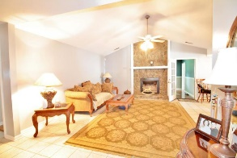
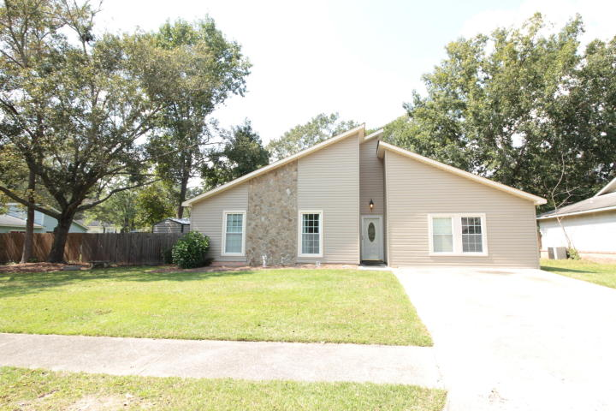
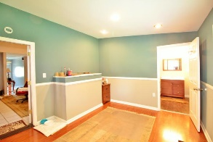
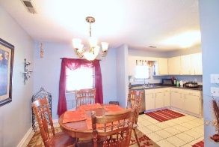
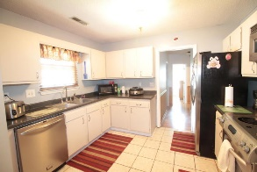
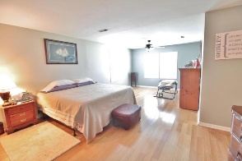
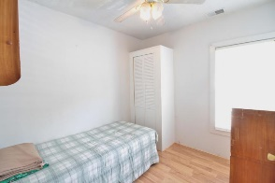
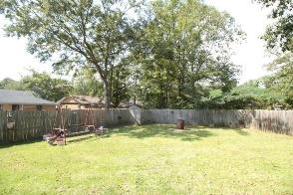
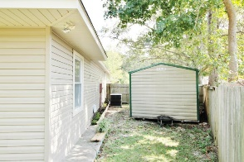
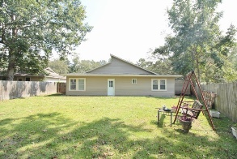
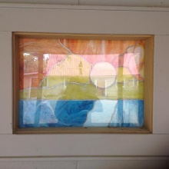

Perfect For A Large Family Or As An Investment Property
116 Surrey Drive
Tramway | Summerville, SC 29483 MLS# 17025946 | $225,000
Welcome home to 116 Surrey Drive! Home is central to I-26, 17A, great restaurants and shopping! This home is unique, large and single story, with plenty of room for large and multiple families, or roommates. This home is also great for rental income potential. The previous garage was converted into 2 small bedrooms, an office/flex space, and a spacious laundry room. Home also has an addition on the backside that could be considered a Mother-in-Law suite, or apartment type space. The master is very large, with a walk-in closet, sitting area and tons of natural light. The great room has cathedral ceilings and a fireplace, that is central to the home. Home has been impeccably maintained including brand new vinyl siding, newer roof, and water heater. Home is also under a transferable termite bond. Also, includes a large shed for plenty of storage or a workshop.
Carla C Davis
Mobile - (843) 437-4873
gaweber@tds.net
AgentOwned Premiere Group
141 A N. Main Street
Summerville, SC 29483

