Slide 1
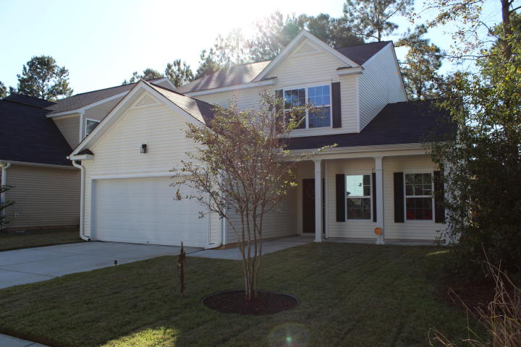
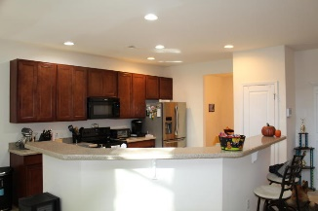
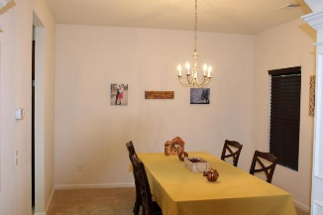
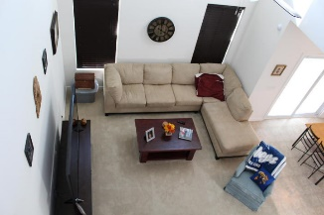

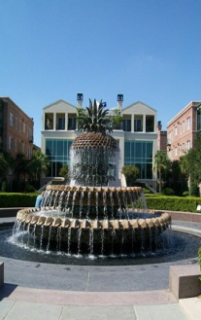
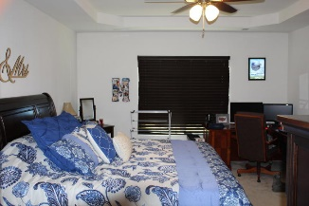
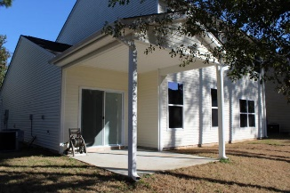
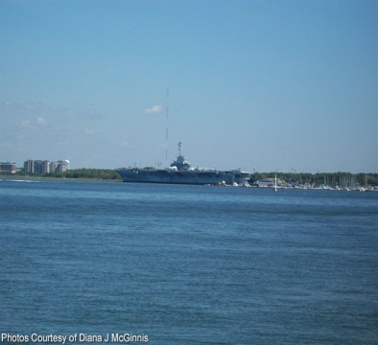
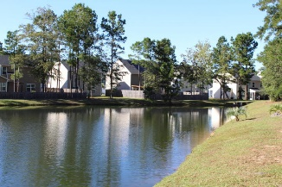


OPEN HOUSE
Sunday Nov 12th 1:00-4:00
$450,000
$450,000
116 Wynfield Forest Drive
Buckshire · Summerville, SC 29485 · MLS# 17029230 · $254,900
Rodney Hancock
(843) 437-1347
rodneyhancock08@gmail.com
mortgageprofessionalsonline.com
This 4 bedroom and 2.5 bathroom home shows like a model! There is an open concept downstairs with a huge master on the main level. The master bedroom also has a deluxe master bathroom with whirlpool tub. The kitchen has 42'' cabinets and stilestone counter tops - it's perfect for entertaining guests!
The covered porch overlooks the pond. Upstairs there are additional bedrooms with a full bathroom and a loft, which is perfect for an office, playroom, bonus room, etc. There is also upgraded wiring throughout the house, a tankless hot water heater and the 2 car garage has a garage door opener.
Pride in ownership really shows throughout this home that was built in 2013.
AgentOwned Charleston Group
902 Savannah Hwy
Charleston, SC 29407
Real Estate ● Mortgage
Insurance ● Business Brokerage

