Slide 1

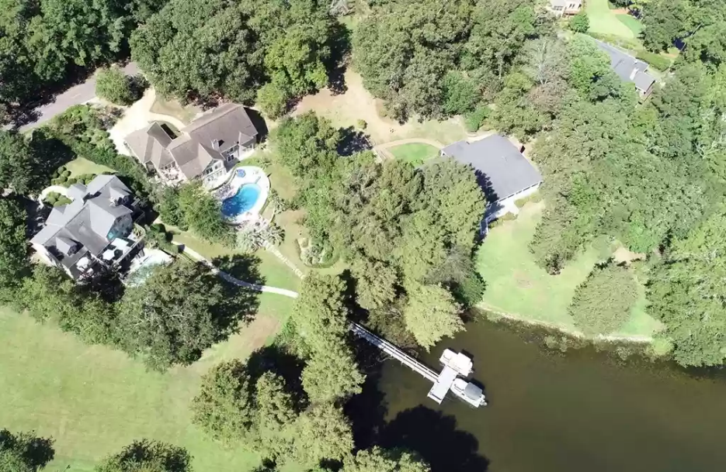
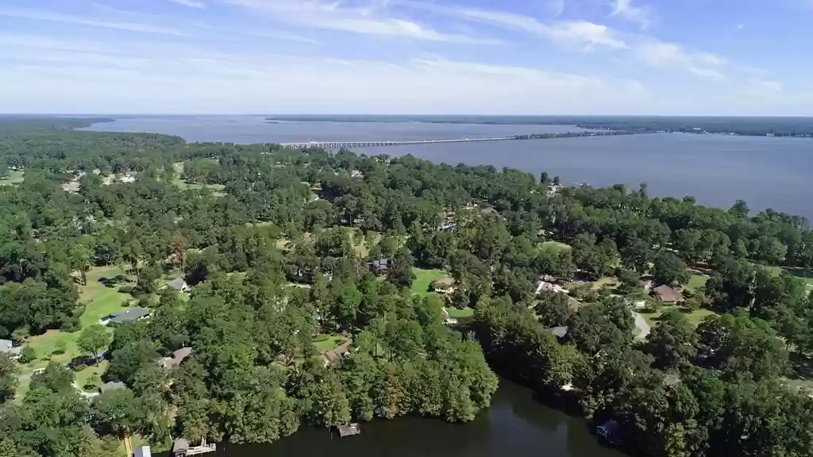
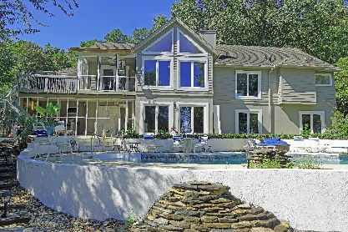
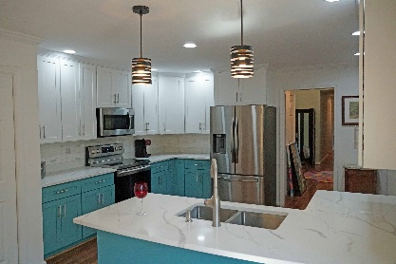
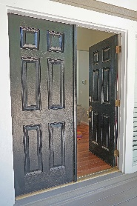
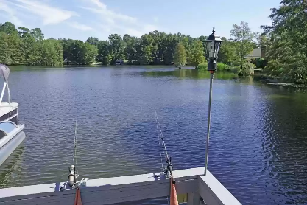
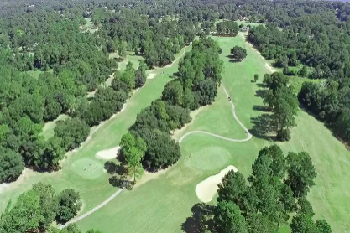

Improved Price ~ Fully Updated
116 Broad River Drive
Santee, SC 29142 ~ $799,000
2021 Updated Lake Marion WATERFRONT 4400 sqft home with pool. Move in ready with all the updates you can imagine. The kitchen is a dream come true. Screened in porch to enjoy coffee over looking the pool and lake.
Enjoy a 3D Tour: https://my.matterport.com/show/?m=ov3idNz3yrs
Lake Homes Realty, LLC
Elloree, SC 29047
www.SCLakeLife.com
Kristie Anderson
(803) 387-9459
kristie@sclakelife.com

