Slide 1


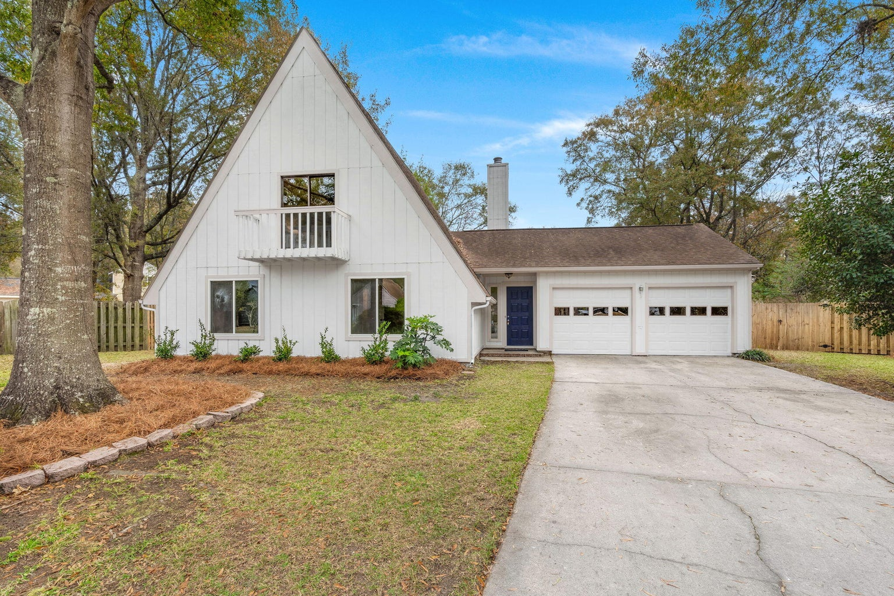
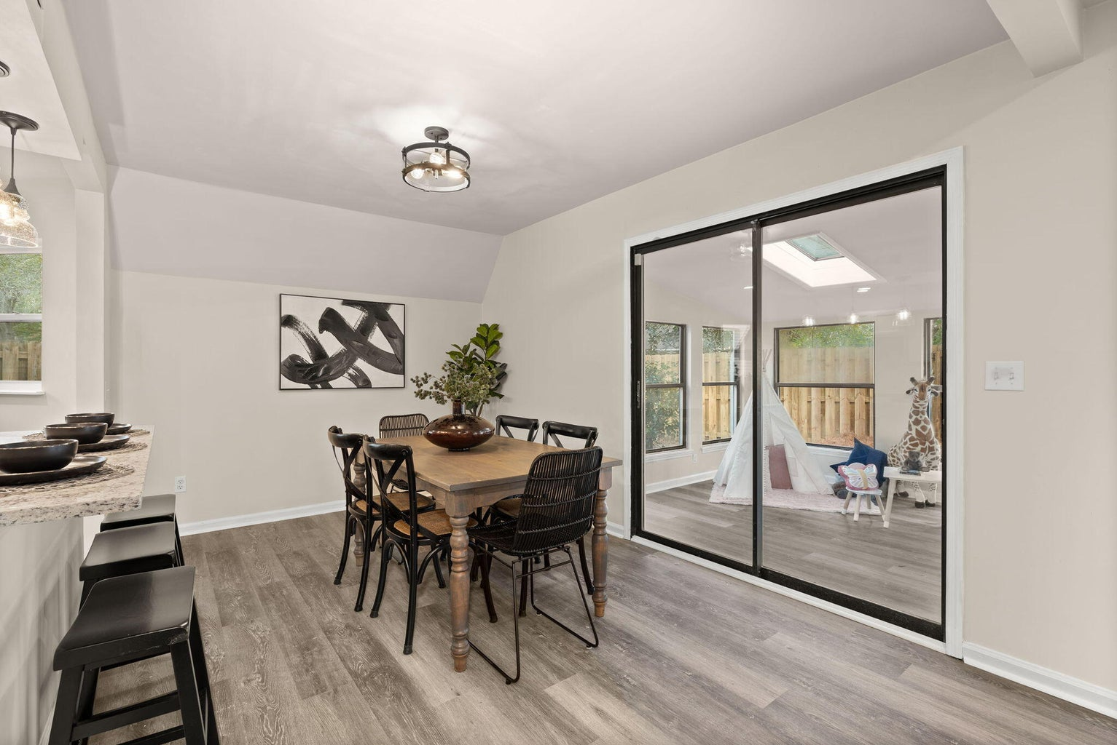
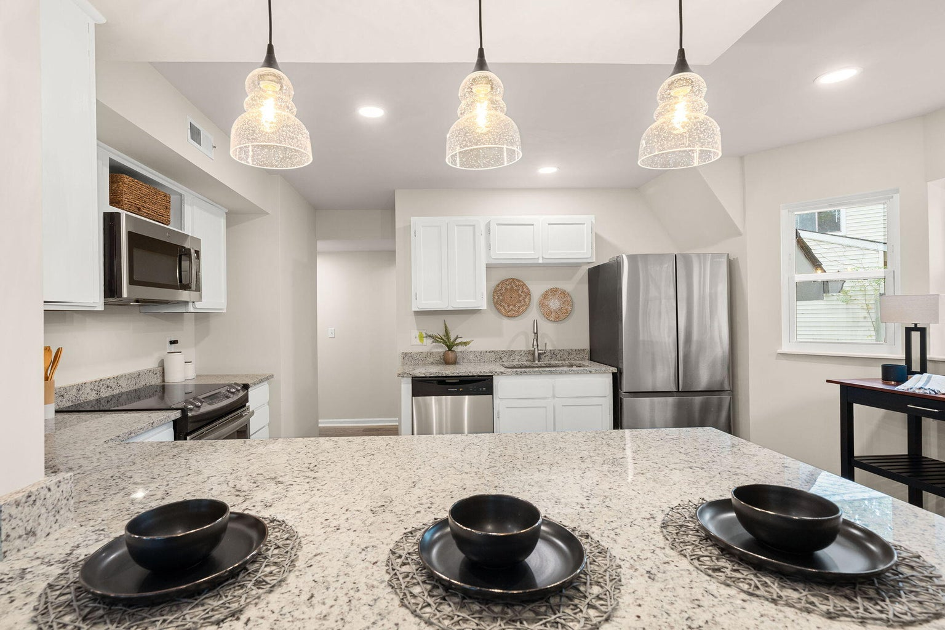
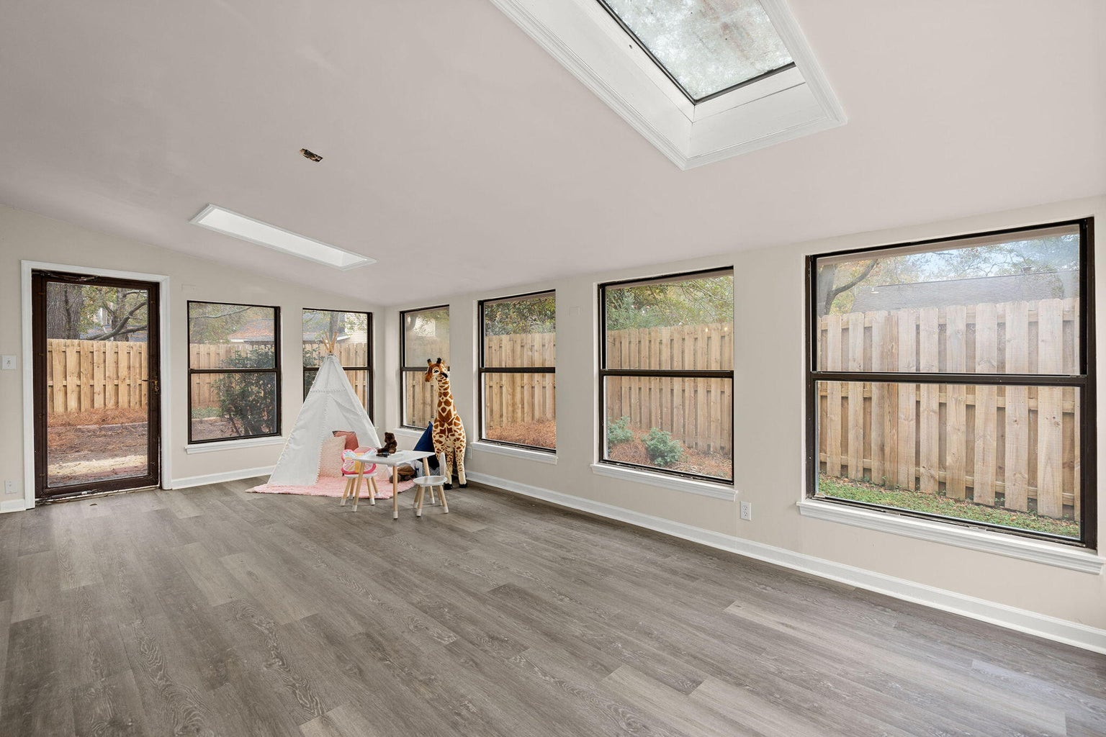
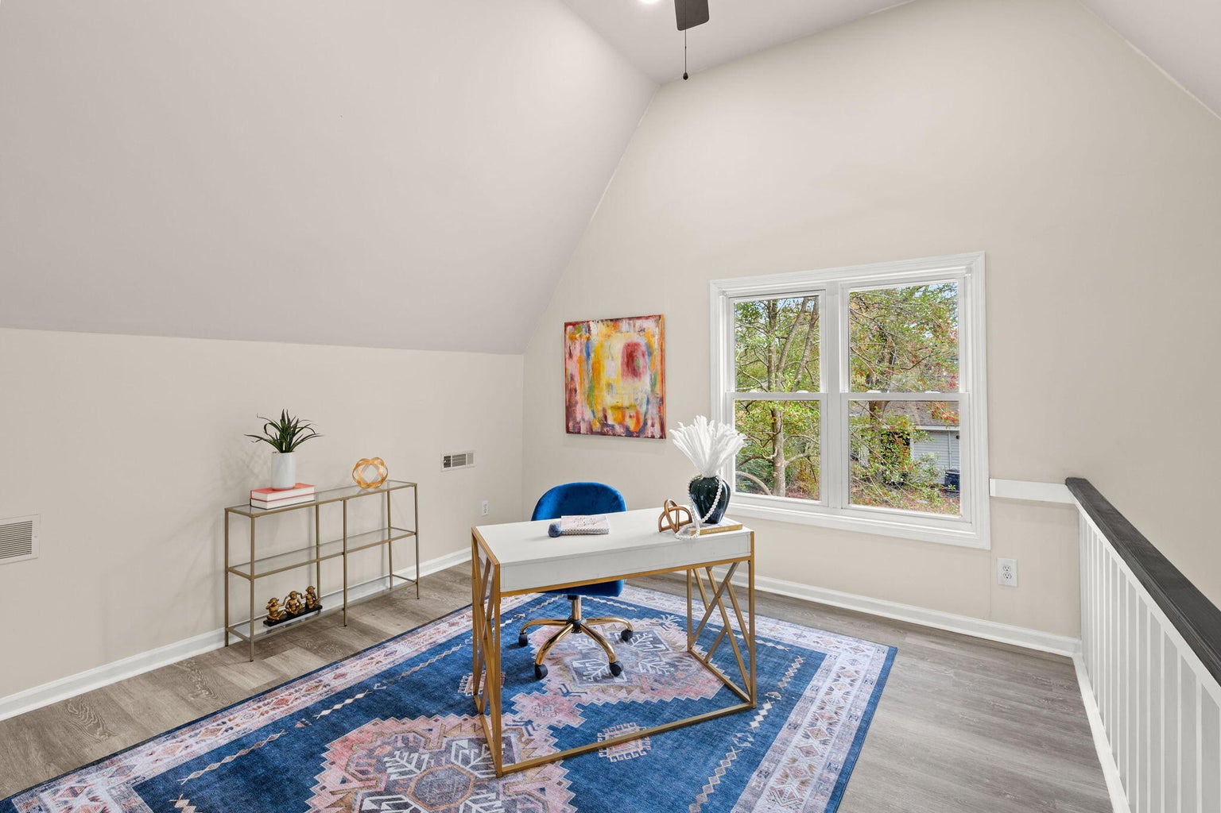
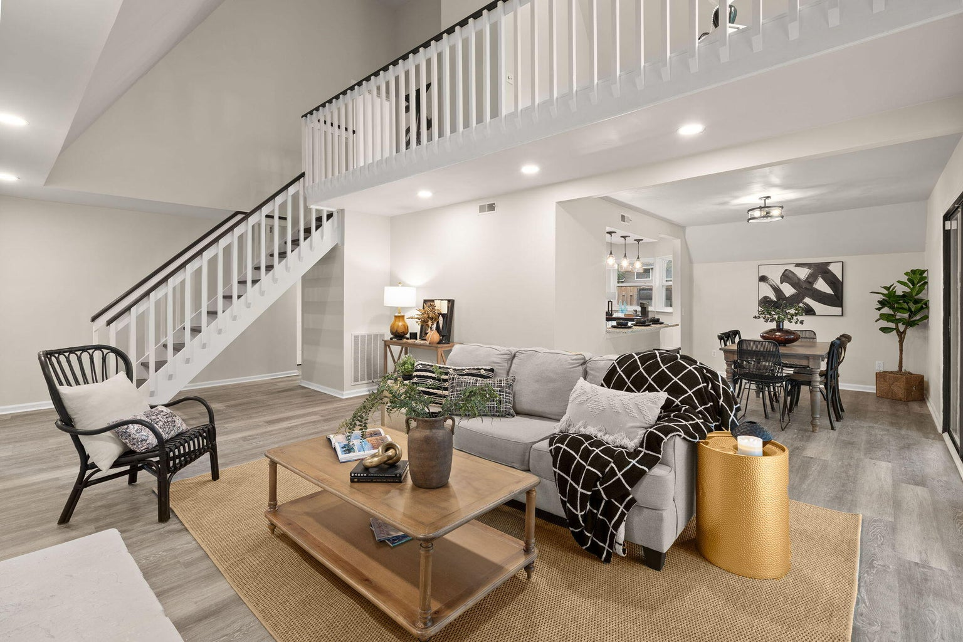
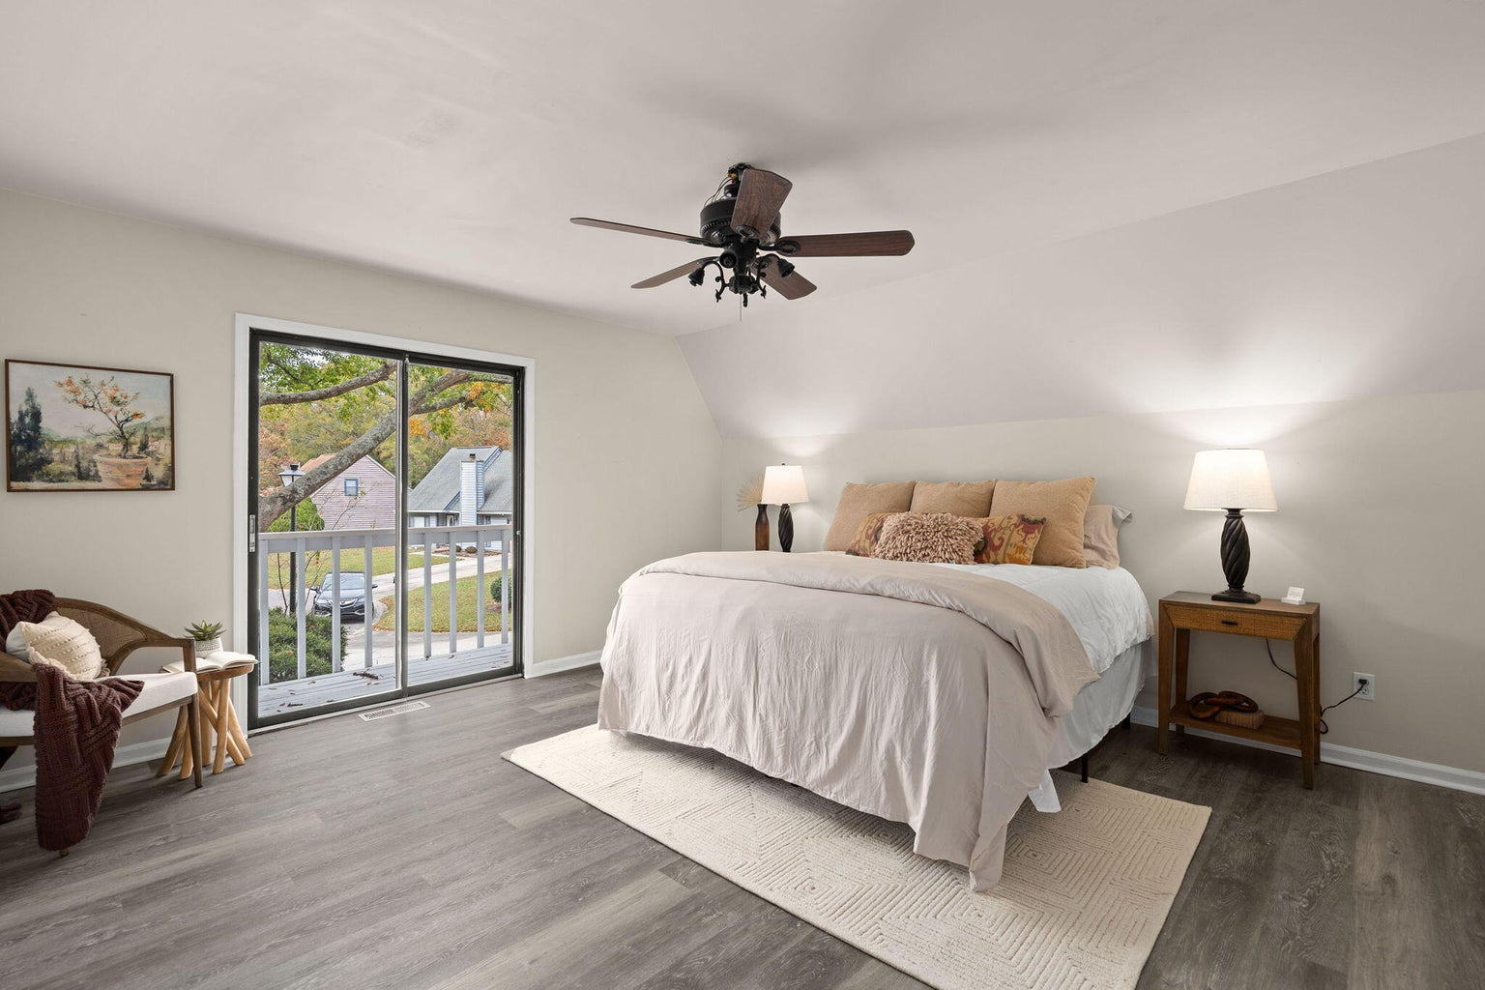
116 Edgewood Lane
Crowfield Plantation
Goose Creek, SC 29445
MLS# 23026138 | $369,900
3 Bed | 2 Bath | 2,039 SF
Why wait for NEW CONSTRUCTION when you can have a renovated home that can close quick???
Come check out this lovely A frame renovated home tucked away on a private cul-de-sac in Crowfield Plantation, one of Goose Creeks premiere neighborhoods. This renovated home offers an open floor plan, soaring ceilings, open balcony, a stone fireplace and a large sunroom perfect for a playroom/flex space. The sunroom is large and easy to access. The sunroom is approximately 278 square feet and does not have HVAC, but it has been included in the total square feet as it offers a ton of extra living space. Some of the many upgrades include, all new luxury vinyl plank flooring, freshly painted interior and exterior, granite counter tops and all new stainless steel appliances in the kitchen.
Leah Rust
The Boulevard Company
806 Johnnie Dodds Blvd.
Mount Pleasant, SC
leahmrust@gmail.com
843-709-9211

