Slide 1
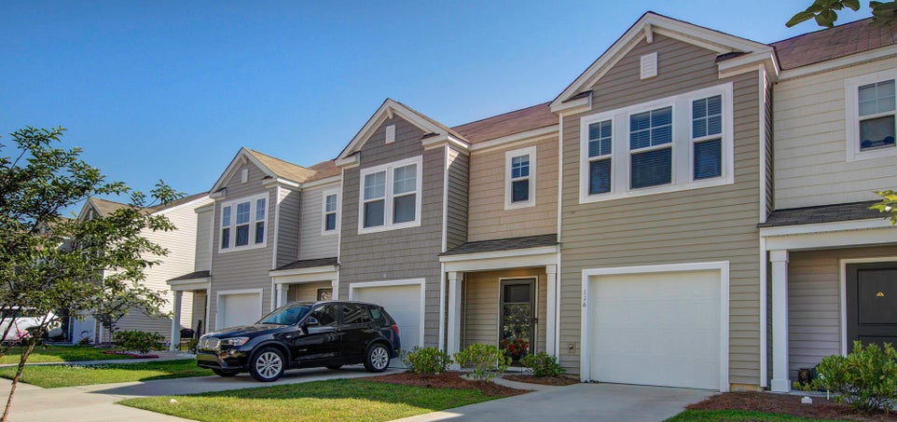
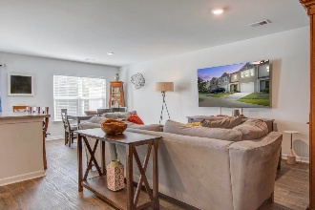
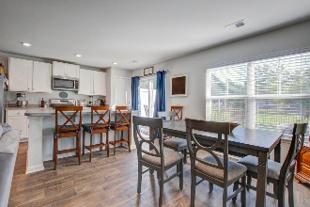
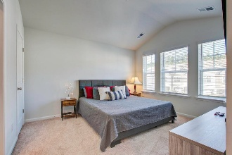
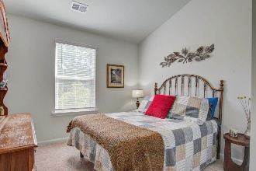
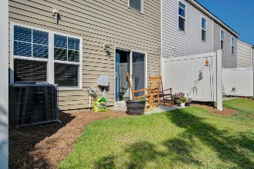


Move In READY Townhome
116 Gaura Lane
Mallard Crossing | Summerville, SC 29483 | MLS# 24029438 | $276,399
This Dillon floor plan is a low-maintenance townhome with an open floor plan built in 2021. It offers 3 bedrooms and 2.5 baths. As you enter, you'll be greeted with LVP flooring throughout the main living areas, a kitchen equipped with stainless steel appliances and large kitchen island great for entertaining. The second floor boasts a large master suite w/ a nice size walk in closet, secondary bedrooms with a shared bathroom and laundry area. Small loft area off of master suite. Seller will include refrigerator with an acceptable offer. This home provides quick access to shopping, dining, schools and entertainment.
Sharee' L. Washington
843-475-0399
sharee@shareewashington.com
www.schomespecialists.com
Carolina Elite Real Estate | 706 N Cedar St | Summerville, SC 29483

