Slide 1
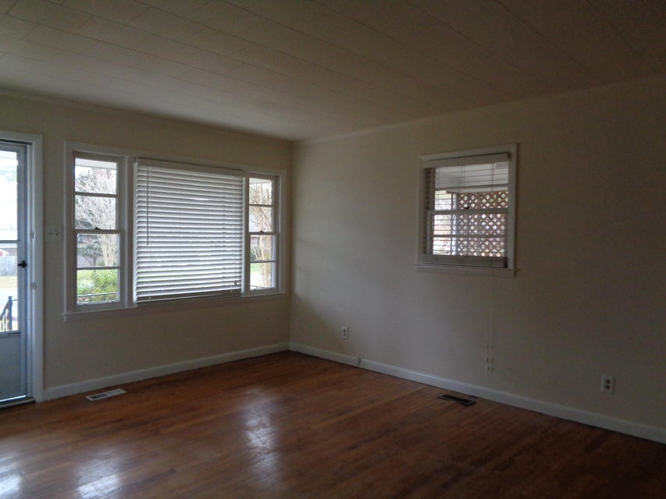
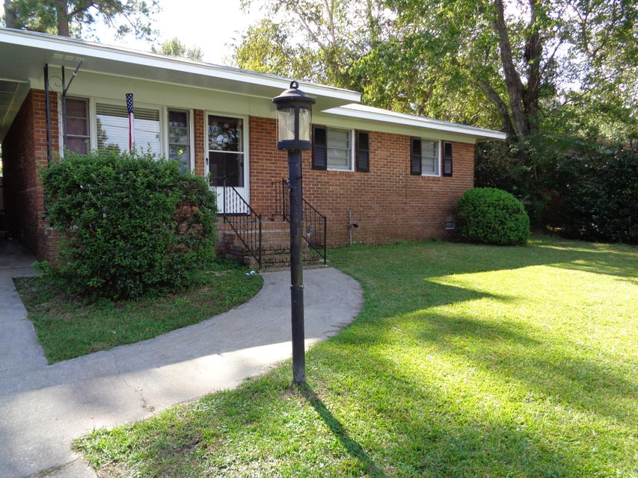
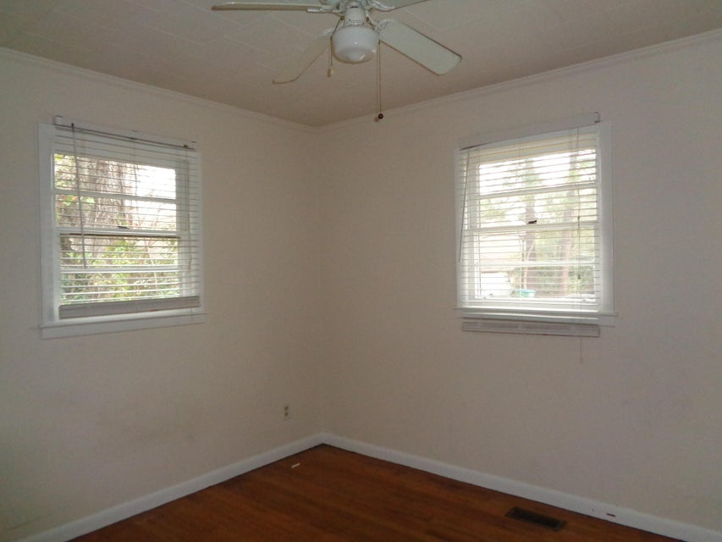
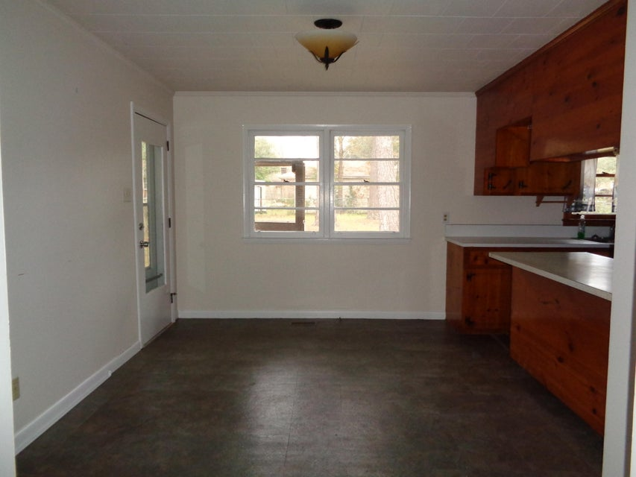
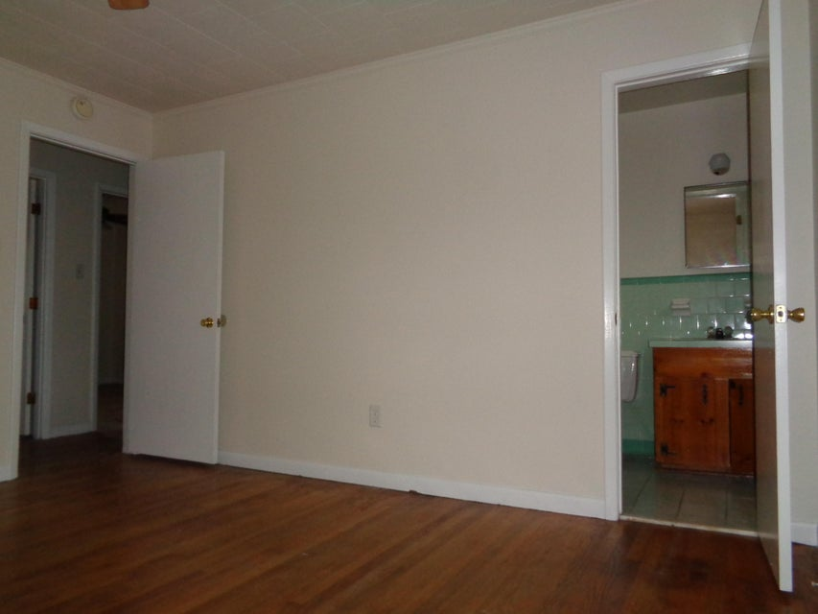
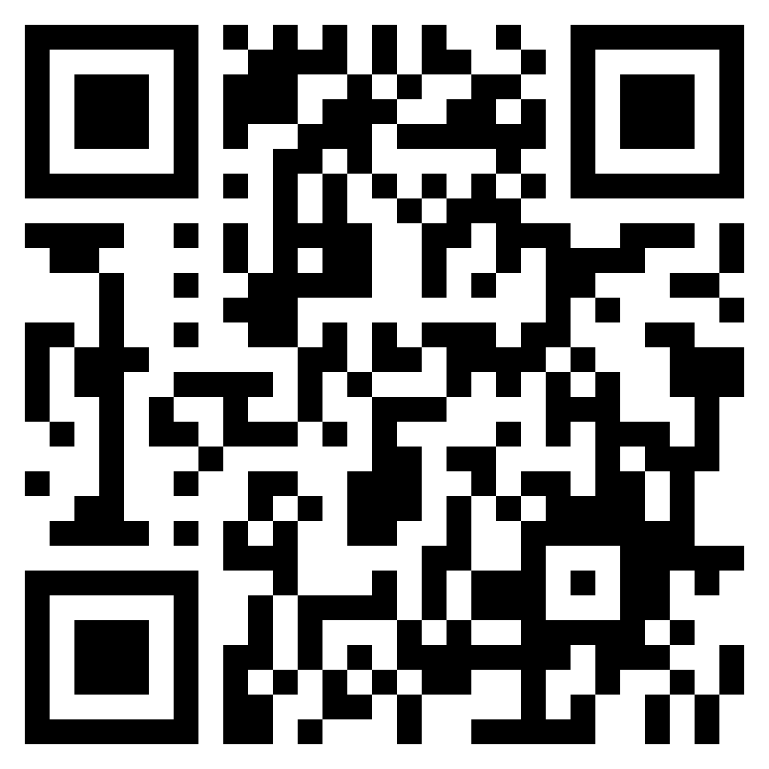
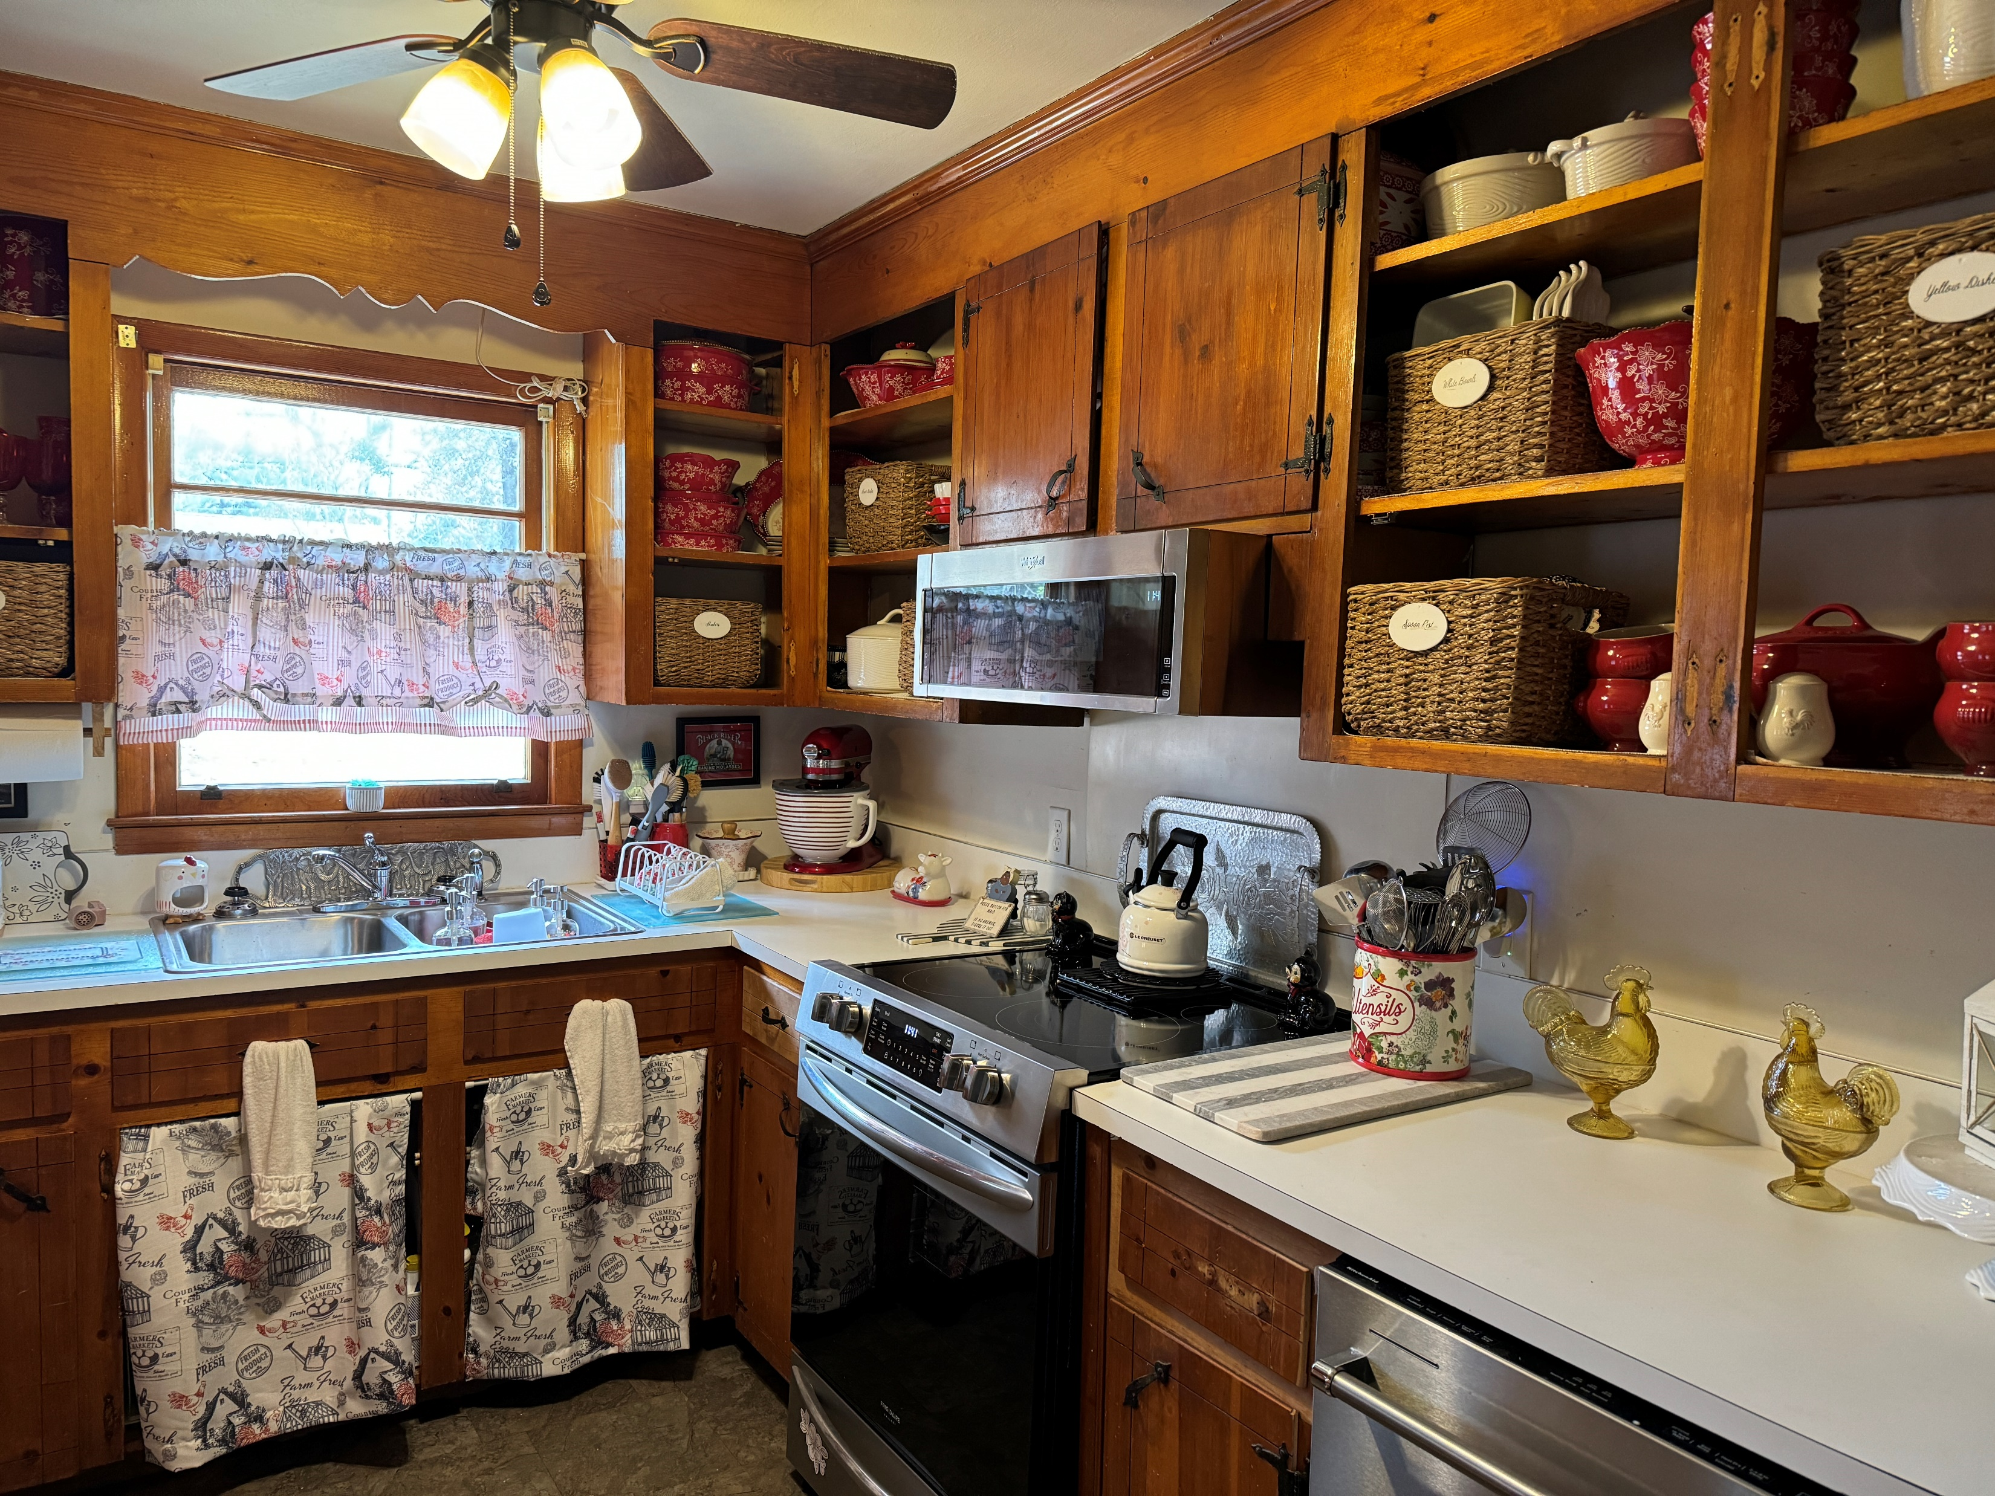
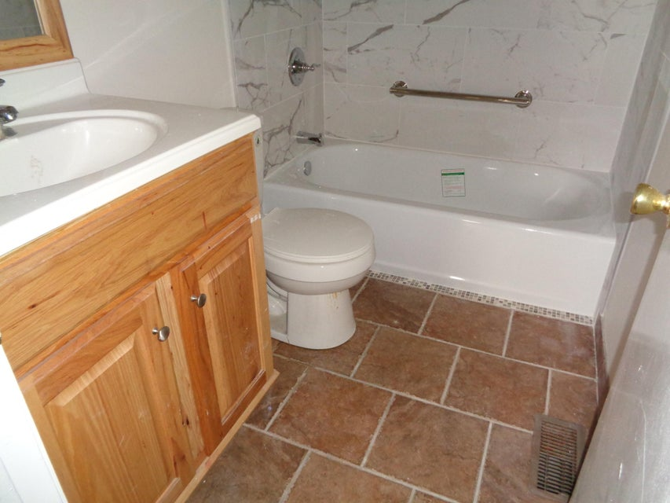


Just Listed
116 Ridge Road
Dorchester Estates
Summerville, SC 29485
MLS# 24005213 | $270,000
Video Tour
New Listing- Charming Brick Ranch with all the right updates!
This little gem in the DD2 School Zone had its roof replaced in 2015, an HVAC system installed in 2021, and a bathroom renovation as well! Oak flooring is found in the family room, hallway and all 3 bedrooms. Newer appliances in the kitchen will convey.
Set on a large fenced in lot, it is conveniently located near shopping, restaurants, parks, and medical facilities. This is a house with great bones and it is ready for a new owner to put their finishing touches on it to make it their charming new home!
Schedule your tour and make this affordable home in th DD2 school zone yours today!
Ellen O'Neil
Broker/Owner, ABR, e-PRO, CNE
Charleston Realtor of Distinction
(843) 300-8530
www.EllenONeilProperties.com

