Slide 1
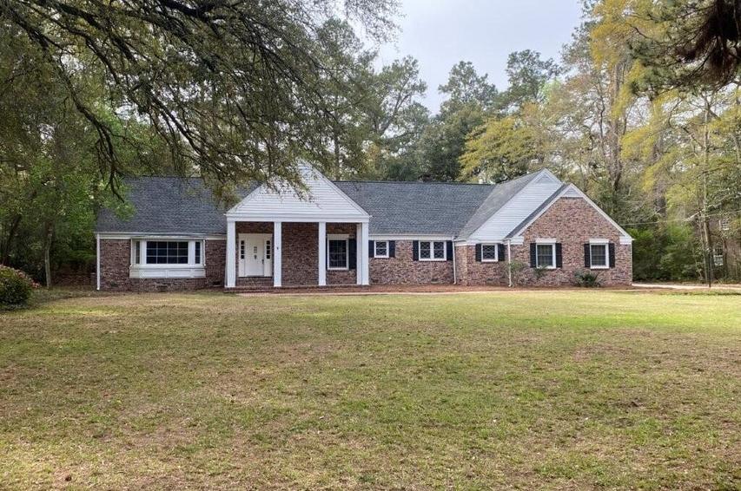
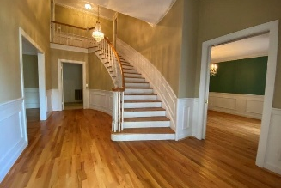
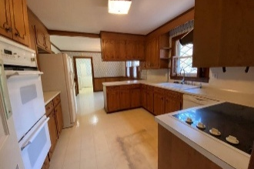
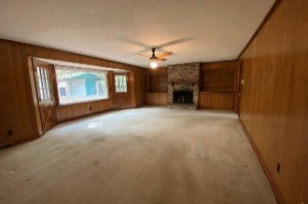
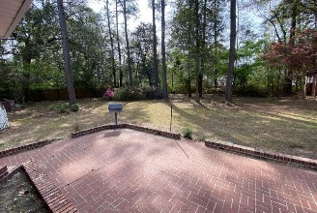
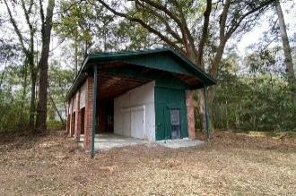


Renovation Opportunity - Almost 1 Acre
$15,000 Agent Bonus
with ratified contract by 4/15/18
116 W Johnston Street
Tea Farm
Summerville, SC 29483
MLS# 25007854
Now Offering at $645,000
$12,100 Under
Recent Appraised Value
Stately Brick veneer home. special material on soffits and columns . This is in place for low maintenance. Brand new roof shingles in 2024.Also replaced 12 sheets of plyboard under the new shingles. Double pane windows including front bay window. 600 square ft garage with back room with plumbing for hobbies or cleaning your pets. 2 new garage door openers Entry foyer is ever so GRAND with curved stairway to second floor. There is an exceptionally large living room and large separate formal dining room. Family room over looks the spacious back yard and features built-in bookshelves/cabinets and gas logs in brick fireplace. There is storage galore with multiple hall closets (one is a walk-in) as you head to the downstairs Primary bedroom/bath/vanity and closet area. Every room in the house has such large comfortable rooms Kitchen and big breakfast room and loads of cabinets. Head toward the attached garage and see the big laundry area and cabinetry to serve your office. Don't forget the 1/2 bath downstairs The second floors features 2 very large secondary bedrooms with Jack and Jill bathroom. and double sized closets. Attic access that is floored for more storage than you can imagine using and a step down attic area that can be accessed by the pull down stair in the garage. This almost 1 acre lot offers great privacy and outdoor living space Also don't forget to walk back to the large RV/Boat building and work shop. The owner and his wife had many wonderful years living in this fine home and beautiful Subdivision. The seller knows that the home needs updated but this is a jewel in the rough. What an opportunity to live here and over time, change to suit you and your family.
This home was custom built for the current owner and wife. They lived in this stately home for over 55 years. The Tea Farm is a special Summerville community.
At this great price if you need a 4th bedroom , there is a very large unfinished (now a second attic space) that could be accessed by a stairway from the big laundry room , then finish off that room and add a window to meet requirement for a window in a bedroom. Just a thought that might make the home better meet your needs for your new home.
Candace Pratt
843-696-5508
candace@prattandco.com
www.prattandco.com
RE/MAX Southern Shores
9209 University Blvd, Charleston, SC 29406

