Slide 1
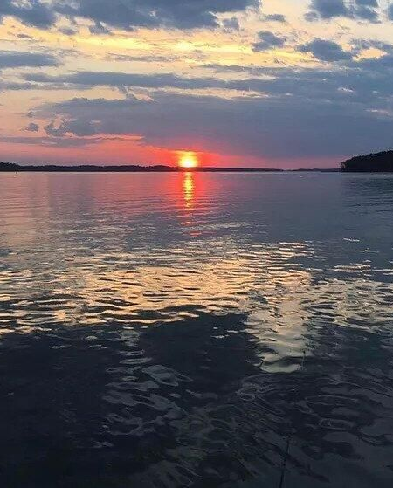
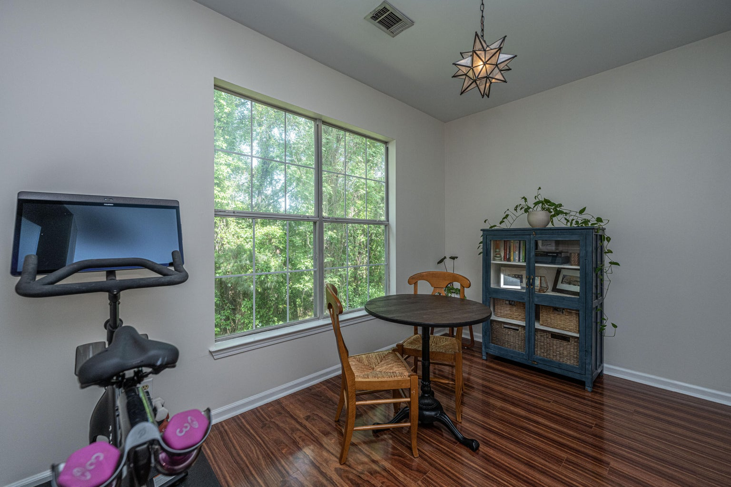
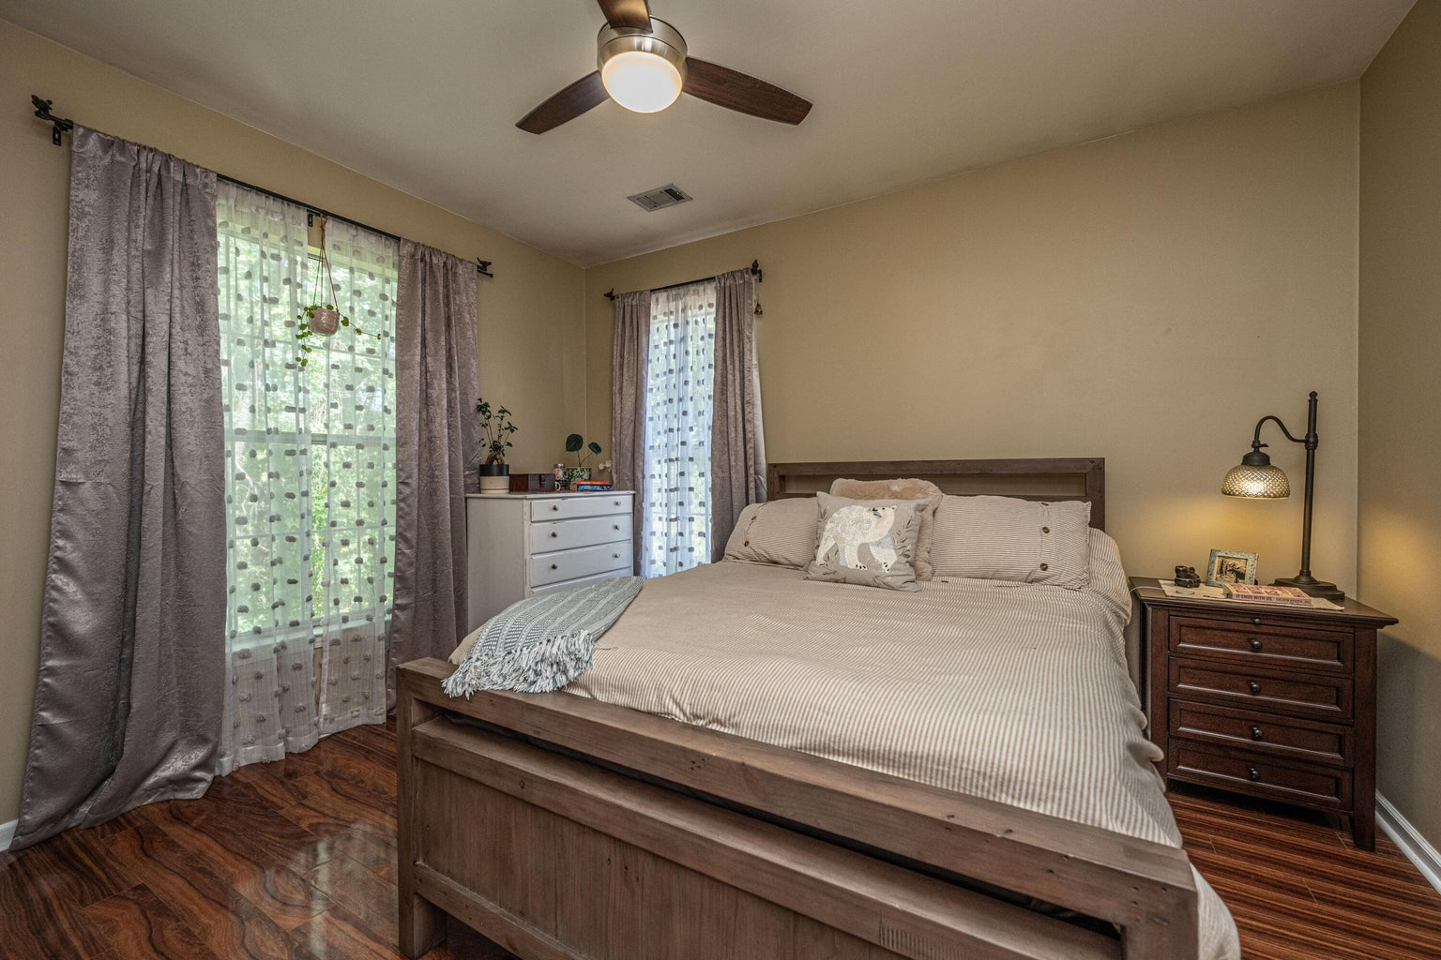



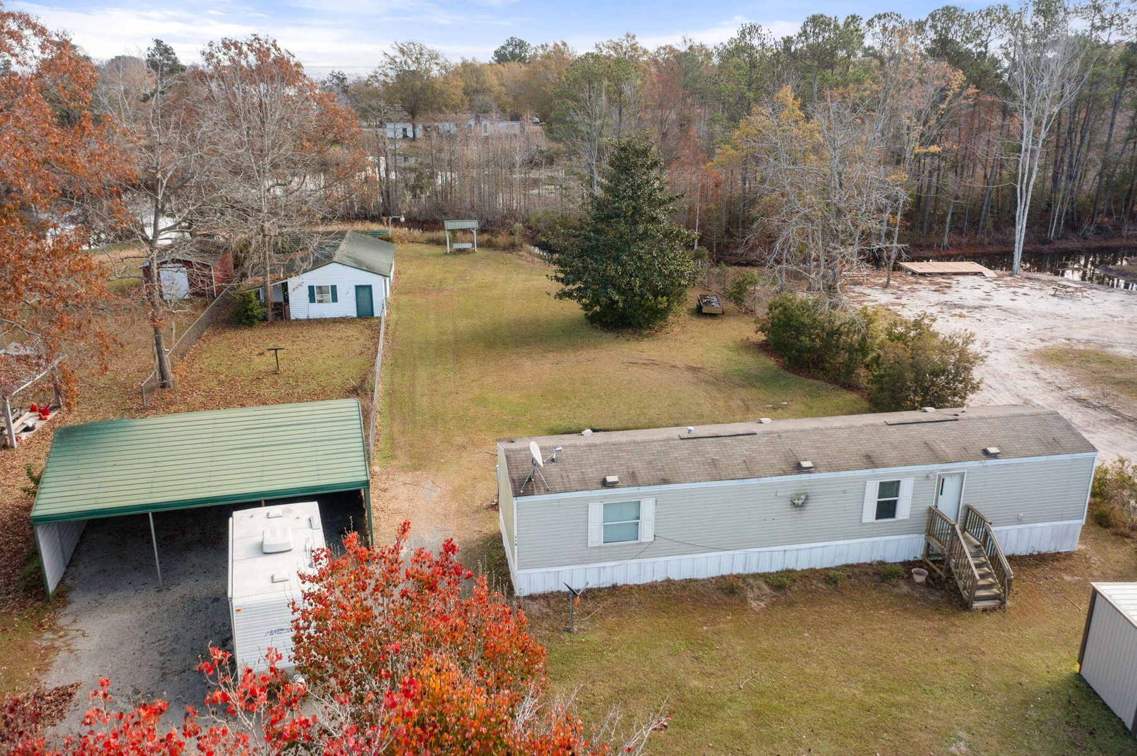
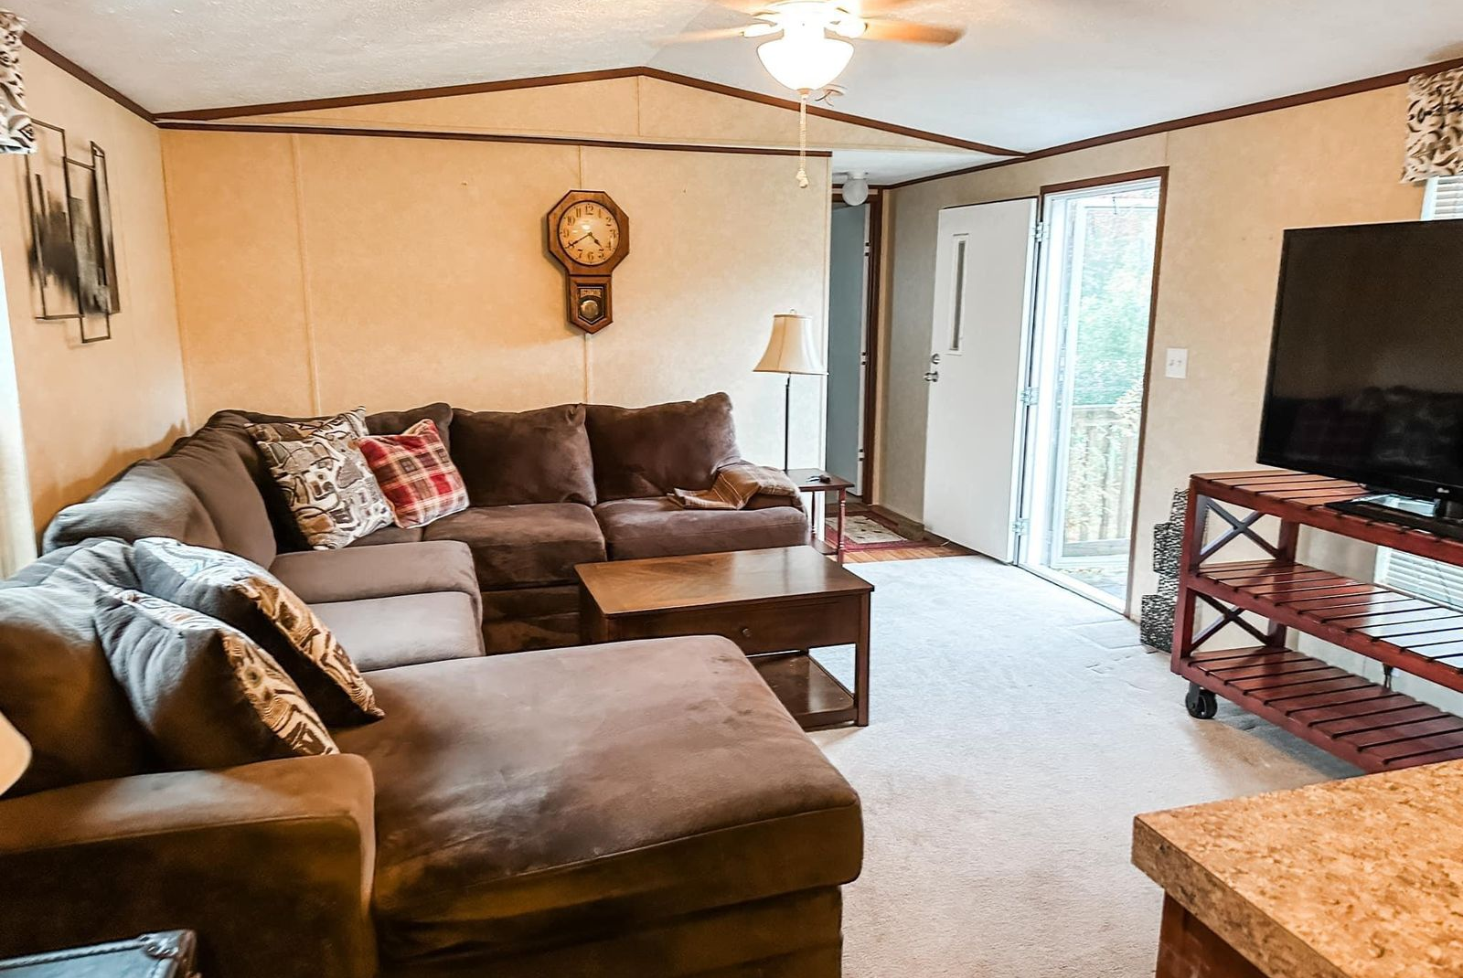
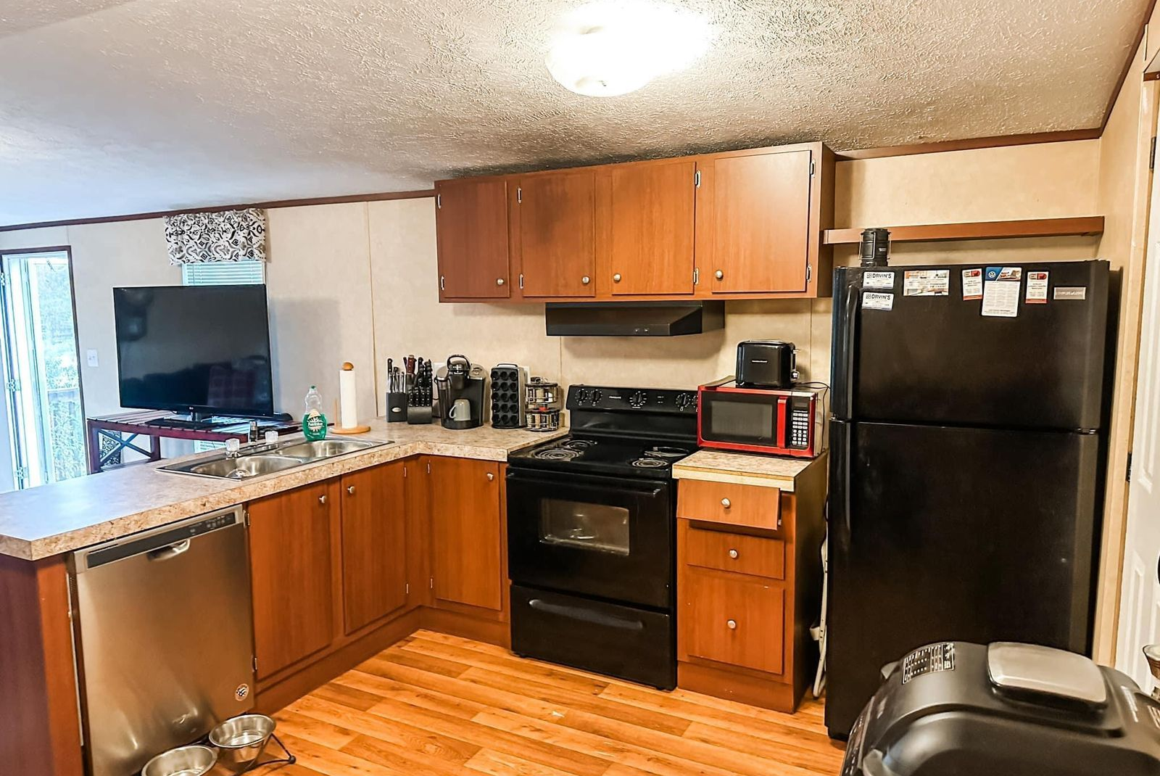
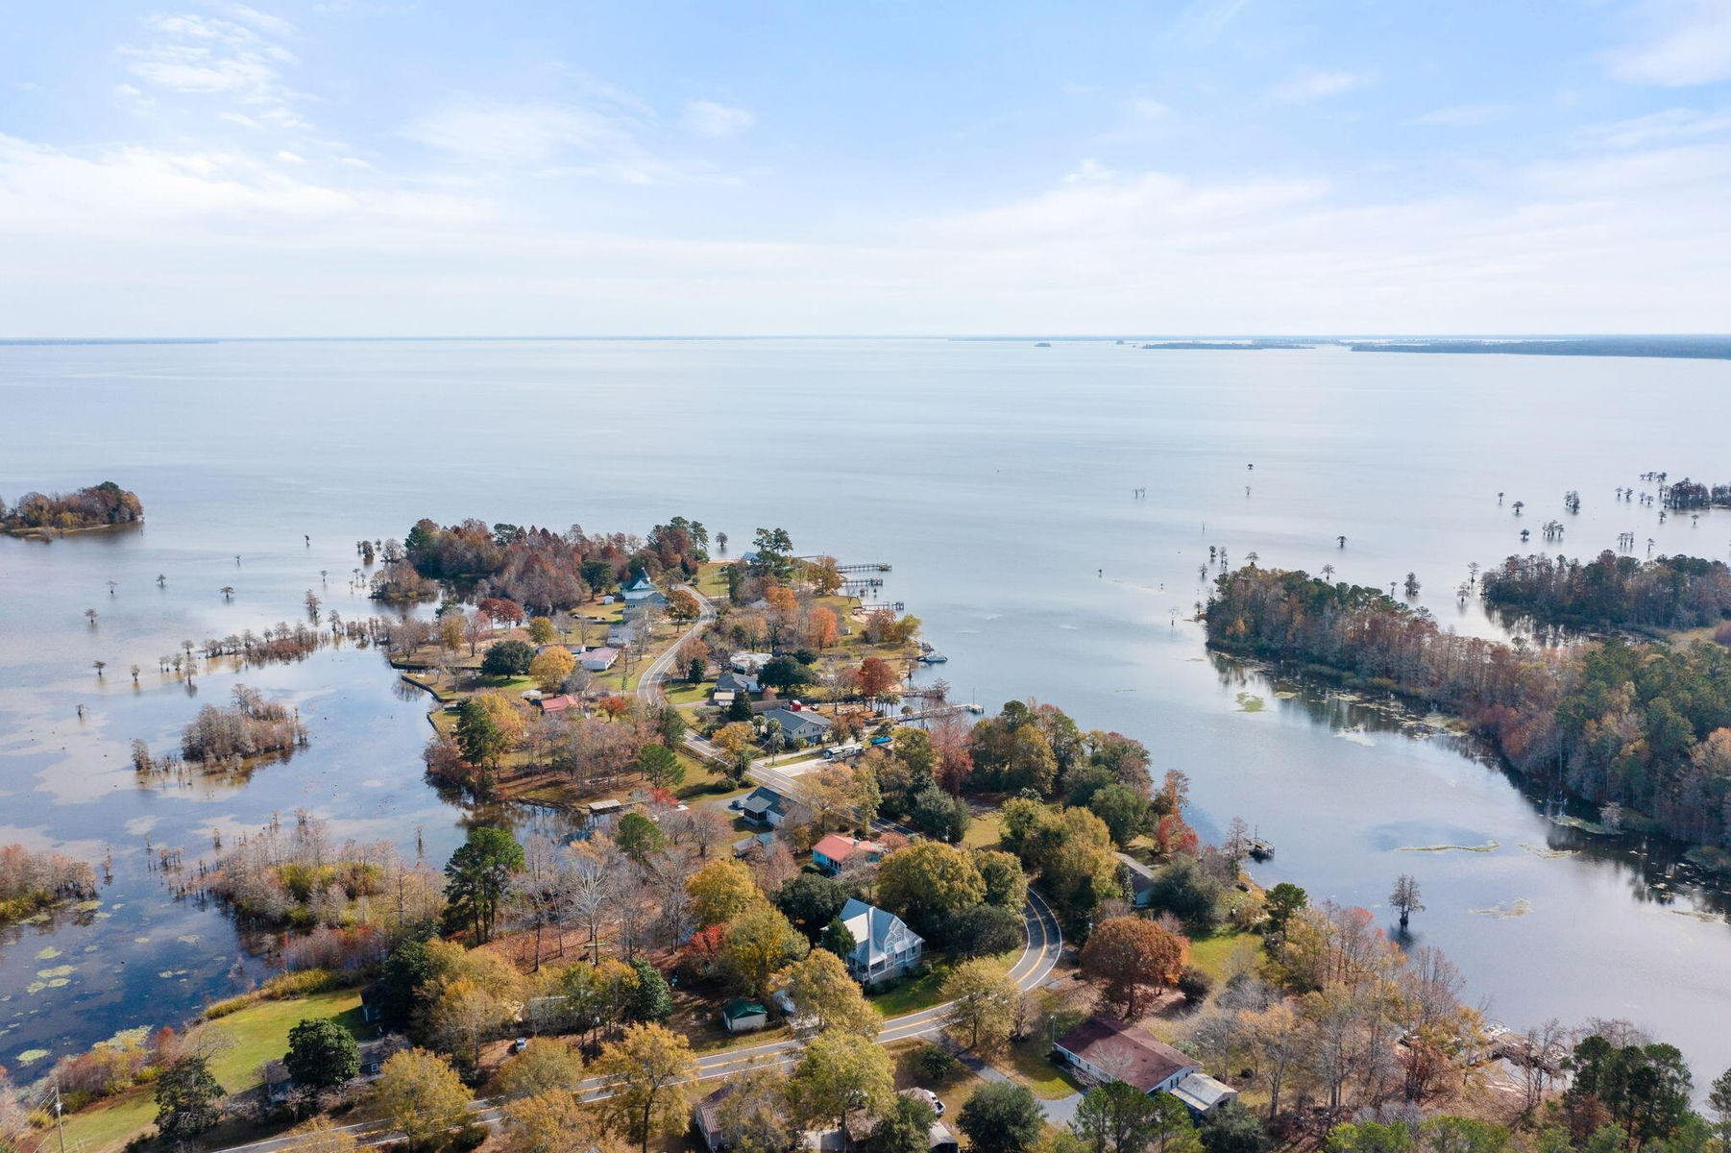


LAKE MOULTRIE RETREAT
Custom 5br, 4.5ba 4700 Sqft Of Flex Space
10’ Smooth Ceiling
Heart Pine Flooring
Master Bedroom Suite On First Level
Second Master On Upper Level
Two Dens With Gas Fireplaces
Formal Dining Room
Gourmet Kitchen With Second Den/Warming Room And Breakfast Room
Walk-in Pantry
Large Bonus/Game Room Above Oversized Two Car Garage
Screen Porch & Outdoor Firepit
Large Pond Lot With Mature Trees And Irrigation System
3 Separate AC Units
Gas Hot Water Heater
New 35-year Roof
Private Gated Community With Community Pool, Clubhouse, Boat Launch And Dock
116 Wares Run
Longpoint | Cross, SC 29436 | MLS# 24000020 | $294,000
4
3
1,844
Almost 1 acre on Lake Moultrie with a private boat ramp.
Huge workshop and 2 car carport. Plenty of parking for your boat or RV.
All for under $300k. Deeded, no Santee Cooper lease.
Telecia Bilton
843-412-3586
tmbilton@rogcoastal.com
Kerry Roberts
843-304-5689 kerrysellscharleston@gmail.com
Realty ONE Group Coastal | 1510 Trolley Rd | Summerville, SC 29485

