Slide 1
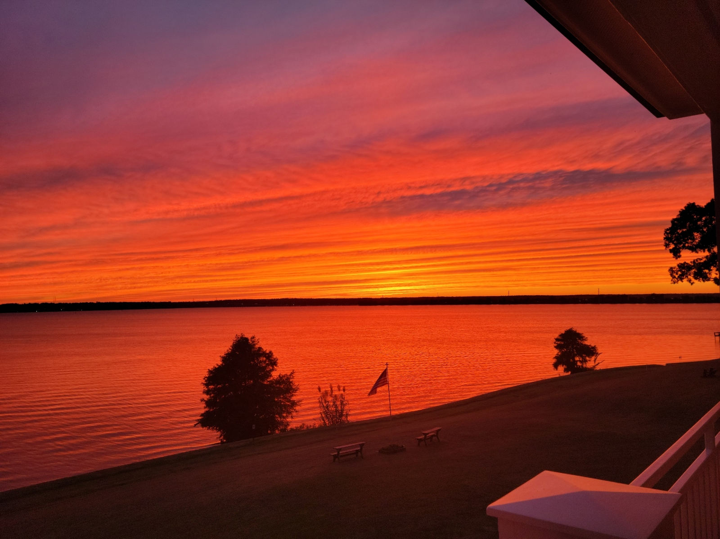
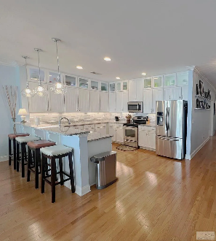
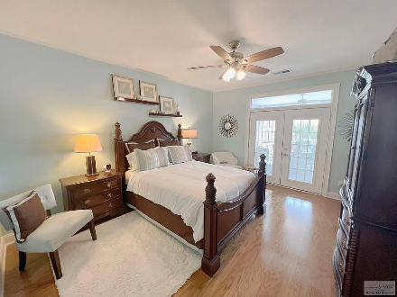
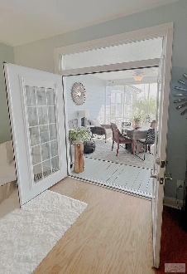
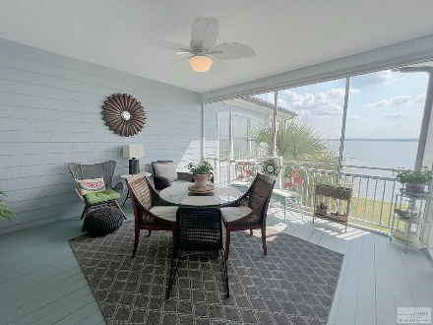
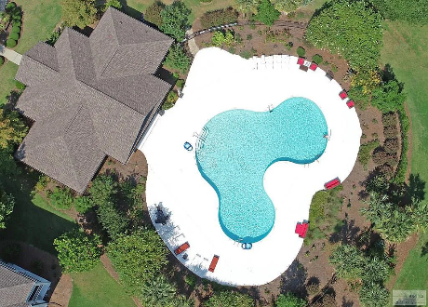

New Price Best View On The Lake
1170 Bridgeview Ln #D301
North Shore at Lake Marion | Summerton, SC 29148 | MLS# 157994 | $550,000
4 Beds | 4 Baths | 2,365 sqft
Experience luxury living at its finest with this stunning 4 bedroom, 4 bath condo on the pristine Lake Marion. As the 'Penthouse' of the lake, this condo boasts unparalleled upgrades, including premium kitchen cabinets, all hardwood flooring, up dated baths, and a wrap-around porch offering a breathtaking 180-degree view of the lake.
Lake Homes Realty, LLC
Elloree, SC 29047
www.SCLakeLife.com
Kristie Anderson
(803) 387-9459
kristie@sclakelife.com

