Slide 1
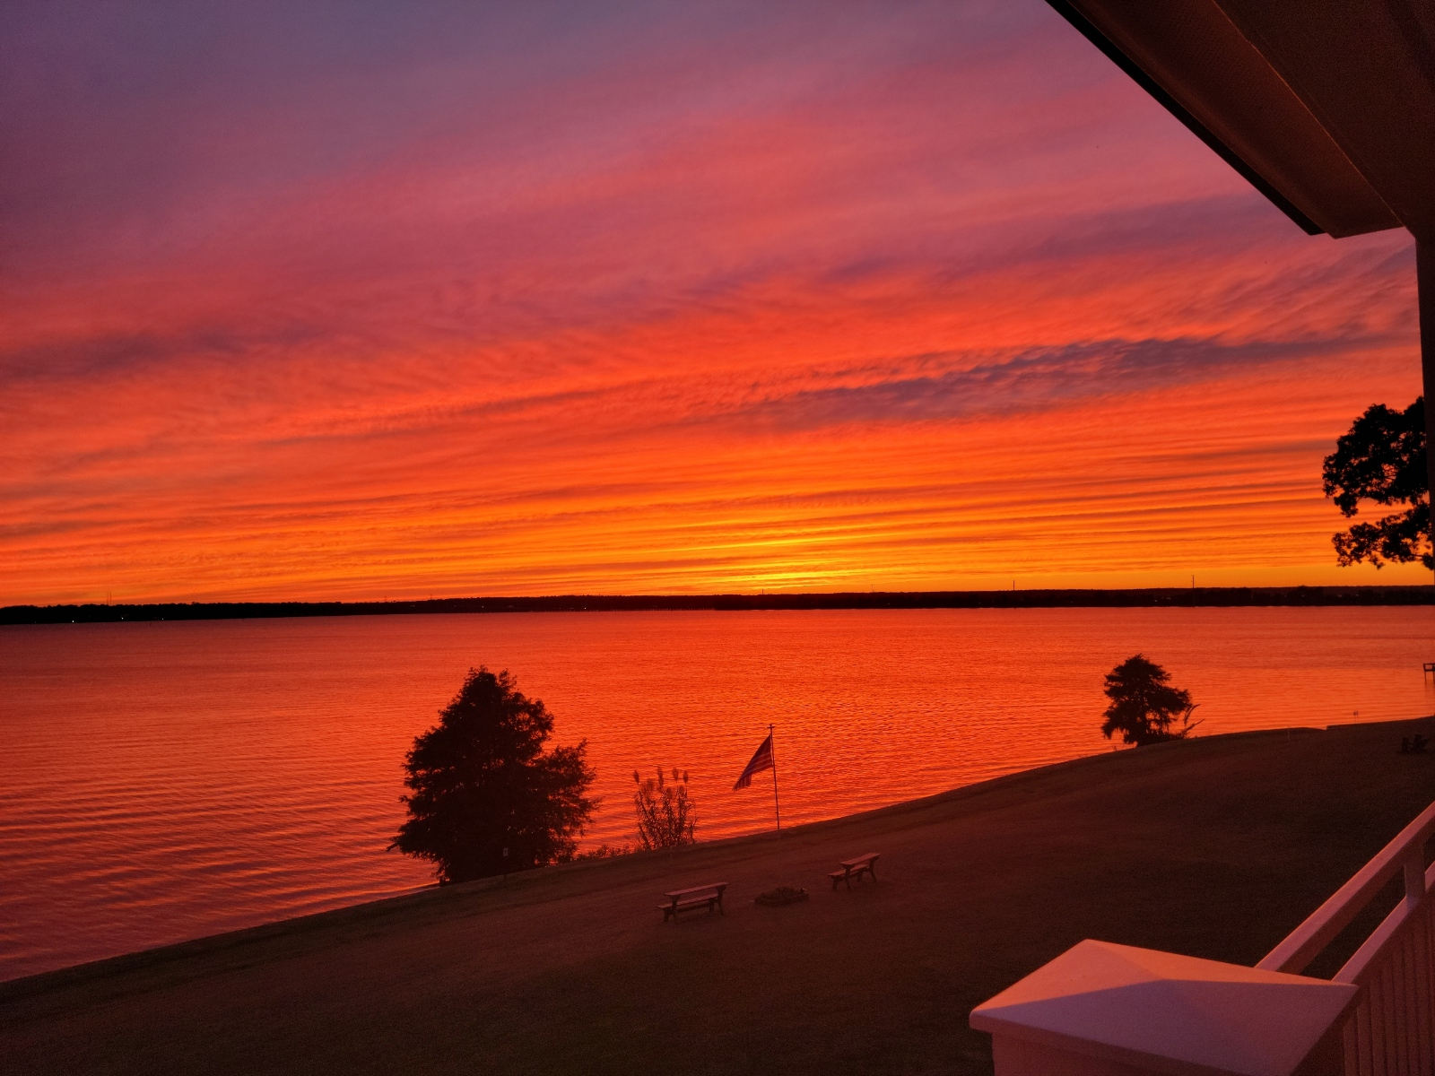
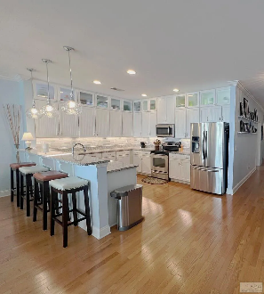
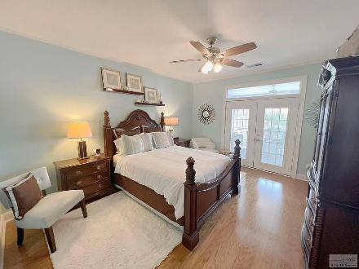
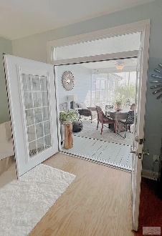
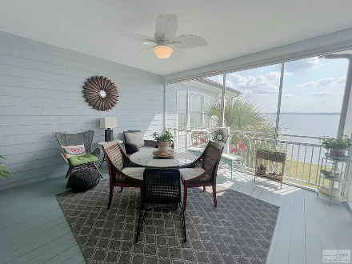
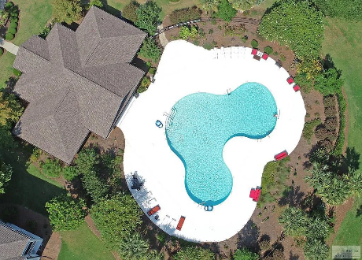

Best View On The Lake
1170 Bridgeview Ln #D301
North Shore at Lake Marion | Summerton, SC 29148 | MLS# 157994 | $650,000
4 Beds | 4 Baths | 2,365 sqft
Welcome to your dream lakeside oasis! This exceptional 4-bedroom condo offers a lifestyle of luxury and tranquility on the shores of Lake Marion. With breathtaking panoramic views, premium amenities, and spacious living areas, this waterfront gem is a true masterpiece. Witness mesmerizing sunsets from your private wrap around balcony. Retreat to the master suite with its own private access to the balcony, a walk-in closet, and an en-suite bathroom featuring a walk in shower. Step outside your door onto the shores of Lake Marion. Enjoy water sports, fishing, or simply relax by the water's edge. Create lasting memories with friends in this tranquil lakeside haven. This meticulously maintained 4-bedroom condo is an oasis of comfort and style, boasting too many updates to list (see docs list)
Lake Homes Realty, LLC
Elloree, SC 29047
www.SCLakeLife.com
Kristie Anderson
(803) 387-9459
kristie@sclakelife.com

