Slide 1
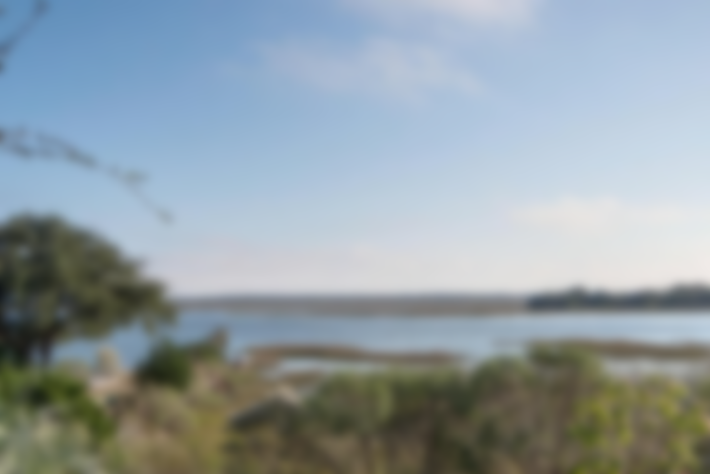
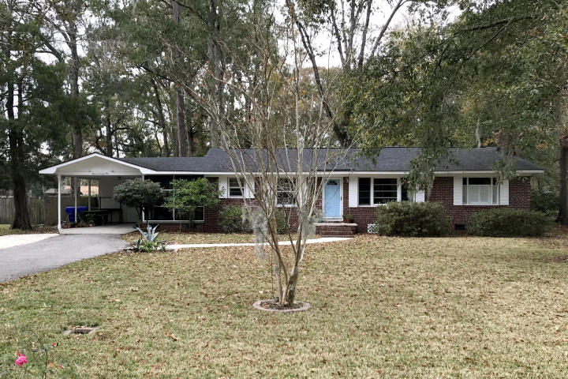
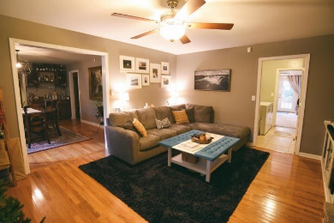
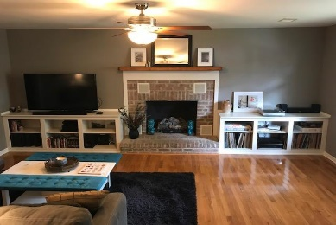
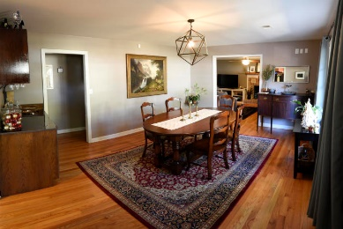
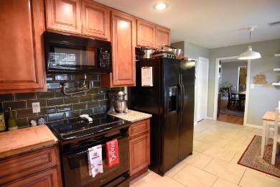
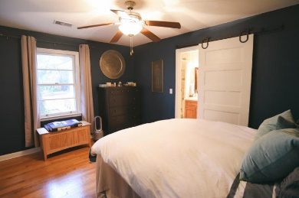
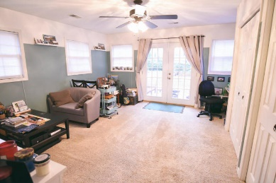
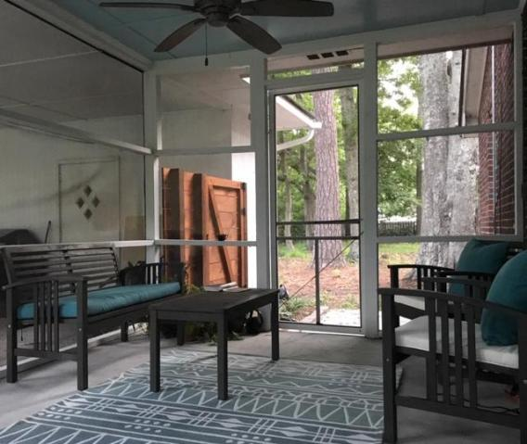
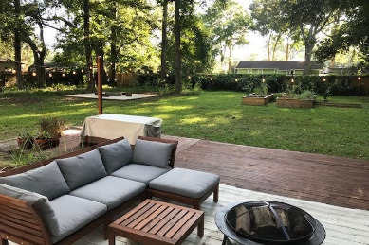


Motivated Sellers! Large Home On Large Lot!
1171 Bradford Avenue
Mccalls Corner
Charleston, SC 29412
MLS# 18032013 ~ $354,900
Brick Home on a very Large lot just minutes from downtown Charleston and Folly Beach! No HOA. This four bedroom home is very spacious with a separate dining room, eat in kitchen also, a huge laundry room, screened porch and deck out back. The fourth bedroom or flex space is very large, with lots of storage and opens to the outdoors. New appliances in kitchen, Top of the line Electrolux electric stove, with pot fill. This home is MOVE IN READY and the Sellers are ready to move so don't miss it! Easy to see!
Jan Miller
Cell (843) 345-9719 | Jan.Miller@nvrealtygroup.com
NV Realty Group | 91 Broad St, Ste A | Charleston, SC 29401
janmiller.nvrealtygroup.com

