Slide 1
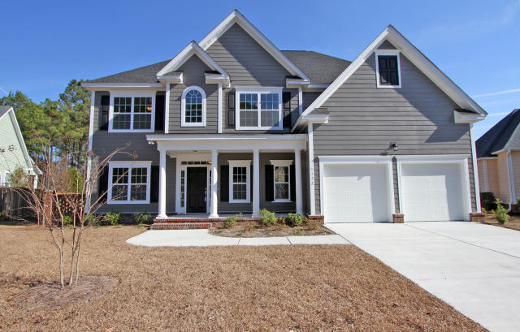
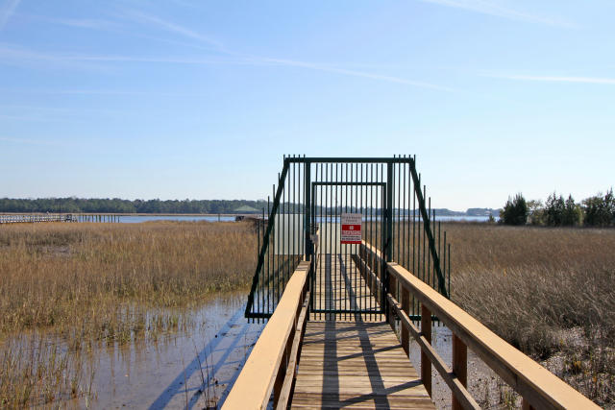
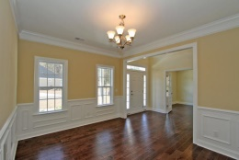
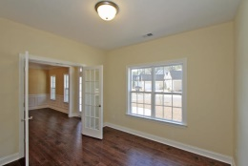
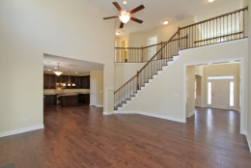
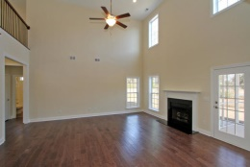
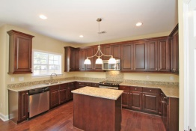
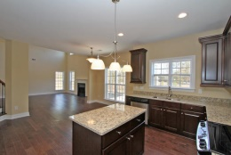
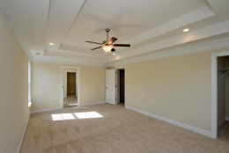
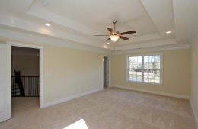
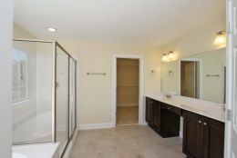
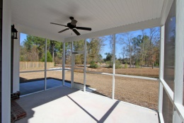
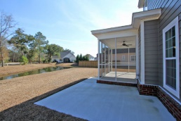
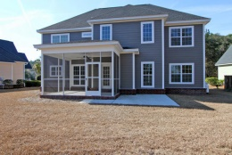


Waterfront Community with
Dock to Wando
1172 Rivers Reach Dr
Wando, SC 29492
River Reach Pointe
MLS# 15002304 - $434,900
NEW SEMI-CUSTOM CONSTRUCTION in WATERFRONT community
with neighborhood dock on Wando River!
Upon arrival, stately architecture generates an amazing 1st impression of this home! Noticeably bright, open, cheery interior*Striking 2 story foyer w/picturesque catwalk above, fireplace, office with glass French doors, & beautiful trim work throughout
The heart of the home, the kitchen features GATHERING ISLAND, GRANITE & STAINLESS*Screened porch w/LAGOON views & patio for BBQs*Great Master Suite with "His & Her" closets*Storage*
Wonderful floor plan! Stroll, golf cart ride or power walk to the Waterfront dock & gazebo for crabbing, fishing, shrimping or daydreaming...and the livin' is easy...
Ask your agent to add this home to your "must see" list today
Sheila Romanosky
(843) 224-0242
sromanosky@carolinaone.com

