Slide 1
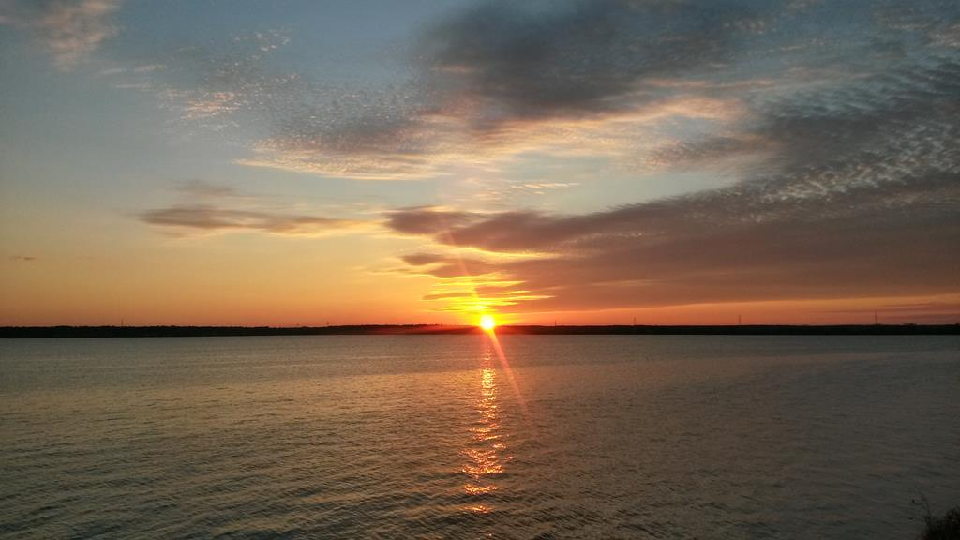
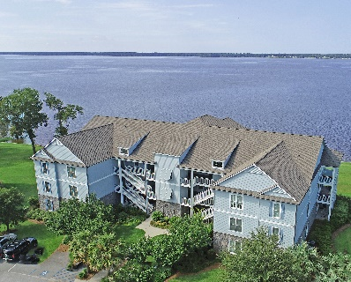
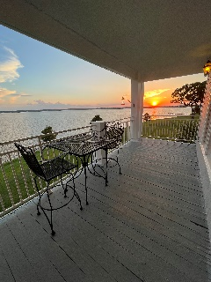
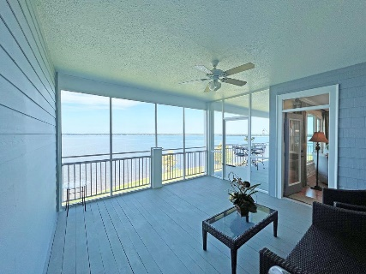
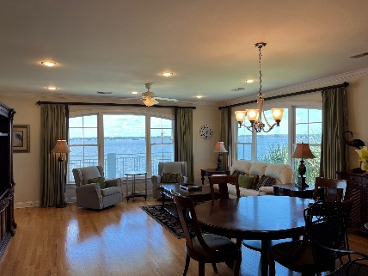

Open House ~ Aug 10th ~ 10-2
1172 Bridgeview Ln # D302
Summerton, SC 29148 ~ MLS# 152323 ~ $449,000
Breath taking 180 degree views of Big Water in this large 1957 sqft 3 bedroom / 3 bath Condo on the top floor over looking Lake Marion. Lake Side Porch over looking the lake has a screened in eating section. Sitting just off I-95 in Summerton only 1 hr to Charleston and Columbia. Condo will convey Fully Furnished, Kayaks and Boat Slip at closing - all you need to bring is the suitcase. The grounds host club house with a gym and Library, large lake side pool, sea wall, 15+/- ac of green space to enjoy, fire pit, day dock, sandy beach, shade trees and spectacular atmosphere! Take the Boat from your boat slip and sail to Charleston for the weekend. Elevators are in each building. Extra storage shed can be purchased for the lake toys and golf cart. Don't miss this rare find! See it today!
Lake Homes Realty, LLC
Elloree, SC 29047
www.SCLakeLife.com
Kristie Anderson
(803) 387-9459
kristie@sclakelife.com

