Slide 1
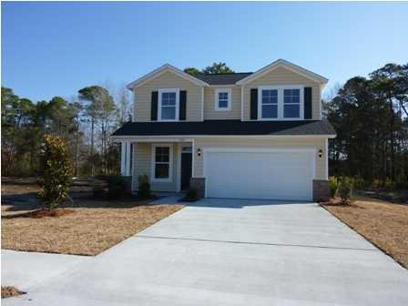

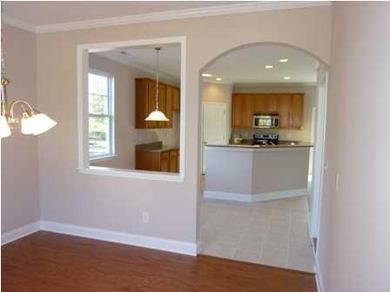
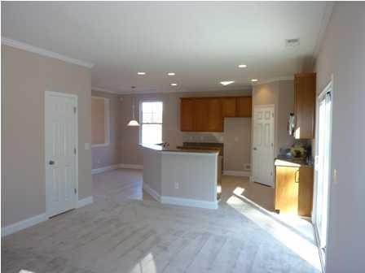
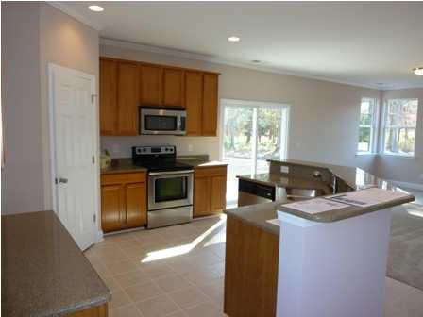
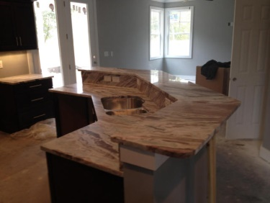
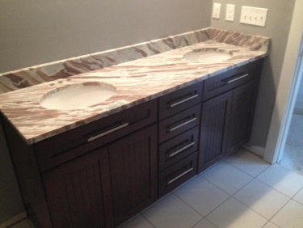
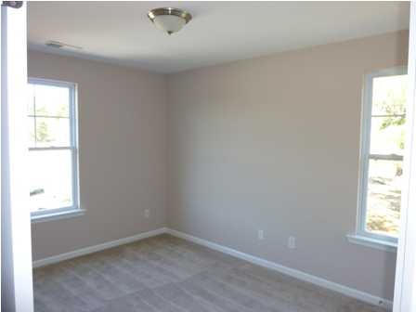
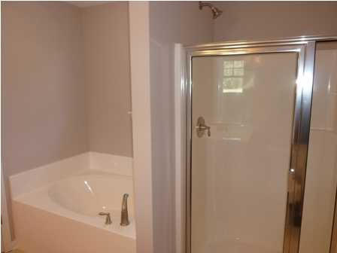
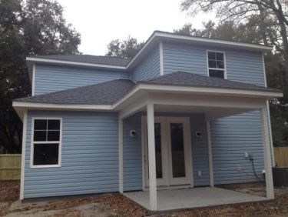
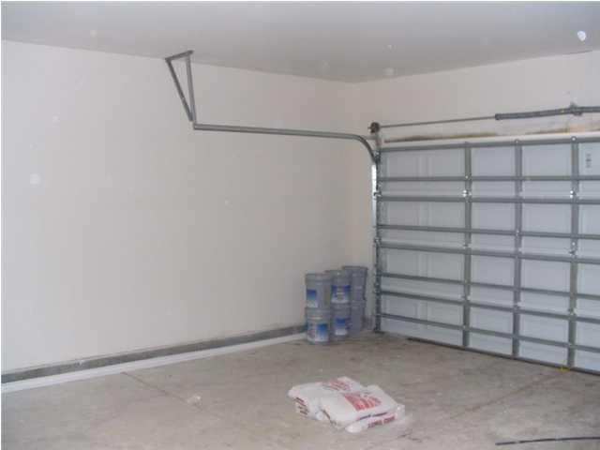
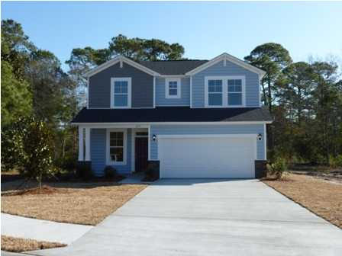



Least Expensive New Construction On James Island!
1173 Oakcrest Drive
Oakcrest
Charleston, SC 29412
MLS# 15004044
$255,000
1,602 SF
3 Bedrooms :: 2½ Baths
Proposed Construction
HIGHLIGHTED FEATURES:
CUSTOM cabinets with NO SLAM drawers (kitchen)
Can lighting
Hardi Plank exterior
TANKLESS water heater
Outside gas hookups for your gas grill (say goodbye to switching out tanks)
HUGE hidden STORAGE area
Powder room
Large back yard
Walk to the Neighborhood park in less than 3 minutes
Zoned for Stiles Point Elem.
Easy access to the new Harris Teeter grocery store. Drive to downtown with NO STOPLIGHTS!!!!
Great Value for NEW Construction in Stiles Point. Be sure to check the comps!
This is the least expensive new construction home on James Island!!! 3 bed 2.5 bath by premier builder, Port City Homes. The Craftsman Plan. Classic exterior features include: craftsman style, low maintenance vinyl siding, architectural shingles and Lo e Vinyl windows with insulated glass. The kitchens are open and feature standard GRANITE countertops, Whirlpool SATINLESS STEEL appliances (microwave, range and dishwasher), Birch kitchen cabinets (42''), recessed can lighting, and tile floors. The upgraded interior finishes include: 9' smooth ceilings with arched doorways on the first floor, six-panel smooth interior doors throughout, hardwood flooring in the foyer and dinning room, tile flooring in baths and laundry room. Crown molding runs throughout the living, dining and Kitchen.
Lizzie H Ray
(843) 452-9298
lizzieray1122@gmail.com
Eric Draper
(843) 442-7118
eric.draper@gmail.com
www.charlestonrealestategroup.com
Charleston Real Estate Partners. LLC | 792 Folly Rd. C1 | Charleston, SC 29412

