Slide 1
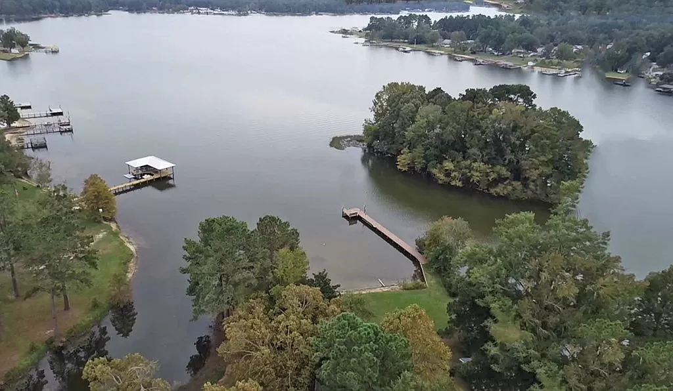
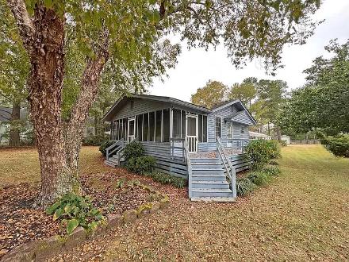
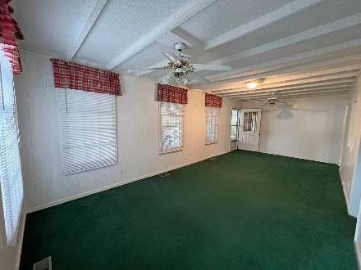
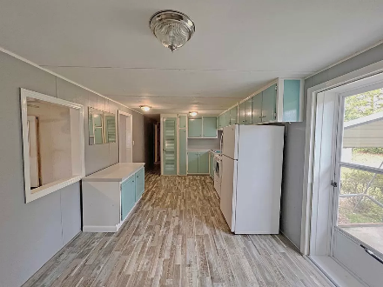
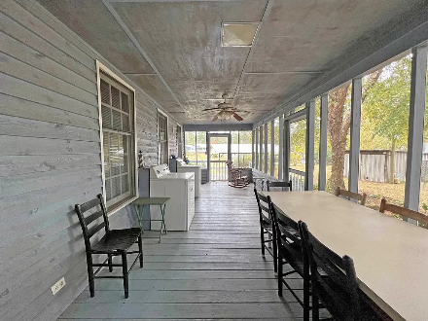
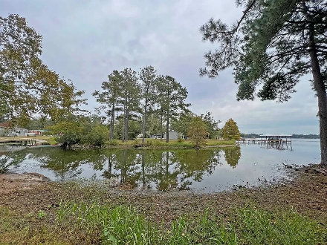

Lake Retreat
1173 Levi St
Manning, SC 29102 | MLS# 161441 | $349,000
Escape to the serene shores of Lake Marion with this charming mobile home, offering a perfect blend of cozy living and breathtaking waterfront views. Wake up to breathtaking waterfront views and unwind on the spacious screened porch. Nestled in a peaceful lakeside community, this property is an ideal retreat for nature lovers, anglers, and anyone seeking a tranquil escape from the hustle and bustle of city life. Cash only older mobile home will not qualify for traditional financing. Updates to the home have been with in the last few years.
Lake Homes Realty, LLC
Elloree, SC 29047
www.SCLakeLife.com
Kristie Anderson
(803) 387-9459
kristie@sclakelife.com

